Slide 1
Chemical Surge Tabletop Exercise
Hosted by: <Organization Name(s)>
Facilitated by: <Facilitator name(s)>
Notes:
Edit or replace as needed to identify host organization

Slide 2
Notes:
Please do not remove

Slide 3
Notes:
Please do not remove

Slide 4
Agenda
Introductions
Overview
Modules
Wrap Up
Hotwash
Notes:
Edit as needed

Slide 5
Introductions

Slide 6

Video

Slide 7
Participating Organizations
Enter text
Enter text
Notes:
Add names of participating organizations, facilities, and organizations

Slide 8
Exercise Overview

Slide 9
Overview
Exercise is scheduled for 2.5 - 3 hours
The primary host will guide the process and environment.
There are three modules, each covering different sections of the Plan.
If breakout groups are used, each breakout group will conduct discussions regarding their section of the Plan. After each breakout session, groups will be asked to share highlights.
The host and participating organizations determine the scope of an After-Action Report (AAR) which may include a single AAR for the exercise, and/or individual AARs completed by the participating organizations.
Notes:
Edit as needed

Slide 10
Schedule
Welcome and Overview – 15 minutes
Breakout 1 - Activation, Roles & Responsibilities
  30 minutes discussion / 10 minutes sharing in large group
Breakout 2 - Operations
  30 minutes discussion / 10 minutes sharing in large group
Breakout 3 – Special Considerations
  30 minutes discussion / 10 minutes sharing in large group
Wrap-up – 15 minutes
Hotwash in Breakout Rooms
Notes:
Edit as needed

Slide 11
Objectives
Articulate the content, elements, and integration of the Chemical Emergency Surge Plan, including Pediatric considerations, with other facility and local plans.
Identify areas for improvement, further development, and linkage between the Chemical Emergency Surge Plans and Pediatric Surge Plans.
<Add additional Objectives as needed>
Notes:
Edit as needed

Slide 12
Guidelines
This is an open, no-fault environment
Base your responses on existing plans, policies, procedures, capabilities, and resources
Please assume the exercise scenario is plausible
Decisions are not precedent setting; consider different approaches and suggest improvements
There is no “hidden agenda” nor are there any trick questions
Issue identification is not as valuable as suggestions and recommended actions
Notes:
Edit as needed

Slide 13
Breakout Groups
<Add instructions if using virtual or physical breakout groups>
Notes:
Edit as needed

Slide 14
Scenario

Slide 15
Scenario Overview
This scenario is based on a fictional accidental incident. The intent is to use a pediatric MCI scenario with layers of complexity sufficient to highlight capabilities and gaps and to inform the content of plans under development or being revised.
When discussing your plan, assume the incident only affects your local area, adjacent areas remain unaffected.

Slide 16
Module 1
Activation, Roles & Responsibilities

Slide 17
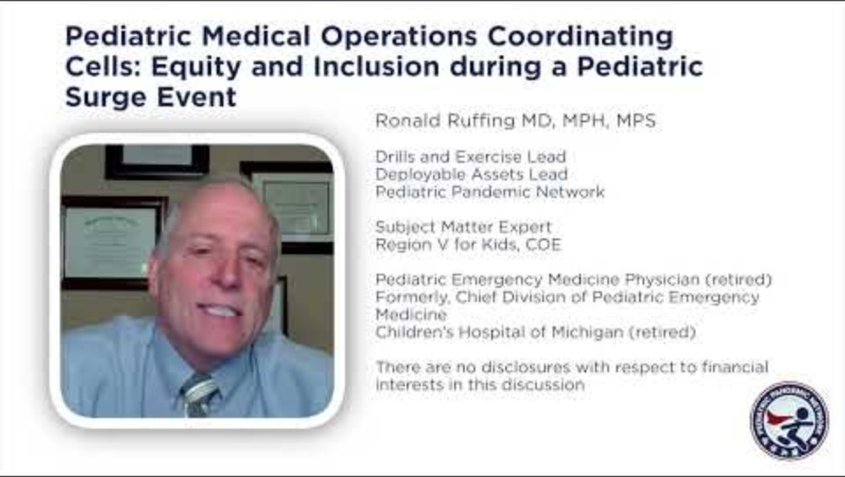
Video
Notes:
Optional video

Slide 18
Module Topics: Activation, Roles & Responsibilities
Activation & Notification
Information Sharing
Roles & Responsibilities
Logistics & Resource Management

Slide 19
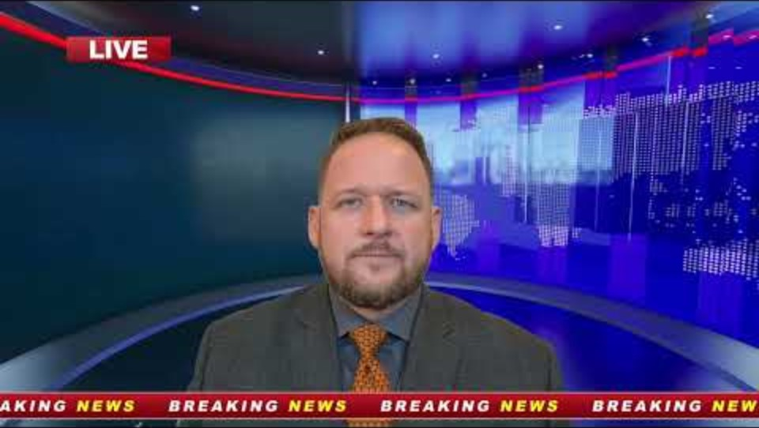
Scenario 1
Notes:
In August, a freight train passing through your local area derails. The train consists of 25 rail cars, containing a mix of freight including lumber and other building materials, food, hospital supplies, and liquid and solid hazardous materials, including coal, liquid fuel chlorine and methyl-ethyl-death. The train derailment occurs near a crossing where a school bus carrying 35 children is stopped.

Slide 20
Go to your Breakout Group
Join your Breakout Group
You will have 30 minutes for discussion
Please be prepared to share highlights after breakout session
Notes:
Edit as needed

Slide 21
Activation/Notification
How would your facility/organization be notified of this event?
What would be your activation process for this event? Who would be responsible for activating other organizations?
Are there any special activation considerations outside of your standard process(es)?
Notes:
Edit as needed

Slide 22
Information Sharing
What are key elements of information your facility/organization would need to gather for this event? Does your plan address these elements? What would you need from other agencies or facilities?
Who are you sharing information with? How are you getting information updates? How do you verify information is correct?
Notes:
Edit as needed

Slide 23
Information Sharing (cont.)
Who is responsible for sharing information (PIO, hospital leader, etc.)? How are you cascading information throughout your facility/organization?
What contacts do you have in your plan for plume modeling?
Notes:
Edit as needed

Slide 24
Roles & Responsibilities
What would be the role of your Facility/organization in this event? What would be the role of your key partners? Are there any noticeable gaps in partnerships for this event?
Are members of your facility/organization assigned roles during an activation? Do you have redundancy of these roles?
Notes:
Edit as needed

Slide 25
Logistics/Resource Management
Do you foresee any potential resource shortages based on this scenario and your local capacity? Who would you need to coordinate with regarding logistics and resource management? Is there an established process?
Does your HCC or facility have an established resource requesting/sharing procedure? If so, who are the key partners and processes related to resource requesting/sharing?
Notes:
Edit as needed

Slide 26
Large Group Sharing
Each breakout group share discussion highlights:
Activation/Notification
Information Sharing
Roles & Responsibilities
Logistics/Resource Management
Notes:
Edit as needed

Slide 27
Module 2
Operations

Slide 28
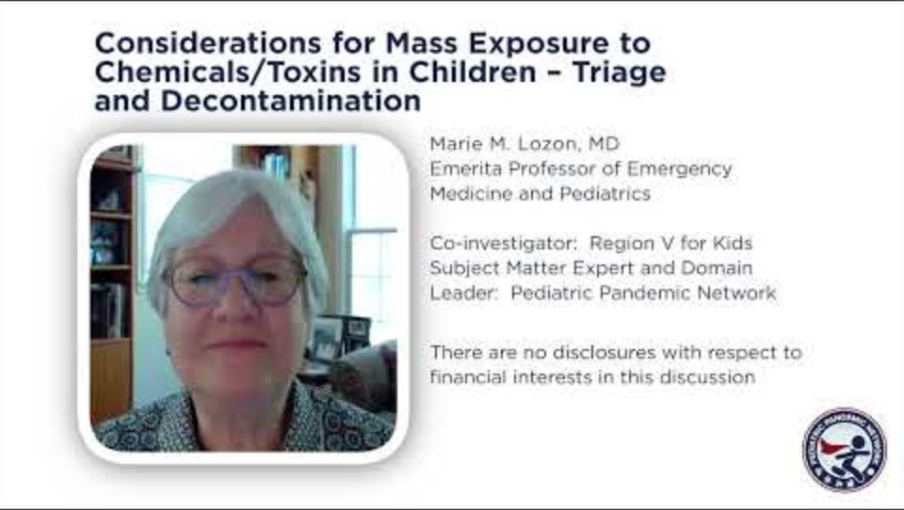
Video
Notes:
Optional Video

Slide 29
Module Topics: Operations
Decontamination
Triage
Patient Care & Management
Treatment
Safety & Control Measures

Slide 30
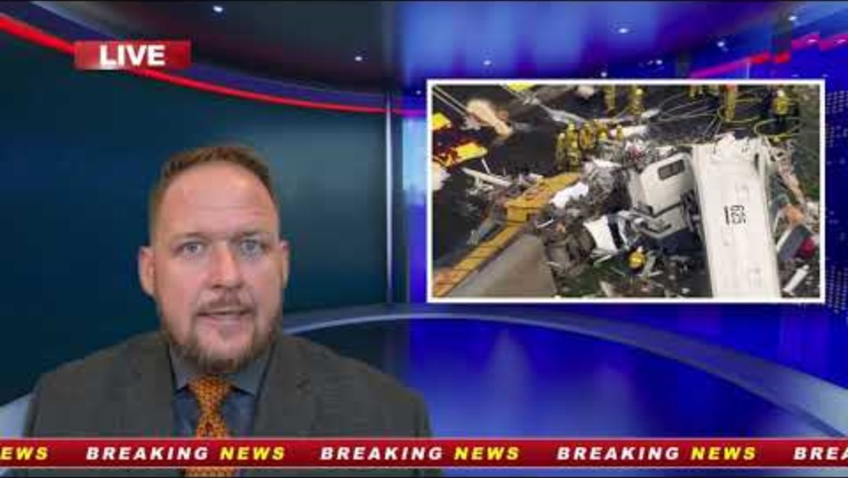
Scenario 2
Notes:
Firefighters, EMS and police arrive at the scene within minutes, and they begin to assess the damage. There is a cloud of vapor escaping from the tanker truck and forming near the ground. The wind is blowing the cloud in the direction of nearby residences.
The bus driver and some of the children are complaining about burning eyes and trouble breathing. On-site triage has been initiated by EMS and transport to local hospitals has begun. All 35 children and the bus driver are being transported to nearby hospitals.

Slide 31
Go to your Breakout Group
Join your Breakout Group
You will have 30 minutes for discussion
Please be prepared to share highlights after breakout session
Notes:
Edit as needed

Slide 32
Decontamination
Does your plan address decontamination considerations?
What would be the role of your facility/organization?
Does your plan address contaminated patients that show up to your facility, but outside of the ED (main lobby, etc.)? How will they get to the ED? Who escorts them? What considerations are made to keep the patient, staff, and scene safe?
Notes:
Edit as needed

Slide 33
Decontamination (cont.)
Does your Decontamination Plan specifically address:
  Pediatrics?
  Special needs?
  Chemical burns?
What requests might you make of your regional authority or HCC?
Notes:
Edit as needed

Slide 34
Decontamination (cont.)
Is there anything different that would be done for pediatric burn patients?
Are you familiar with Burn centers in your state and how they can be reached?
Notes:
Edit as needed

Slide 35
Triage
What tool are you utilizing for patient triage? Does it align with the regional or community triage process?
Do you have a different tool for adults vs pediatrics? Does your triage protocol consider the need for decontamination?
Notes:
Edit as needed

Slide 36
Patient Care & Management
Who is responsible for determining how many patients your facility can take? Pediatric patients? How is this being communicated internally and externally?
Does your plan address the surge of patients into your facility that may need to be held or admitted for prolonged treatment?
  Pediatric Surge?
  With Special Needs?
  Coordination within your region?
  Coordinated with HCC?
  Transfer of pediatric patients?
  Age considerations?
Notes:
Edit as needed

Slide 37
Patient Care & Management (cont.)
Does your plan address privacy concerns for children?
Does your plan address infant or toddler handling risks?
Notes:
Edit as needed

Slide 38
Treatment
Does your facility have specific protocols for the treatment of contaminated patients?
  Skin Burns?
  Inhalation injury?
  Antidotes/Countermeasures?
Specific protocols for treatment of Pediatrics?
Notes:
Edit as needed

Slide 39
Safety & Control Measures
Does your decontamination plan address scene safety? Does it address safe handling of decontamination materials and wastewater management? How would you address a shift in wind resulting in contamination of your decontamination area?
What decontamination training does your staff receive? Who receives it? Are there others that will/may be impacted that should also receive training?
Notes:
Edit as needed

Slide 40
Large Group Sharing
Each breakout group share discussion highlights:
Decontamination
Triage
Patient Care & Management
Treatment
Safety & Control Measures
Notes:
Edit as needed

Slide 41
Module 3
Special Considerations

Slide 42
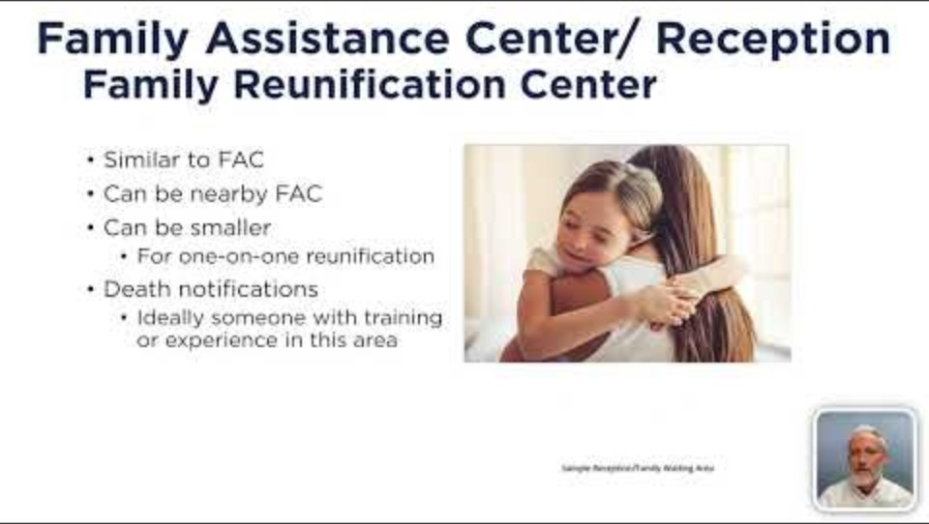
Video
Notes:
Optional Video

Slide 43
Module Topics: Special Considerations
Behavioral Health
At Risk Populations
Reunification
Fatality Management
Security

Slide 44
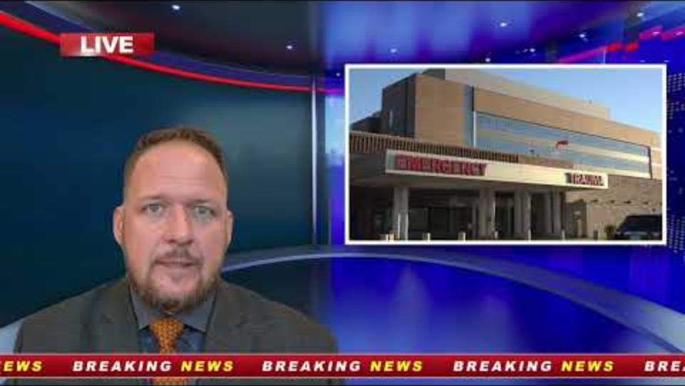
Scenario 3
Notes:
Soon, first responders are experiencing breathing issues and skin irritation, and nearby residents, businesses and facilities are noticing hazy air, breathing issues and burning eyes. Dispatch is noticing an uptick in calls, and hospitals are flooded with patients with symptoms and worried well, after seeing news reports about the derailment.
Within two miles of the accident scene there is a significant amount of low-income housing, a nursing home for veterans, two homeless encampments, an elementary school for K-8 graders, a high school, and a day care for low-income children with physical and learning disabilities.

Slide 45
Go to your Breakout Group
Join your Breakout Group
You will have 30 minutes for discussion
Please be prepared to share highlights after breakout session
Notes:
Edit as needed

Slide 46
Behavioral Health
How does your plan address the potential behavioral health impacts of this incident specifically on children and families? What actions would your HCC or facility take or consider at this time. Do you expect any requests from your HCC or other facilities? (e.g. routine use of psychological triage for increased risk for behavioral health impacts; activation of your pediatric mental health response strategy such as MH IAP, MH EEIs)
  What essential elements of information for pediatric behavioral health are in your plan? What could your HCC or facility contribute to behavioral health situational awareness? (e.g. Population level impact projections, GAP analysis, disaster systems of care linkages)
Notes:
Edit as needed

Slide 47
Behavioral Health (cont.)
How would unaccompanied minors' mental health needs be supported while awaiting reunification? What is your strategy for managing pediatric mental health emergencies among the evacuees and injured? How does your plan address these support elements?
How would you support the behavioral health of involved staff for this response? (e.g. individual self-triage and resiliency plan specific to responders)
Notes:
Edit as needed

Slide 48
At Risk Populations
What groups may be at higher risk of impacts, or more severe impacts, from this incident? Does your plan address these groups?
Are there potential barriers to reaching this population, or providing care and support to this group?
What resources and services are available to address these barriers? Are they captured and/or addressed in your plan?
Do plans address the specific needs of children?
Notes:
Edit as needed

Slide 49
Reunification
What are the roles and responsibilities around reunification for this incident? At this point in time, what processes should be taking place to address reunification needs?
Does your plan address special considerations such as ensuring a child is reunited with their legal guardian (e.g.: situations with custody disputes)?
How would behavioral health and spiritual care resources be integrated into reunification processes?
Notes:
Edit as needed

Slide 50
Fatality Management
Do you have a mass fatality plan? Do you have community partnerships or a response team to assist with mass fatalities?
Does your plan address handling contaminated bodies? What is the process?
Does your plan address cultural and/or religious considerations when it comes to management of bodies?
Notes:
Edit as needed

Slide 51
Security
Does your plan incorporate collaboration with Law Enforcement?
Does the plan include additional security for the situation and decontamination zone?
Notes:
Edit as needed

Slide 52
Large Group Sharing
Each breakout group share discussion highlights:
Behavioral Health
At Risk Populations
Reunification
Fatality Management
Security
Notes:
Edit as needed

Slide 53
Wrap Up

Slide 54
Feedback on Exercise
Initial thoughts:
Was overall time too long or too short?
Were breakouts too long or too short?
Other comments and suggestions?
Notes:
Edit as needed

Slide 55
Final Reminders
Resources provided in Facilitator Guide
Include Facility/Organization name to be included in the list of participants.
Please complete the Participant Feedback form
Notes:
Edit as needed

Slide 56
Hotwash

Slide 57
Hotwash
Group Discussion:
What is covered well in the plan?
What are areas for improvement in the plan?
What additional plans or policies should be revised?
What are your Improvement Action Items?
Notes:
Edit as needed

Slide 58
Notes:
Please do not remove

