Slide 1


Toxic Exposures
Module 10

Slide 2
Learning Objectives
Understand the increased vulnerability of children with toxic exposures
Describe the priorities of disaster scene staging when a hazardous materials incident has occurred
Describe the clinical presentation and management of common toxic exposures encountered in disaster scenarios

Slide 3
Lecture outline
Big important concepts
Common toxic exposures after
  Natural disasters
  Man-made disasters

Slide 4


Pediatric Vulnerabilities
Notes:
Children are the most vulnerable population group, especially children less than 5 years of age.
Some characteristics that made them more vulnerable are:
Shorter Stature 🡪 Many chemicals are more dense than air and consequently exist at higher concentrations closer to the ground. The same principle applies with radiation exposures.
Decreased fluid reserve, increased risk for dehydration (vomiting and diarrhea assiciated toxic exposures and infections
Larger skin surface area to body mass ratio 🡪 toxins can more easily be absorbed in higher concentrations
Less subcutaneous fat 🡪 causes a child to be at higher risk for hypothermia with decontamination
Less keratinization present in skin 🡪 corrosives can penetrate deeper leading to increased severity in injury
Higher minute ventilation per body mass 🡪 aerosolized or gaseous toxins are more extensively absorbed.
Decreased fluid reserve 🡪 children are at increased risk for dehydration with vomiting and/or diarrhea associated with toxic exposures or food-born illness.
Immature motor skills 🡪 Children are less likely to be able to physically remove themselves from a dangerous situation.

Slide 5

“all hazards” approach
Notes:
FEMA’s “All Hazards Approach” - Creating a simultaneous plan for the more likely public health emergencies (earthquakes, floods, unintentional hazardous incidents, infectious outbreaks), as well as terrorist events (rare, but potentially catastrophic events). Tox disasters could fall into either/both category.

Slide 6
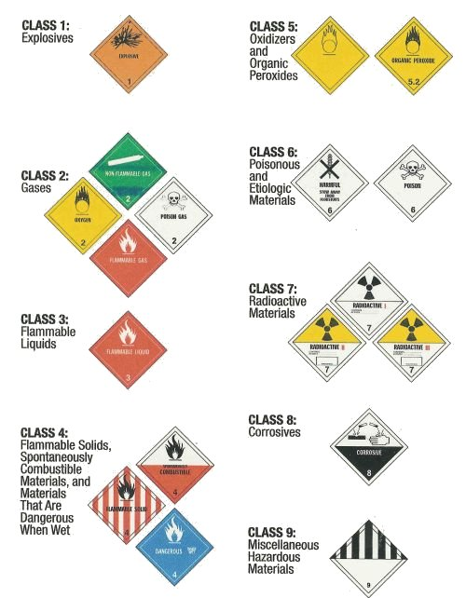
hazardous materials
a.k.a.
hazmat
Notes:
USDOT Hazmat definition: “Any material that can cause harm to people, property or the environment”

Slide 7
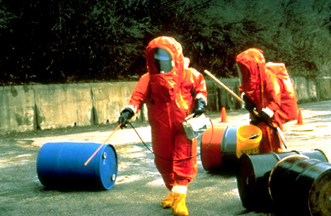
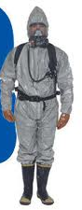

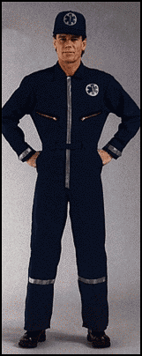
A
B
C
D
the ABCs of PPE
Notes:
Level A is the highest level of protection. It provides respiratory, skin and vapor protection. The healthcare worker is required to wear a self-contained breathing apparatus (SCBA) under this type of suit. Level A suits are used in the hot zone only
Level B provides the highest level of respiratory protection but less skin protection and no vapor protection
Level C PPE is the most commonly used by Health Care Personnel, because it permits to deliver care. Same skin protection as level B, but lower resp protection, which is using a powered air purifying respirator or PAPR, followed by using a face mask with a HEPA filter. The other levels are too cumbersome, and is usually used by rescue personnel entering in the hot zone, that need to have absolute protection. A hospital or health care centers PPE use is usually adequate with Level C protection to handle patients arriving from the scene needing decontamination
Level D is the lowest level and it is equivalent to a regular healthcare worker uniform. A level D suit should NEVER be worn in a hazardous material incident.

Slide 8
Downwind, downhill, downstream
Patient dispo point
Decontamination: ambulatory, independent
Contaminated waste
Clean, definitive triage and treatment
Triage
Decontamination: people’s stuff
Decontamination: non-ambulatory, need help
Emergency treatment
Hot zone
Warm zone
Cold zone
Patient movement
Notes:
Disaster Staging when there is a tox/hazmat concern:
Hot or Impact Zone:
This primary zone represents the area of continued danger such as ongoing fires, falling debris or exposure to
hazardous materials.
No medical treatment should be given in the hot or impact zone. At most, the rescue worker could attempt
to open an airway through positioning or place a patient on a backboard for spinal precautions.
Wear full protective gear, and possible initial triage
Decontamination or Warm Zone:
Zone represents area of hazardous materials contamination
Contaminated clothing removed, flushing/washing, thermal protection
Patients can be stabilized and decontaminated in this zone.
This zone should ideally be upwind, uphill, and/or upstream from the hot/impact zone.
Goal: to prevent further patient exposure and contamination of the staff
Should be divided into 2 groups:
Those who can remove their own clothing
Those who require assistance with clothing removal
Clothes and other personal articles should be placed slowly and carefully in small bags labeled with the patient’s name, address and phone number
Support Zone or Advanced Medical Post Zone:
This zone should contain no threat of secondary decontamination or equipment, personnel or victims.
It is the area of definitive patient treatment and triaging.
Examination, stabilization, and triage
No one from the general public or media should be allowed in any of the zones.

Slide 9

decontamination
Notes:
Assess all stable patients for the need of decon prior to further exam, triage, or treatment
Decon is usually more important with chemical and radioactive exposures than with biologic exposures
The goal of decontamination is to prevent further patient exposure and to prevent contamination of the staff
In general, not recommended to send a critically ill pt to the hospital prior to decon because they will need it prior to entering the hospital
Hospital level planning should account for patients who could arrive from the disaster scene on foot or in a private vehicle. These patients will also require decontamination.
Moving from head to toe, flush the skin and hair with water for 3-5 minutes. Avoid getting water in the eyes
Irritated eyes should be flushed with water or saline for at least 5 minutes
Remove contact lenses when present

Slide 10

Notes:
Children are very susceptible to hypothermic stress with decontamination. If possible, use lukewarm water. Swaddle the child immediately afterwards.

Slide 11

treat the patient
not the poison
Notes:
Always begin with ABC’s: Airway, Breathing, Circulation
Symptomatic and supportive care is sufficient for majority of poisonings
Every patient must have a complete physical exam
Two questions for the unknown exposure: 1) does this exam fit a particular toxidrome or “poisondrome”? 2) does this history/exam suggest the patient requires an antidote, or some other specific management beyond supportive care?
Toxidromes - Clinical manifestations from toxic exposures may vary considerably and may present with partial toxic syndromes

Slide 12

Notes:
Do not induce vomiting
Vomitus: wipe up with towels and double bag the towels. These bags should also be labeled “toxic waste”

Slide 13
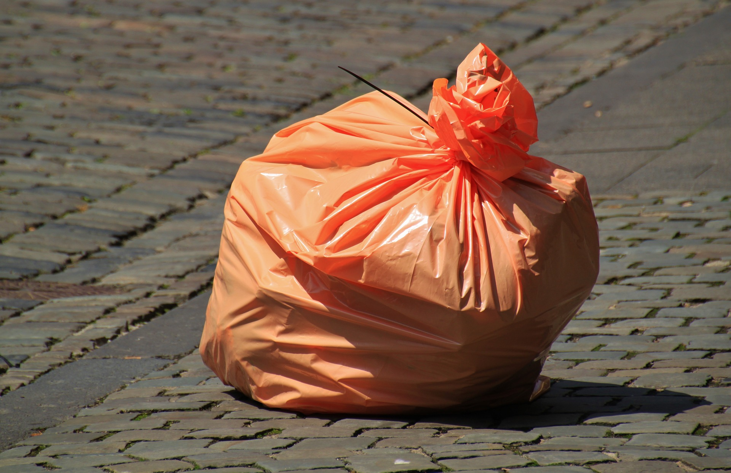
Toxic Waste
Notes:
Clean all non-disposable gear with a 5% hypochlorite solution (1 part household bleach to 9 parts water)
Protective clothing should be removed, bagged and discarded in a waste container labeled as “toxic waste”
All personnel should then wash with copious amounts of soap and water

Slide 14

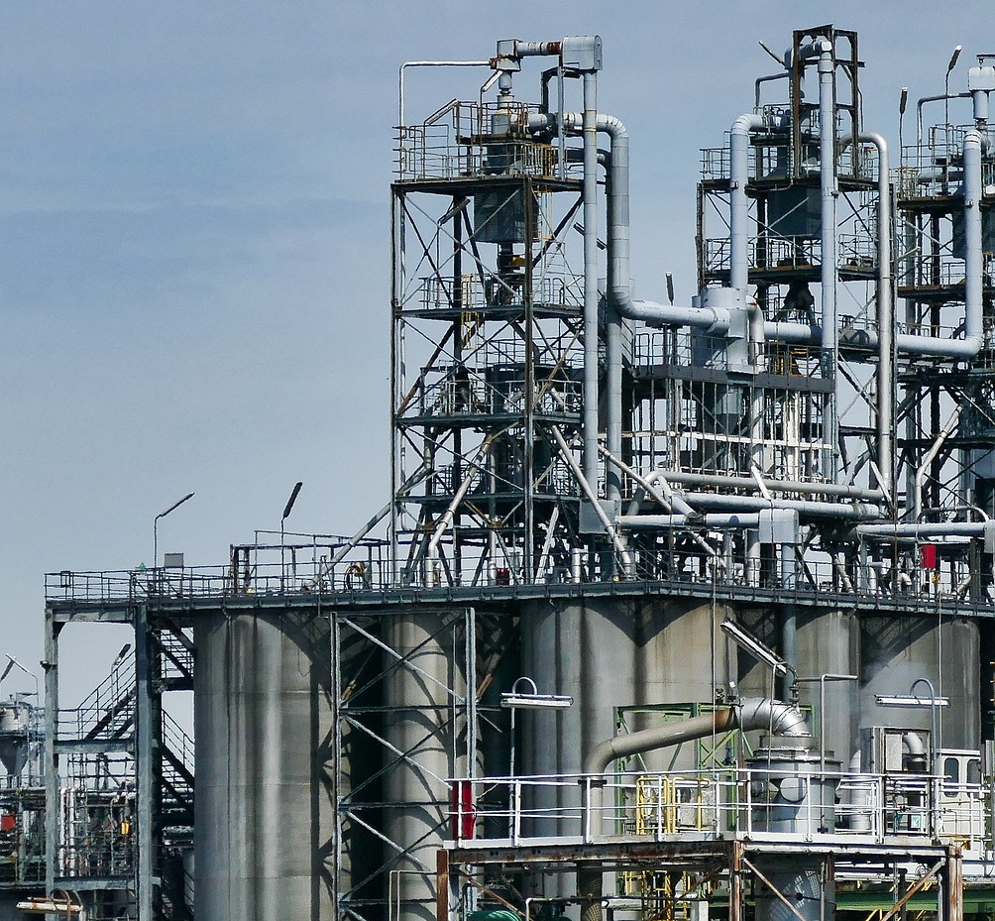
natural
disasters
man-made
disasters
Notes:
Any force of nature (earthquake, tsunami, landslides, etc.) that disrupts the soil or causes structural damage to surrounding buildings can result in toxin release.
Man made: Chemical, Biologic, Nuclear, Thermomechanical. May not be immediately obvious that a disaster has occurred.

Slide 15
Downwind, downhill, downstream
Patient dispo point
Decontamination: ambulatory, independent
Contaminated waste
Clean, definitive triage and treatment
Triage
Decontamination: people’s stuff
Decontamination: non-ambulatory, need help
Emergency treatment
Hot zone
Warm zone
Cold zone
Patient movement
Notes:
Disaster Staging when there is a tox/hazmat concern:
Hot or Impact Zone:
This primary zone represents the area of continued danger such as ongoing fires, falling debris or exposure to
hazardous materials.
No medical treatment should be given in the hot or impact zone. At most, the rescue worker could attempt
to open an airway through positioning or place a patient on a backboard for spinal precautions.
Wear full protective gear, and possible initial triage
Decontamination or Warm Zone:
Zone represents area of hazardous materials contamination
Contaminated clothing removed, flushing/washing, thermal protection
Patients can be stabilized and decontaminated in this zone.
This zone should ideally be upwind, uphill, and/or upstream from the hot/impact zone.
Goal: to prevent further patient exposure and contamination of the staff
Should be divided into 2 groups:
Those who can remove their own clothing
Those who require assistance with clothing removal
Clothes and other personal articles should be placed slowly and carefully in small bags labeled with the patient’s name, address and phone number
Support Zone or Advanced Medical Post Zone:
This zone should contain no threat of secondary decontamination or equipment, personnel or victims.
It is the area of definitive patient treatment and triaging.
Examination, stabilization, and triage
No one from the general public or media should be allowed in any of the zones.

Slide 16
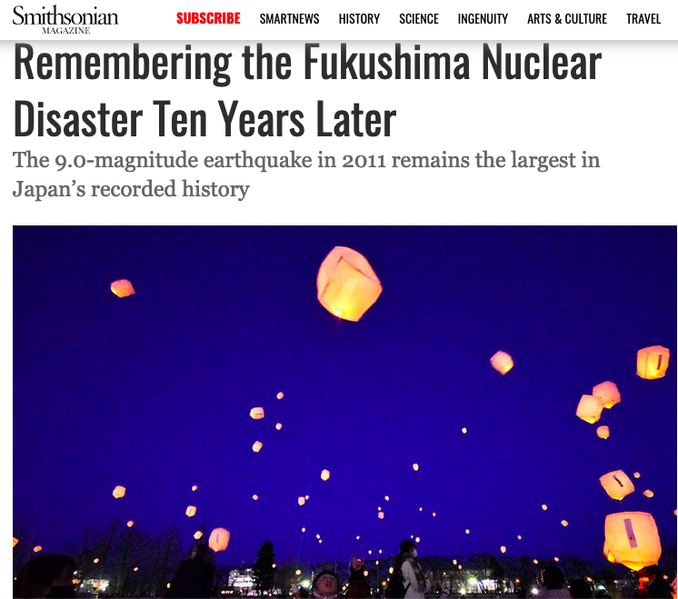
earthquake
tsunami
flooded emergency generators fail
nuclear reactor cores overheat
release of cesium-137, iodine-131
Notes:
March 11, 2011 – the most powerful earthquake ever recorded in Japan’s history occurred, triggering a tsunami which flooded a nuclear reactor in Fukushima and led to equipment failures that allowed the release of cesium-137 and iodine-131 into the atmosphere and seawater.
Damage to area industries can lead to toxin exposures affecting large numbers of people. Healthcare workers should be vigilant in disaster situations for clustering of symptoms that could suggest an ongoing exposure in the area.

Slide 17
natural
disasters
man-made
disasters
Notes:
Any force of nature (earthquake, tsunami, landslides, etc.) that disrupts the soil or causes structural damage to surrounding buildings can result in toxin release.
Man made: Chemical, Biologic, Nuclear, Thermomechanical. May not be immediately obvious that a disaster has occurred.

Slide 18
earthquake
tsunami
flooded emergency generators fail
nuclear reactor cores overheat
release of cesium-137, iodine-131
Notes:
March 11, 2011 – the most powerful earthquake ever recorded in Japan’s history occurred, triggering a tsunami which flooded a nuclear reactor in Fukushima and led to equipment failures that allowed the release of cesium-137 and iodine-131 into the atmosphere and seawater.
Damage to area industries can lead to toxin exposures affecting large numbers of people. Healthcare workers should be vigilant in disaster situations for clustering of symptoms that could suggest an ongoing exposure in the area.

Slide 19
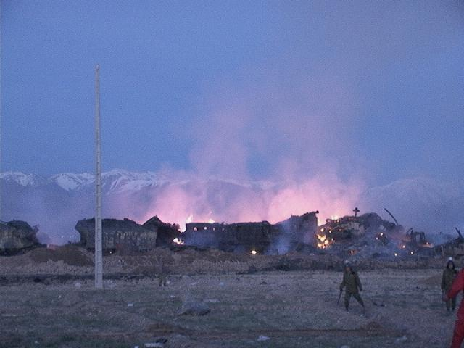
Another cautionary tale:
Neyshabur/Nishapur train disaster
18 Feb 2004
Photo credit: matin fattahi https://en.wikipedia.org/wiki/Nishapur_train_disaster
Notes:
51 rail cars that stopped started moving and then collided with a locomotive stopped at Khayyam Station -> initial fire just before 5am local time. The rail cars carried sulfur, fertilizer (ammonium nitrate), cotton wool, and oil/petrol. 7 cars of ammonium nitrate = ~400 tons. Firefighters set up an incident command system and evacuated nearby homes. Initial fire was ~90% controlled by 9am. Firefighters moved a rail car that unbeknownst to them (no hazmat fire diamond on the car) was carrying ammonium nitrate near the fire -> set off massive explosion felt up to 70km away.

Slide 20
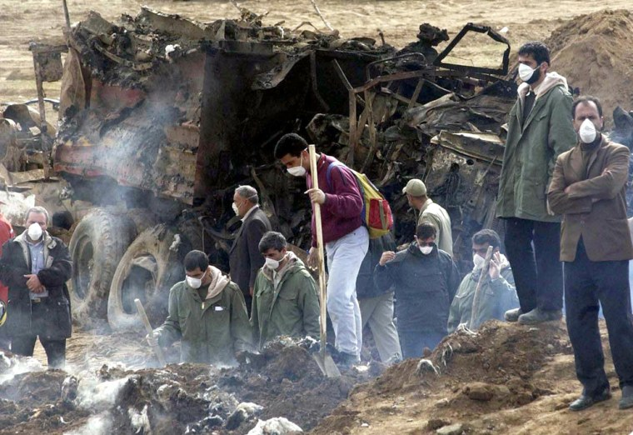
Over 300 killed
Over 400 injured
Photo credit: Hasan Sarbakhshian / AP
https://www.nbcnews.com/id/wbna4300626
Notes:
Failure to control the hot zone initially -> hundreds of spectators watching the firefighters working to control the initial fire and were within the immediate blast radius when the rail cars exploded -> hundreds dead and injured, homes destroyed.

Slide 21
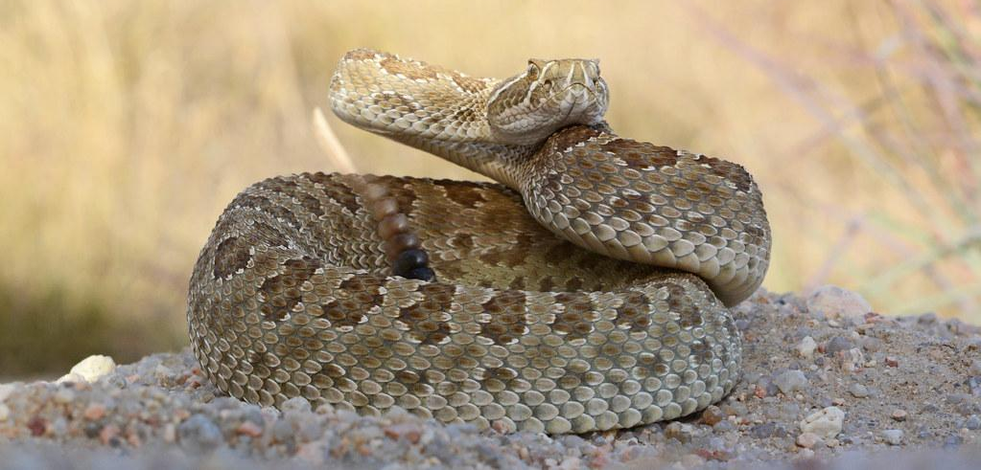
I got displaced too 😢
Notes:
Know what type of poisonous animals are prevalent in the community
Where snakes are prevalent know bite management
Wash the snake bite with soap and water. Immobilize the extremity and keep it below the level of the heart. Transfer to the hospital as quickly as possible.

Slide 22
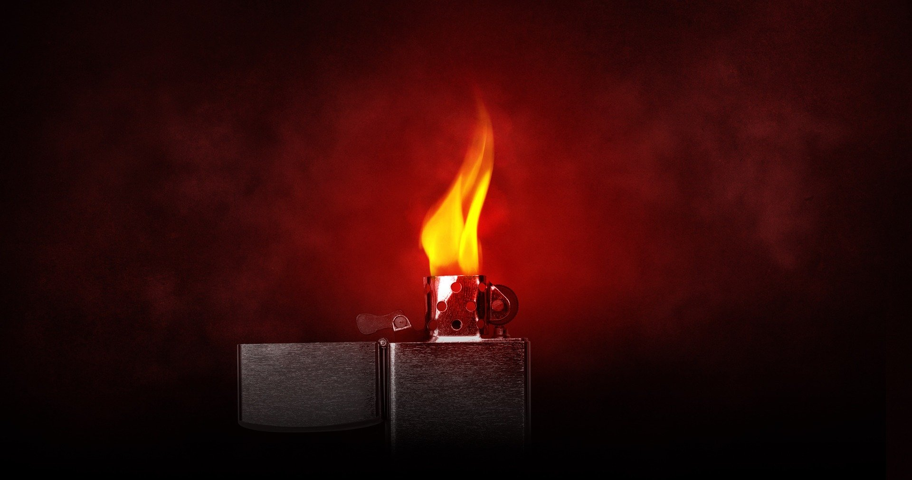
back to fire and flammables…
Notes:
Fires are extremely common after any natural disaster
CO and CN are common dangerous combustion products. Others may be difficult to predict and depend on what’s burning
Consider CN if synthetic materials were involved in a fire or in patients who have severe metabolic acidosis or hemodynamic instability
Measure serum lactate, if possible
Can get blood CN levels, but results will be delayed
Treatment: hydroxocobalamin (or old cyanide antidote kit) + supplemental oxygen

Slide 23
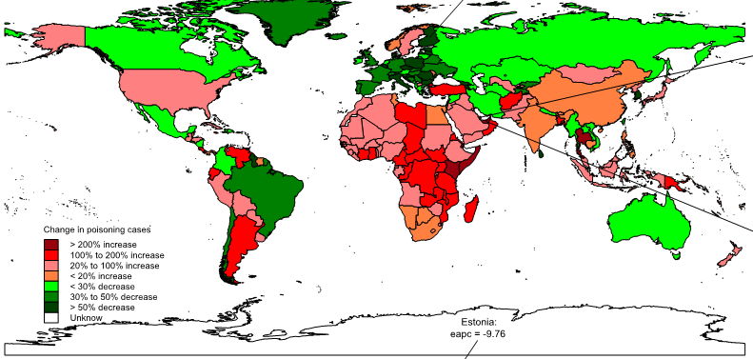
Name that poison gas:
colorless
odorless
non-specific symptoms
Long J, Sun Y, Zhao J, et al. Temporal trends of carbon monoxide poisoning mortality at the global, regional and national levels: a cross-sectional study from the Global Burden of Disease study, 1990 and 2017. BMJ Open 2021;11:e053240.
Notes:
Map showing the change in carbon monoxide deaths by country from 1990 to 2017.
Homes, for example, can have natural gas leaks, electrical fires and sewage line damage leading to secondary exposures. Carbon monoxide poisoning due to generator use in improperly ventilated areas is common. It is difficult to detect exposure without a detector because the gas is colorless and odorless, and symptoms of exposure are nonspecific: headache, nausea, dizziness. Young children: fussy, poor feeding, lethargy, “colic,” etc
Carbon monoxide competitively binds to hemoglobin forming carboxyhemoglobin. This product holds onto oxygen much more tightly than oxyhemoglobin. As a result, oxygen is not properly delivered to the tissues and hypoxia results. In severe exposures, victims may lose consciousness and if not removed from the exposure will eventually die.
The most important first step is to remove the patient from the exposure into fresh, uncontaminated air. Administer 100% supplemental oxygen if available. Half-life of carboxyhemoglobin: Room air = 4-5 hours, FiO2 100% = 1-2 hours

Slide 24
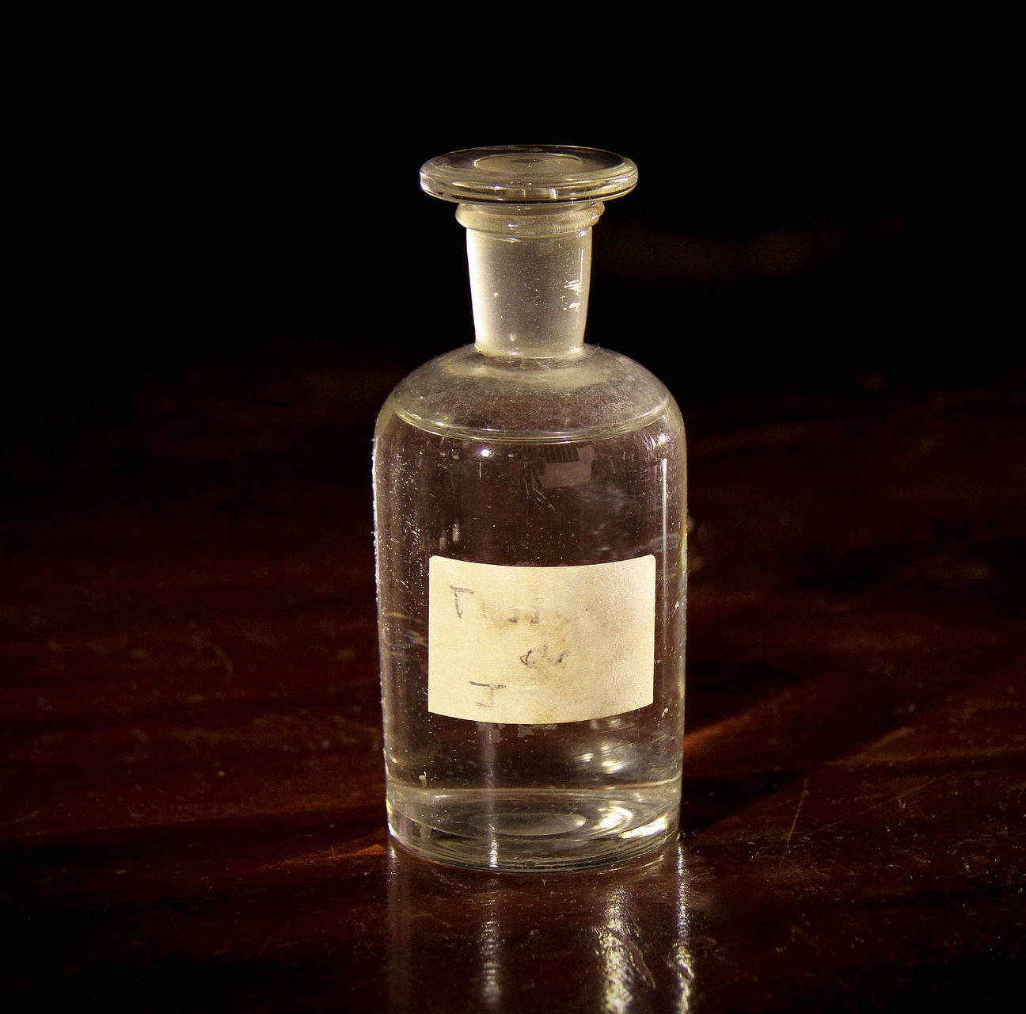
chemical
exposures
Notes:
The signs and symptoms of a chemical exposure generally appear fairly quickly leading to rapid identification of the “hot zone.”
Some examples (aerosolized):
Nerve agents (Tabun, Soman, Sarin, VX)
Vesicants (Sulfur mustard)
Pulmonary irritants (Chlorine gas, phosgene)
Riot control agents (Mace, tear gas, pepper spray)
Incapacitating agents (Various, historically antimuscarinic agents and ultrapotent opioids)
In the ammonium nitrate example, nitric oxides (nitric oxide - NO and nitrogen dioxide NO2 being the most damaging)

Slide 25
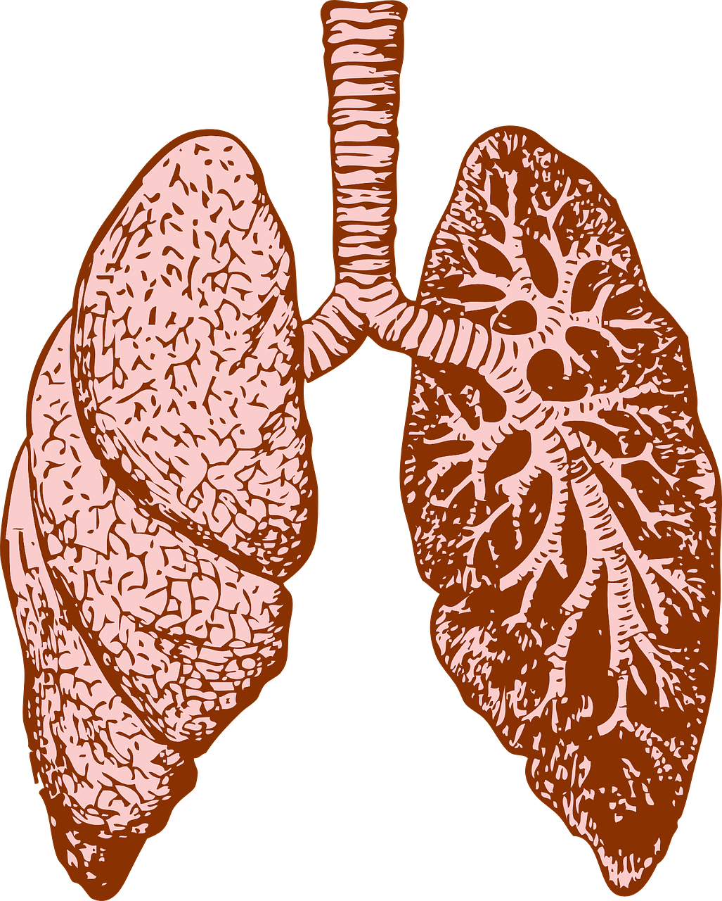
example: pulmonary irritants
coughing, dyspnea, maybe eye/skin irritation
remove from exposure + decon (in case of skin irritation) + supportive care

Slide 26
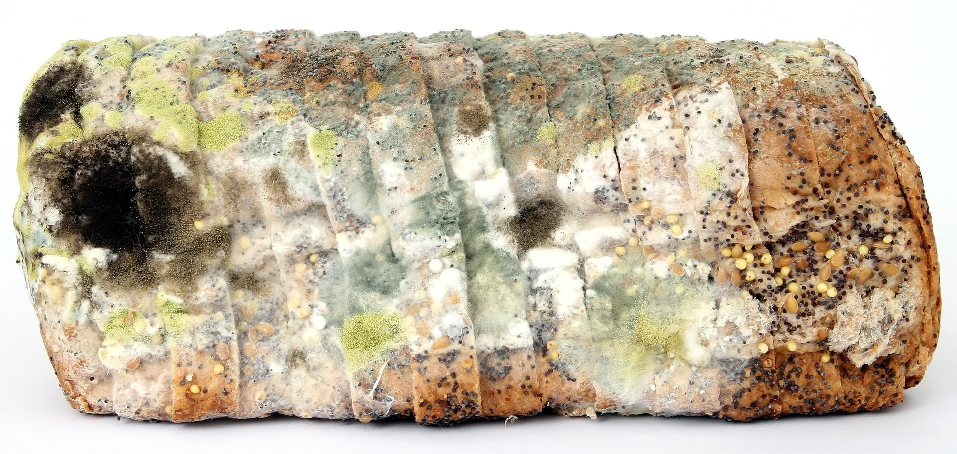
biologic exposures
Notes:
Have significant potential to affect large portions of the population
Symptoms develop more insidiously than chemical exposures. Therefore, patients will present at different times and locations
Many therapies for biologic warfare agents have not been studied in children and therapeutic dosing may have to be adjusted for a child’s size
A hot zone can be extremely difficult, if not impossible to establish.

Slide 27
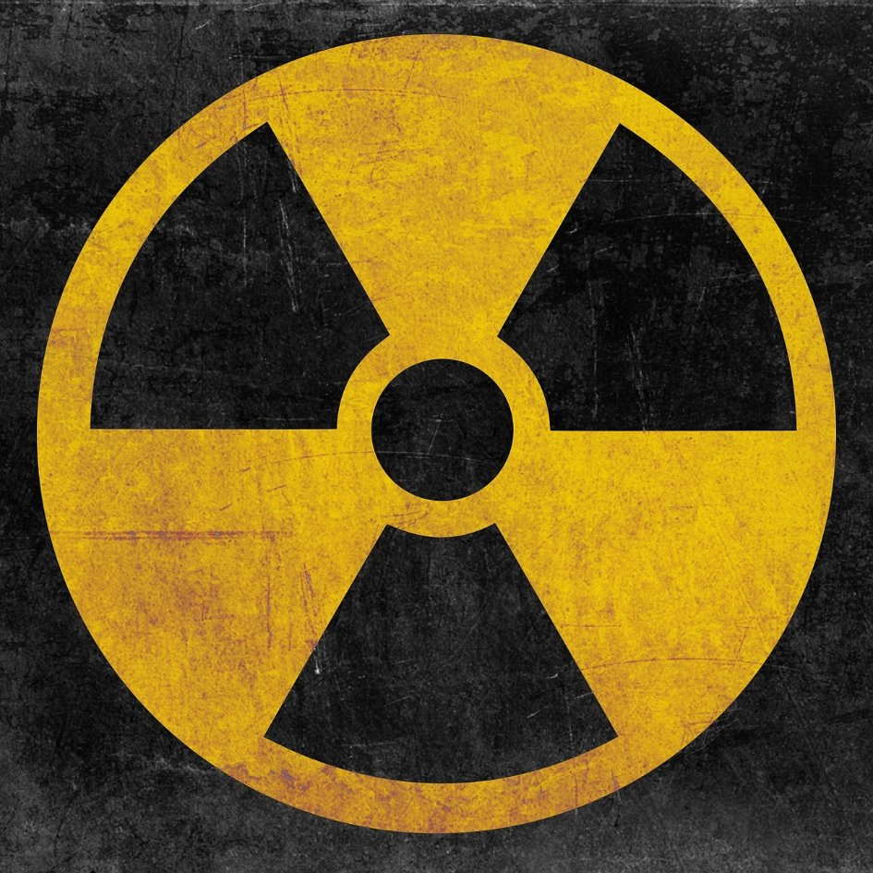
radiation exposures
a brief primer:
radiation = energy as particles or waves
principles of protection:
  time
  distance (inverse square law)
  shielding
Notes:
Radiation = energy in the form of waves or particles
Causes tissue damage by either physically damaging DNA or by damaging other molecules that create reactive species
Principles of protection:
Time
Distance (inverse square law)
Shielding

Slide 28
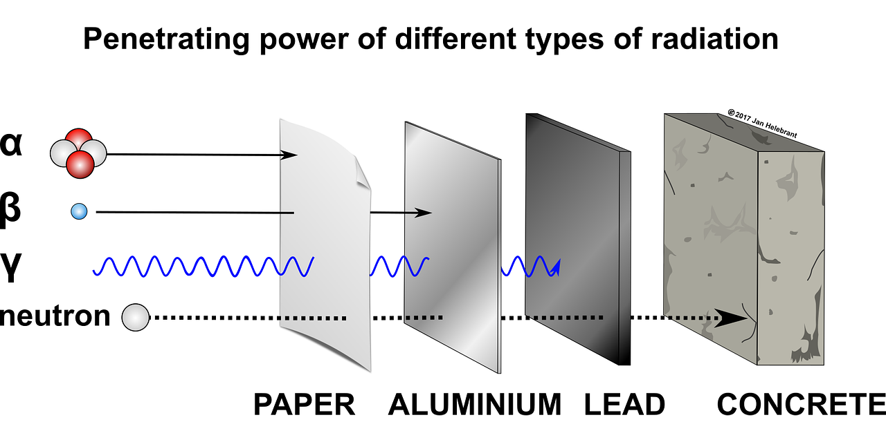
Notes:
For slide notes, do we want to provide 'what' produces which level of radiation?...addressing level 1 knowledge

Slide 29
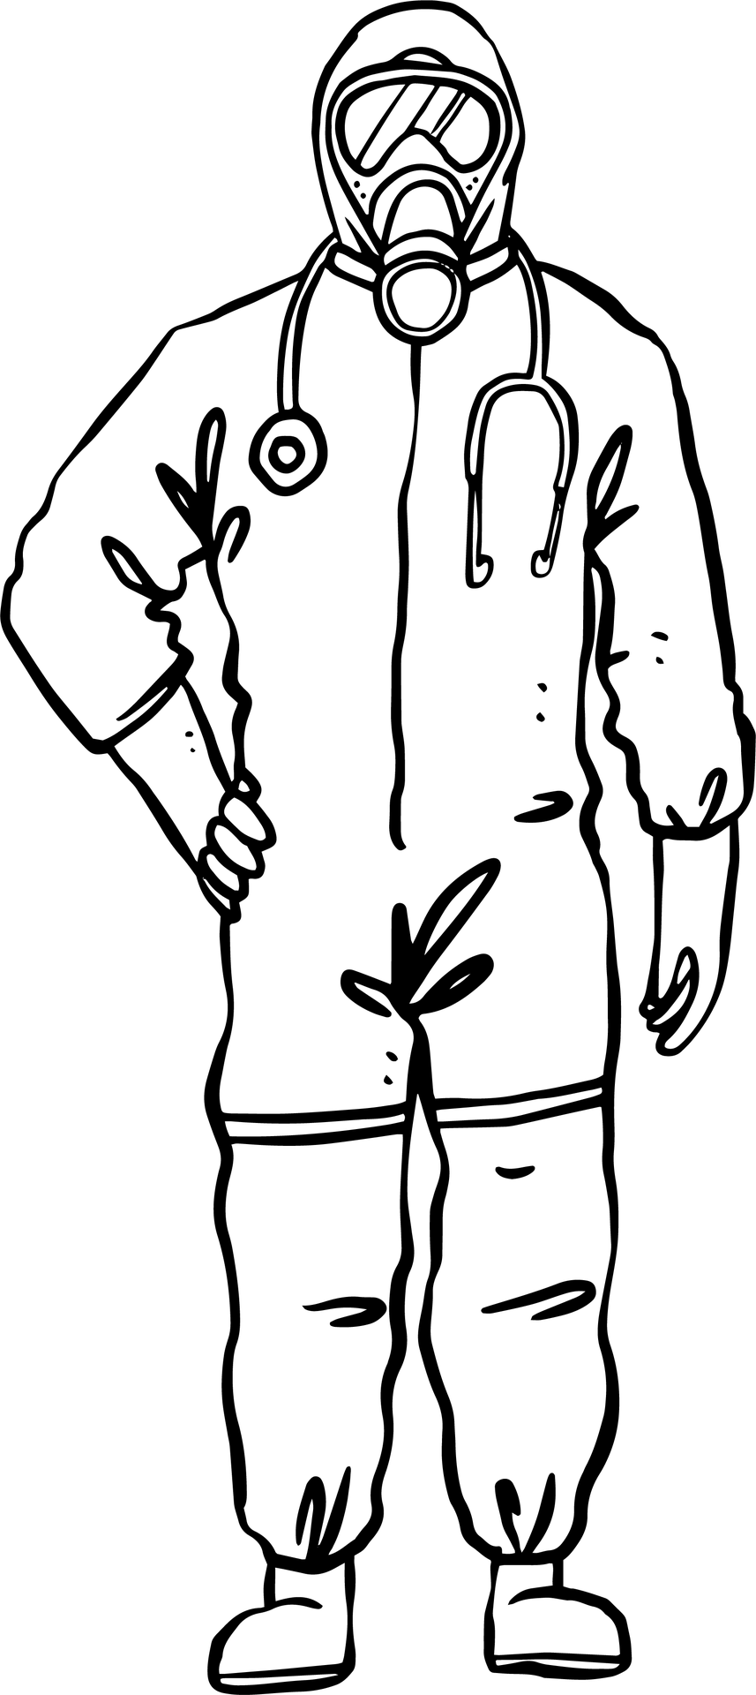
full face mask with HEPA filter (or wet cloth)
don’t bring this
neck seam taped
splash-proof outerwear
two pairs of gloves, cuffs taped
socks tucked under clothes, cuffs taped
waterproof shoe covers

Slide 30
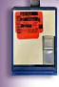
full face mask with HEPA filter (or wet cloth)
instead, wear this (clip on dosimeter)
neck seam taped
splash-proof outerwear
two pairs of gloves, cuffs taped
socks tucked under clothes, cuffs taped
waterproof shoe covers

Slide 31
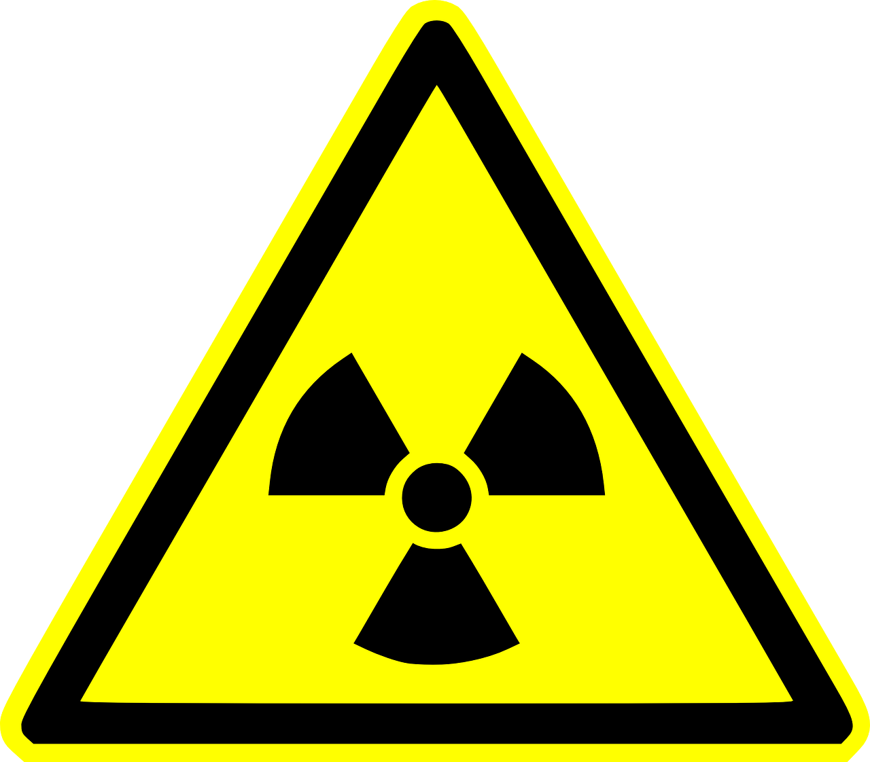
decontamination: special considerations
Notes:
Slowly remove (cut, don’t tear) clothing, double bag
Gently scrub all contaminated wounds with soap and water. Wipe AWAY from wound.
After wounds, clean orifices around face, then hair, then intact skin.
All bodily fluids (urine, stool, vomit, etc.) are potentially contaminated and should be handled as toxic waste
Radioactive dust is a huge problem. It collects essentially everywhere and can lead to further patient and healthcare personnel contamination.
Effort has to be made to remove radioactive dust from wounds in order to prevent deeper penetration into the wound.

Slide 32
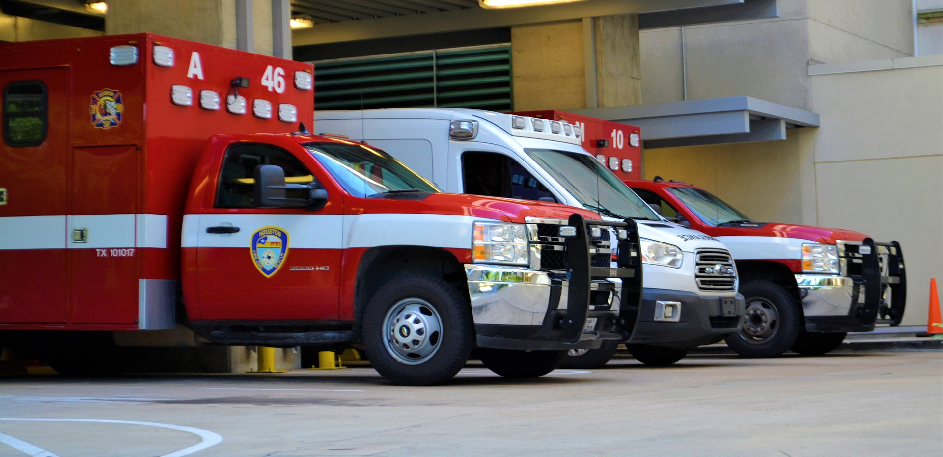
Notes:
External survey with Geiger counter, collect nasal swabs
If a patient needs surgery, do it as soon as possible (wound healing will worsen with time)
Measure a complete blood count (CBC) as soon as possible, every 2-3 hours for first 8-12 hours
Measure CBC’s 4-6 times a day for the first 2-3 days to follow decline in lymphocytes

Slide 33
special topics: potassium iodide (KI)
Age | KI dose (mg)
Birth to 1 month old | 16
1 month < 3 years | 32
> 3 years to 18 years | 65
> 18 years or > 70 kg | 130
Notes:
Radioiodines are common isotopes released from nuclear power plant reactions.
The thyroid is targeted by radioiodines and exposure puts one at risk for future development of thyroid cancer.
The younger victim naturally has a longer expected lifespan and consequently a longer time period in which the cancer can develop.
**All patients weighing over 70 kg should be given the adult dose (130 mg) of KI.
KI tablets can be dissolved in a pleasant tasting liquid. Side effects are mild (gastrointestinal distress and/or rash). One dose is effective for 24 hours. Most patients only require 1 dose. When removal for the exposure is impossible, subsequent doses will be required. Thyroid levels in 2-4 wks (if one dose given)
Avoid repeating dose for pregnant and breastfeeding women and new born infants
If given before exposure, can prevent 100% of radioiodine uptake, if given 24 hours after expposure, efficacy decreases to <10%

Slide 34

special topics: dairy milk and breastmilk
Notes:
Radioiodine is secreted into breast-milk
If possible, exposed lactating mothers should not breast-feed their infants until deemed safe
Radioiodine is also secreted into the milk of livestock and distributed on the local produce
These products should not be eaten until public health authorities have declared them safe for consumption

Slide 35

Poison Control Center
1-800-222-1222
Chemtrec
1-800-262-8200
www.chemtrec.org
CDC
1-800-CDC-INFO
www.cdc.gov
REAC/TS
865-576-3131
https://orise.orau.gov/reacts/index.html
Notes:
Chemtrec: 24 hr hazmat chemical incident response
CDC: Centers for Disease Control and Prevention
REAC/TS: Radiation Emergency Assistance Center/Training Site (24 hour assistance for medical management of those involved in a radiological/nuclear emergency)

