Slide 1
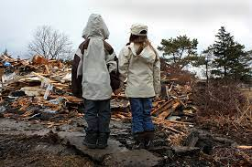
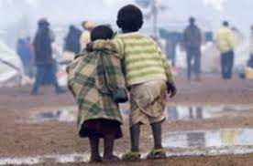


The Emotional Impact of Disasters on Children and their Families
Module 9

Slide 2
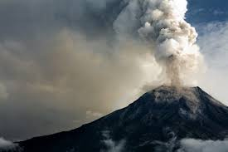
Gwen Mitchell, Psy.D.
Clinical Psychologist | Associate Professor
University of Denver
International Disaster Psychology: Trauma &
Global Mental Health Program
No Financial Disclosures

Slide 3
Learning Objectives
1
2
3
4
Characteristics that determine Vulnerability in Children & Adolescents
Children’s Emotional response to disaster
Age Specific Interventions
Prevention, & Detection of MH problems

Slide 4

Impact of Disasters & Types of Responses
Symptoms can be normal & of short duration – don’t get in the way of normal recovery
Certain factors influence vulnerability – developmental stage matters
Emotional triage, referrals, action plans and the role of different providers
Notes:
Only 1/3 suffer long term consequences
5 elements of PFA
1) CREATE A SENSE OF SAFETY
Creating a sense of safety means you communicate to the brain’s fight or flight system that the stressful situation is over. You can do that by shielding the patient from a disturbing scene or explaining to the individual that they’re safe. Reinforce this by showing them what you’ve done to make the scene safe, like moving them away from a precarious edge or pointing out that the thunderstorm has passed and the weather has calmed.
2. CREATE CALM
This is important both before and while responding. Speaking and acting calmly can show your patient they’re in a safe place and can start calming themselves. If you’re struggling to calm yourself or your patient, use simple tools like taking a deep breath, counting to four, then letting your breath out slowly, and coaching your patient to do the same. It’s hard to calm someone else when you don’t feel calm yourself, so check your own composure before helping your patient.
3. CREATE SELF AND COLLECTIVE EFFICACY
Efficacy is your ability to produce a desired result. You can help your patient foster self-efficacy by making them an active part of their own rescue. Remind your patient of their existing strengths, allow them to care for themselves or help their companions, and involve them in decisions about their care. This helps them overcome the feeling of helplessness that sometimes comes with a traumatic event. They’re no longer a victim, but a part of the team.
4. CREATE CONNECTION
Creating connection helps the patient tap into the social supports that surround them. You can create connection by building an on-scene relationship with your patient: use their name and build a rescue partnership. This also includes connecting the patient with loved ones or even pets.
5. CREATE HOPE

Slide 5
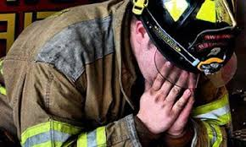
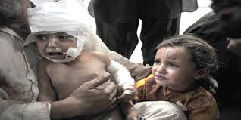
1) spot and educate about short term reactions
2) Understand how trauma is a process not an event
3) Victims and responders may experience shame and guilt (i.e. survivor guilt & moral injury)

Slide 6

Emotional Vulnerability in Children & Adolescents
(immediate)
1
Developmental stage
Extent of dependency on family adults
Gender
Personally witnessed the trauma event
Previous physical and mental health
Recovery or adaptive capacity (i.e. loss of favorite play area, loss of siblings/friends)
Notes:
Research has consistently shown that when it comes to mental health outcomes following a disaster, women are generally at higher risk for developing mental health problems compared to men. Several factors contribute to this increased vulnerability:
Social and Cultural Roles: Women often bear a significant burden of care in families, which can increase stress following a disaster as they manage their own emotional responses along with those of children and other dependents.
Prevalence of Certain Disorders: Women are more likely to experience disorders such as depression and anxiety, which can be exacerbated by the stress and trauma associated with disasters.
Exposure to Trauma and Violence: Disasters can lead to increased rates of domestic violence and sexual assault, risks that disproportionately affect women.
Economic Vulnerability: Women may face greater economic instability than men, as they are often employed in lower-wage jobs or may be economically dependent, which can be destabilizing when resources are scarce post-disaster.
Reproductive Health Needs: Women have specific health needs that may be neglected during and after disasters, such as access to maternal health care and sanitary products, adding to their stress and affecting their mental health.
Social Support Systems: While strong social support can be protective of mental health, women's networks might be disrupted more than men's in some contexts, affecting their coping mechanisms.

Slide 7

Notes:
Prior to the 1980s children in dissaters were written about but rarely consulted. Much of the research on children and disaster continues to rely on parents teachers or clinicians reports of children's well being
Value in this but not all children’s behaviors are rooted in systemic observations. Mekana (Katrina)– “chose to hide her emotions and hold feelings in because her mother was angry and struggled with depression.
The best way to learn about children is to learn from children

Slide 8
Risk Factors
Direct victims (e.g., those injured) or direct or indirect witness
parental divorce, high ACEs, prior Dx
Children and staff who felt at the time that their life was in jeopardy, families that struggles to communicate openly
Children and staff exposed to horrific scenes (e.g., bloody children or those severely injured), including those indirectly exposed through the media
Notes:
rg

Slide 9

Orchids & Dandelions
Many children are able to thrive in any environment, while others may flourish only under the most favorable conditions. New findings reveal the complex interplay of factors that creates "dandelion" and "orchid" kids.
A minority of children—about one in five—show an exceptional susceptibility to both negative and positive social contexts, with stress response circuits highly sensitive to adverse events.

Slide 10
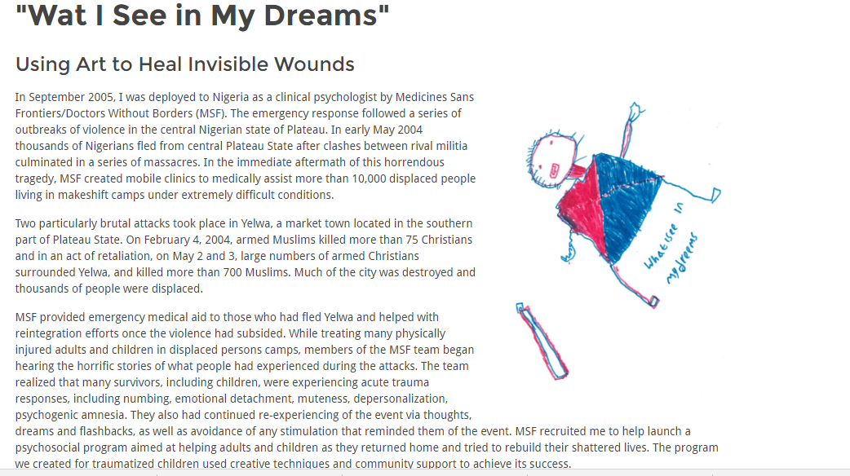
Notes:
I want to use some children’s drawings to help illustrate some of the symptoms kids can experience.

Slide 11
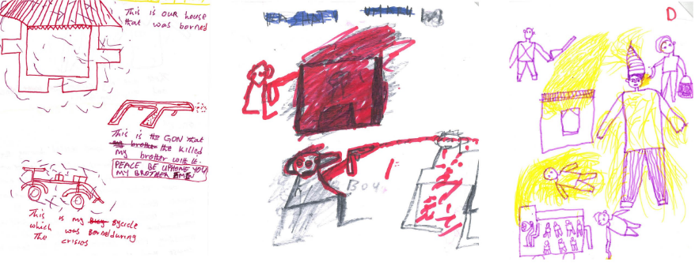

Slide 12
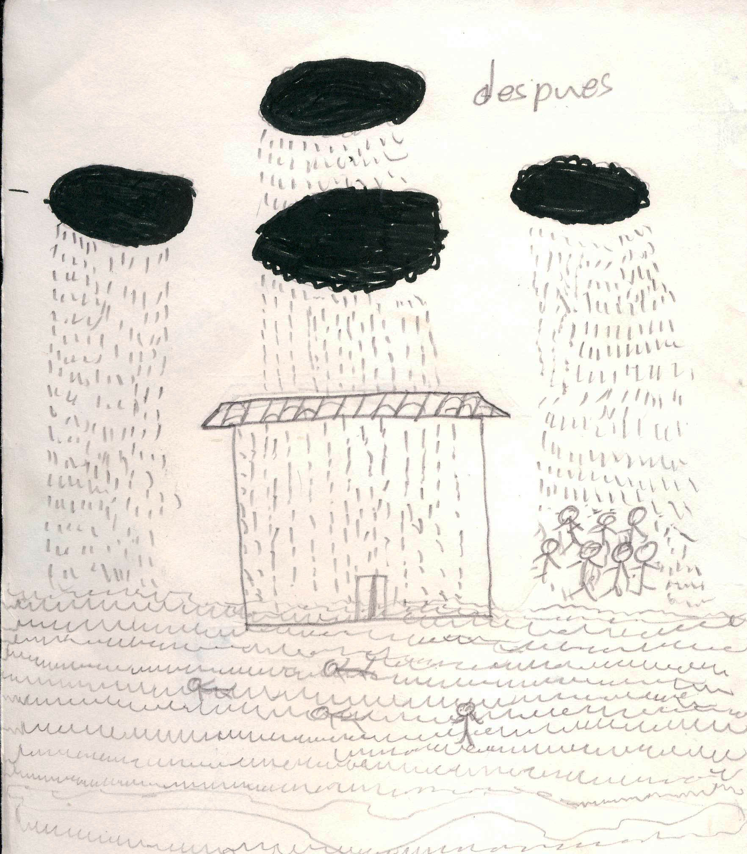
Notes:
This is a picture that a 9yo boy drew depicting life after the hurricane. He only used black. You can see people getting rained on, and others, some living, some dead, being carried by the currents. He had several family members who died. The boy was having nightmares, difficulty sleeping, was sullen, was afraid of being be separated from his mother, and was reluctant to participate in group activities. He was afraid when he saw clouds or felt the wind. When I asked his name, he said “I don’t have a name, it was carried away by the rushing water”.
This boy, one-two months after the Hurricane, had acute fears of wind, clouds in the sky and any loud noises. He had difficulty sleeping and could not get thoughts of dead and dying people, many of whom were family and friends, out of his mind. Though there were play activities at the school where he was sheltered, he did not want to participate. He missed his dad, who staying near Posoltega trying to make claims for financial assistance to the both the Nicaraguan government and to aid agencies.

Slide 13
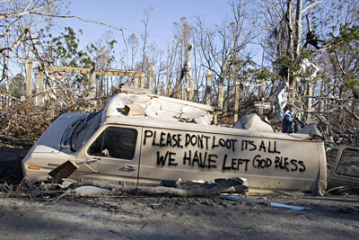
Community related risk factors for emotional vulnerability
Disruption in schedules and routines
school closings
Induction of fear and erosion of safety
Opportunism that undermines safety
Notes:
These risk factors relate to how severely communities are affected. Are schools closed? Are police available? Looting may occur post-disaster, in some scenarios children in desperate living situations may be taken advantage of.

Slide 14
Resilience Variability in Trauma Response
Peek & Fothergill (2015) Children of Katrina: longitudinal study of children. Discovered 3 trajectories
Declining
Finding equilibrium
Fluctuating
Misleading perceptions on children:
The resilience myth
Helpless victim myth
Disasters are equal opportunity events myth
Notes:
RG

Slide 15
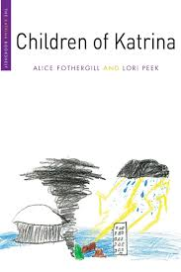
CASE STUDIES:
Daniel: Cumulative vulnerability and continuing crisis
Mekana: DIsaster as Catalyst
Isabel & Zachary: Resource Depth and Long-term Stability

Slide 16
Emotional response: weeks, months, years
2
DV related reactions that may increase post disaster
Pessimism about the future
Repetitive play
trauma enactment
Somatization
Substance abuse

Slide 17
Most frequent emotional disorders /trauma responses
ASD / PTSD
Depression
Anxiety
Oppositional Defiant

Slide 18
3
Children may express distress differently than adults
Behavioral manifestations may be misunderstood
Limited communication skills lead to non-verbal expressions – look for them!
Younger children may harbor cognitive distortions especially around causation
Developmental Considerations
(Age Specific)

Slide 19
SPHERES OF CHILDREN’S LIVES
Family
Extra-Curricular Activities
Housing
Health
Housing
Peers
Notes:
We need to think beyond the medical model here. People who can intervene in a supportive way include, but are not limited to, all of the following:
Hospital staff personnel
Child care workers, Day care providers
Teachers and teacher’s aids
Secretarial staff (e.g., can assist with communication and reunification services)
Traditional mental health providers (e.g., psychiatrists, psychologists, social workers, etc.)
Other healthcare providers (e.g., pediatricians, nurses, etc.)

Slide 20

Interventions: beyond the medical model (what to look for and who can intervene)
Understand emotional reactions
Pay attention to behaviors at home and at school or daycare
Don’t underestimate children’s distress
Screening tools for PTSD and depression may be helpful
Reduce the emotional impact
Provide support, comfort, and time for play and discussion
Model healthy coping behavior / Direct parents to seek help, if needed
Facilitate recovery
Normalize routines as soon as possible / Listen to children and validate their feelings Encourage activities that help them express their feelings

Slide 21
Interventions: parents & caregivers
4
Return to normal routines, with additional supports and appropriate accommodations
Patience
Encourage children to spend time with friends
Encourage children to resume their developmental tasks
Set normal and appropriate limits to children
Allow children to talk about their worries and feelings
Parents should get support and treatment if indicated
Help teachers see the problem and show understanding
Notes:
rg

Slide 22

Saying Goodbye
this can be achieved through painting, planting and caring for a tree, praying, lighting a candle, or any other suitable expression.
It is helpful for children to find their own unique way of saying goodbye to someone they have lost
Notes:
rg

Slide 23

Explaining death to children
Ask children their understanding of death
Explain death using simple and direct terms.
It is best to present both the facts about what happens to the physical body after death, as well as the religious beliefs that are held by the family
After explanations have been given to children, it is helpful to ask them to review what they now understand about the death
Notes:
rg

Slide 24
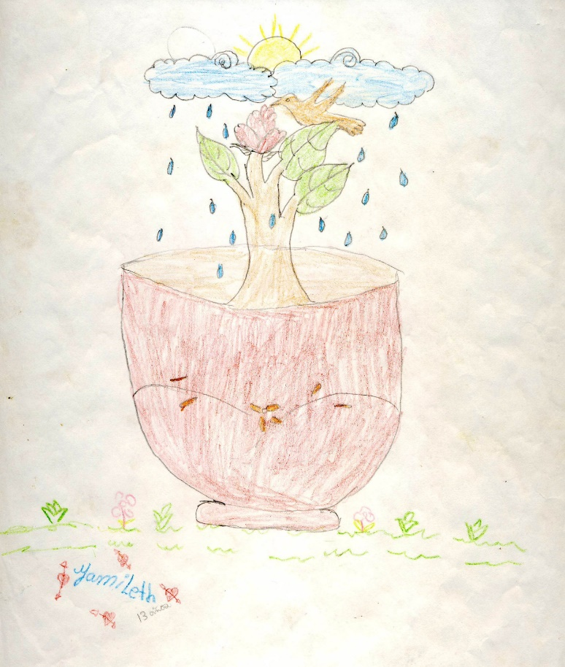

Disaster type: Hurricane
Disaster stage: four months later
Emotional vulnerability/risk factors: witnessed death of relatives, friends, loss of home and school, poverty, separation from father
Emotional response: Separation anxiety, sleep difficulty, nightmares, Headaches, sadness, fear of bad weather, Intrusive thoughts
Interventions:3 months temporary safe place to stay, reunification with family, food, clothing, school, support groups, recreation
Result: symptom improvement, hope mixed with tears
Notes:
I got to know this 12 year old girl and her mother in the temporary shelter where she stayed for 3 months and met with her again after she returned to her devastated community several months after the disaster. She was still sad, and very frightened of clouds and rain: this was especially so since she and her family were living in a temporary shelter only 50 feet away from a river. However, she had friends, was happy to be re-united with both parents, and hoped to return to school soon. Her picture, shows a tree in a pot. The tree does not have roots in the ground, like herself and her family. The tree is starting to blossom, and a dove (isn’t that the bird that Noah saw after the flood) with tiny wings (perhaps like herself) is resting. The sun is trying to come out, but it is still raining tears.

Slide 25
CRITERIA TO SEEK
MENTAL HEALTH ASSISTANCE
Suicidal or homicidal ideation
Persistent somatic complaints
Avoiding behavior or anxiety symptoms that interfere with everyday life
Alcohol or substance abuse
Symptoms persist > 3 months and interfere with everyday life
Behavioral changes
Behavioral school problems
Withdrawal behavior that interferes with social life
Consider risk factors: recent parental divorce, death of a significant close relative, having moved or changed school recently
Notes:
rg

Slide 26
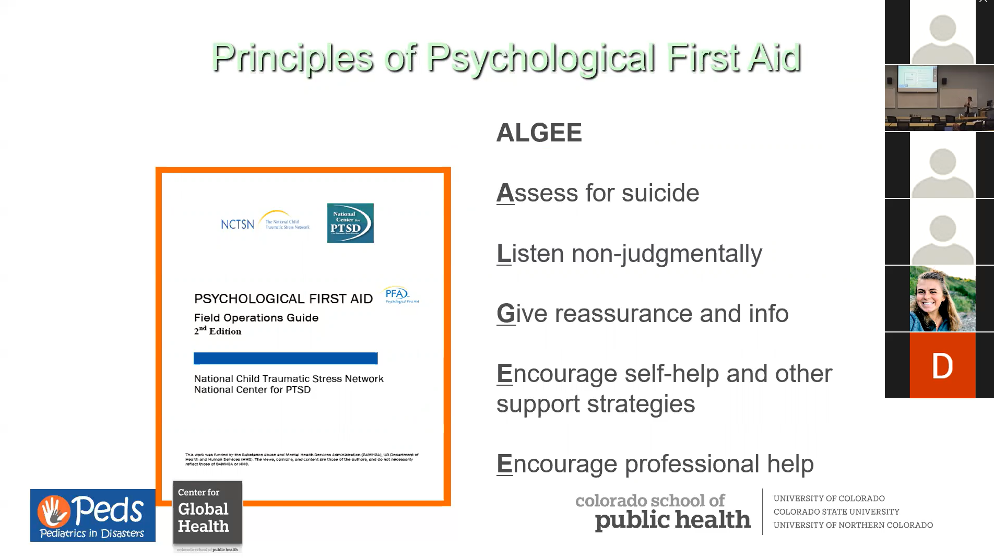

Slide 27
References & Resources
1. American Academy of Child & Adolescent Psychiatry (AACAP) - Disaster Resource Center for Parents and Families: Website: AACAP Disaster Resource Center
National Child Traumatic Stress Network (NCTSN) - Resources for Parents and Caregivers: Website: NCTSN Resources
SAMHSA - Disaster Distress Helpline: Website: SAMHSA Disaster Distress Helpline
UNICEF - Child Protection in Emergencies: Website: UNICEF Child Protection
Save the Children - Emergency Response and Recovery Resources: Website: Save the Children Emergency Response
Child Mind Institute - Coping After a Disaster or Traumatic Event: Website: Child Mind Institute - Coping
Substance Abuse and Mental Health Services Administration (SAMHSA) - Children and Disasters: Website: SAMHSA - Children and Disasters
Psychological First Aid for Schools Field Operations Guide: PDF: Psychological First Aid for Schools Guide (PDF)
These resources provide up-to-date information and support for parents, caregivers, and professionals dealing with children's mental health during and after disasters or traumatic events.

