Slide 1


Food and Nutrition Security in Disasters

Slide 2
Learning Objectives
Learn how to Assess Food Security in Crisis Situations
Learn How to Identify Malnutrition
Review WHO Treatment Guidelines for Severe and Moderate Acute Malnutrition in Children under 5.

Slide 3
Emergency Food Security Assessment

Slide 4

The purpose of an Emergency Food Security Assessment is to assess the impact of shock on the food security of households and communities within the affected area.
Famine is declared when malnutrition is widespread, and when people have started dying of starvation through lack of access to sufficient, nutritious food. Inequality is a critical factor, with low incomes in particular putting affordable food beyond the reach of millions.
WFP Hunger Map Live
Notes:
In 2023, there are 40.4 million people in 51 countries at the ‘emergency’ phase of food insecurity. The greatest threat currently lies in Yemen and South Sudan. Among the most vulnerable groups are internally displaced people and refugees caught between the frontlines of hunger, many of whom are totally dependent on food assistance for their survival.
Some of the biggest causes of famine are conflict and climate shocks.

Slide 5
Key Questions
Does the shock have an impact on food security?
  How does the crisis situation compare with pre-crisis? Is the population food insecure?
Has the level of malnutrition among the population been exacerbated by the shock?
  Is the population likely to remain or become food-insecure or malnourished in the future?
How severe is the problem?
  How severe is food insecurity and/or malnutrition?
How do people cope?
  Are the affected people able to cope with the problems on their own, without becoming more food-insecure and malnourished?

Slide 6
Key Questions cont.
Who? How many? Where?
  Which population groups are more food-insecure and/or malnourished now? Which may groups may become so in the future?
  How many people are affected now? How many may be affected in the future?
  Where are these people located?
Why?
  What are the causes of present and future food insecurity and malnutrition?
What is needed?
  Can the affected people cope with and recover unaided? Are they already receiving assistance?
  Is additional assistance needed? If so what type? For whom? When? Where? How much? For how long?
  Can the government and national organizations provide this assistance or is international assistance required?
  What is the appropriate response?

Slide 7
Core Concepts
Livelihoods
  “Livelihoods comprise capabilities, assets (including both material and social resources and activities required for a means of living linked to survival and future well-being.” “Humanitarian Charter and Minimum Standards in Disaster Response,” The Sphere Project, Geneva, 2004.
Notes:
In general the more assets a household has and the more varied the strategies available to it, the more resilient the household will be. However, households with many physical, financial or natural assets may be targeted during conflict or civil unrest increasing vulnerability.

Slide 8
Core concepts cont.
Food Security
  “Food security exists when all people, at all times, have physical and economic access to sufficient, safe, and nutritious food to meet their dietary needs, and food preferences for an active and healthy life.” World Food Summit, 1996
  Food availability: physical availability of food in the area through production, trade, stocks, transfers
  Food access: Household ability to acquire adequate amounts of food through home production / stocks, purchase, barter, gifts, borrowing, and food aid.
  Food utilization: Household utilization of food to which they have access and individual ability to absorb and metabolize nutrients.
  Stability – food is present at all times in terms of availability, access & utilization

Slide 9
Core Concepts cont.
Nutrition Security
  “Food insecurity is one of three underlying causes of malnutrition [the others being health and care practices], and therefore wherever there is food insecurity there is a risk of malnutrition, including micronutrient deficiencies. Consideration of the impact of food insecurity on the nutrition situation is an essential part of food security assessment. However, it should not be assumed that food insecurity is the sole cause of malnutrition, without considering possible health and care causal factors.” The Sphere Project, Geneva, 2004
  Food Security
  Health Status and the Public Health Environment
    Body’s ability to absorb nutrients which can be impacted by sickness and diarrhea
    Hygiene practices, access to clean water, sanitation, waste disposal systems
  Care practices
    The way in which dependent household members are fed and cared for (babies, young children, disabled, elderly, food distribution within the household)

Slide 12








Slide 13
The World Bank Food Security Update September 15, 2022
https://thedocs.worldbank.org/en/doc/40ebbf38f5a6b68bfc11e5273e1405d4-0090012022/related/Food-Security-Update-LXIX-September-15-2022.pdf

Slide 14
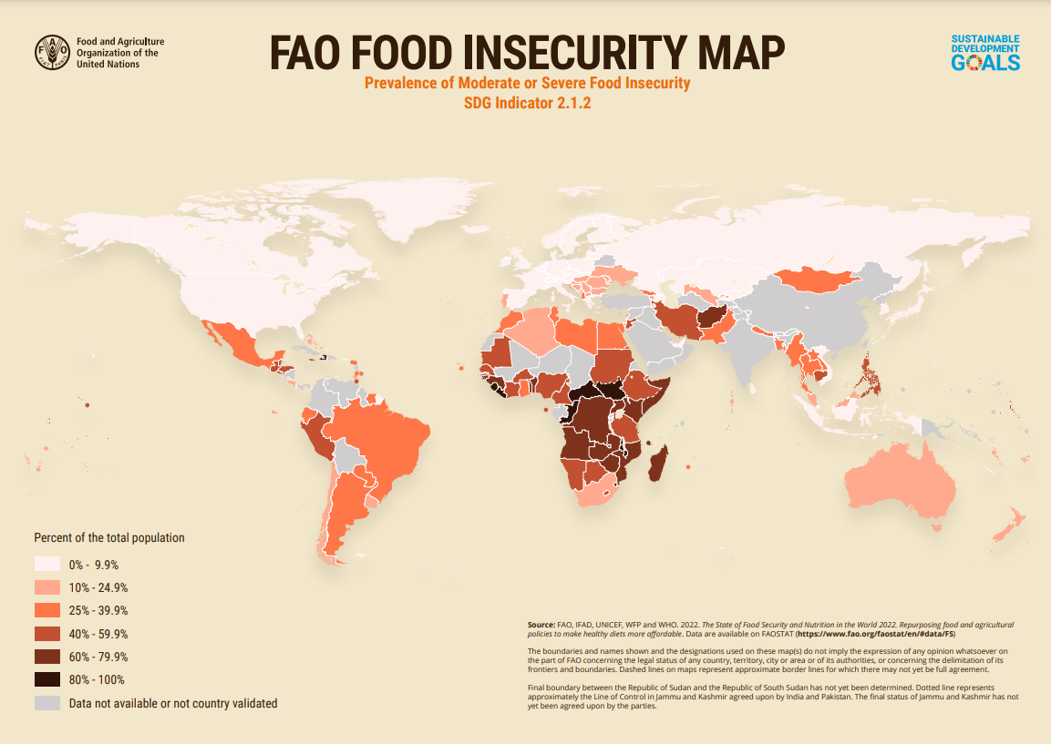

Slide 15

“Facing Food Insecurity on the Front Lines” by Sara Aridi The New York Times April 10, 2020

Slide 16

A recent statewide survey, conducted in April by Hunger Free Colorado, found 1 in 3 (33%) of Coloradans are food insecure, meaning they lack reliable access to nutritious food.
Even more startling is the clear inequities along racial and demographic lines when examining hunger and income loss. Long-standing disparities in access to healthy food have grown dramatically due to the pandemic and 43% of non-white and Latinx individuals are now struggling to put food on the table, compared to 29% of white Coloradans.
Households with children also remain at the forefront of Colorado’s hunger crisis, with 44% unable to consistently put healthy food on the table, posing risks to the long-term health and well-being of hundreds of thousands of children across the state. Among households with children,30% of adults reported having to regularly cut back or skip meals because there wasn’t enough money to buy food.
https://hungerfreecolorado.org/partner-with-us/initiatives/covid-food-insecurity-survey/

Slide 17
Assessment and Treatment of Malnutrition
Notes:
Key Findings
According to the recent statewide survey:
1 in 5 Colorado households (21%) consider hunger a top concern
1 in 3 (33%) of Coloradans are food insecure, meaning they lack reliable access to nutritious food, with people of color and households with children facing even higher levels of hunger
Forty-three percent of non-white and Latinx individuals are now struggling to put food on the table, compared to 29% of white Coloradans
Almost half of households with children (44%) are struggling to have regular access to
nutritious food
1 in 5 adults in Colorado (20%) reported having to cut back or skip meals because there wasn’t enough money to buy food. Among non-white or Latinx households that rose to 26%.
1 in 6 children (16%) are not getting adequate nutrition because there is not
enough money for food
Forty-five percent of Coloradans identified the high cost of healthy food as a problem
for their household

Slide 18
Vulnerable Groups
Children < 5 years
Children removed from their family or community
Pregnant or Lactating Women
Families supported only by women
Physically or Emotionally Disabled
Individuals with Chronic Disease
Elderly
Families having lost their home or job as a result of the disaster
Notes:
See www.spoonfoundation.org

Slide 19
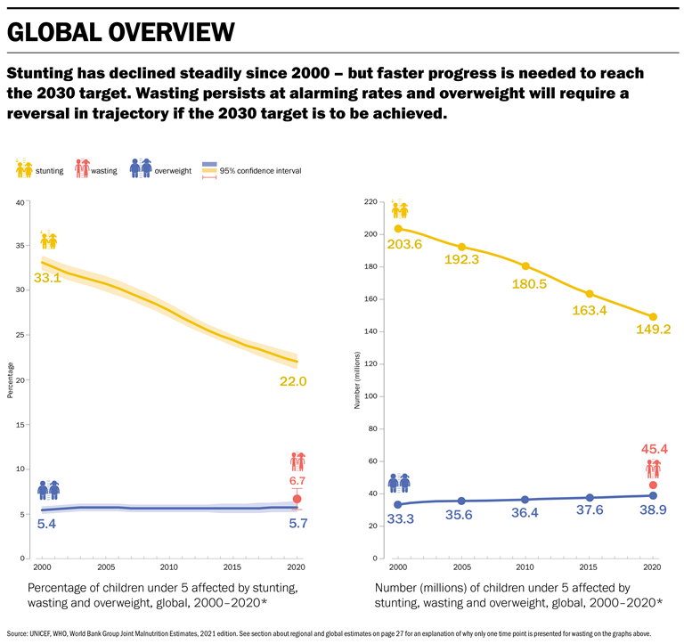
Current Trends in Childhood Malnutrition

Slide 20
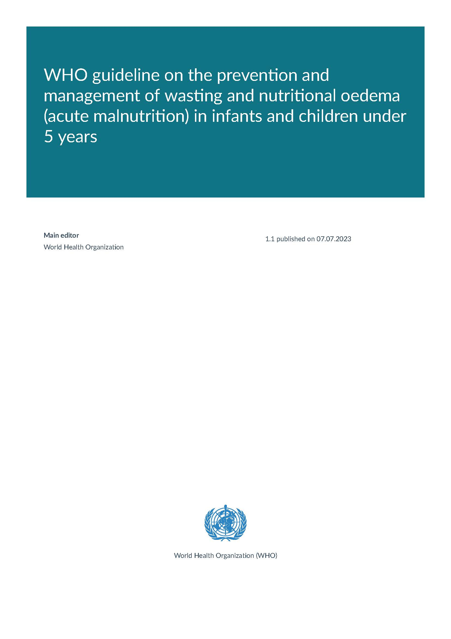
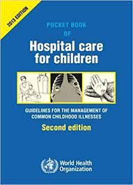
Resources

Slide 21
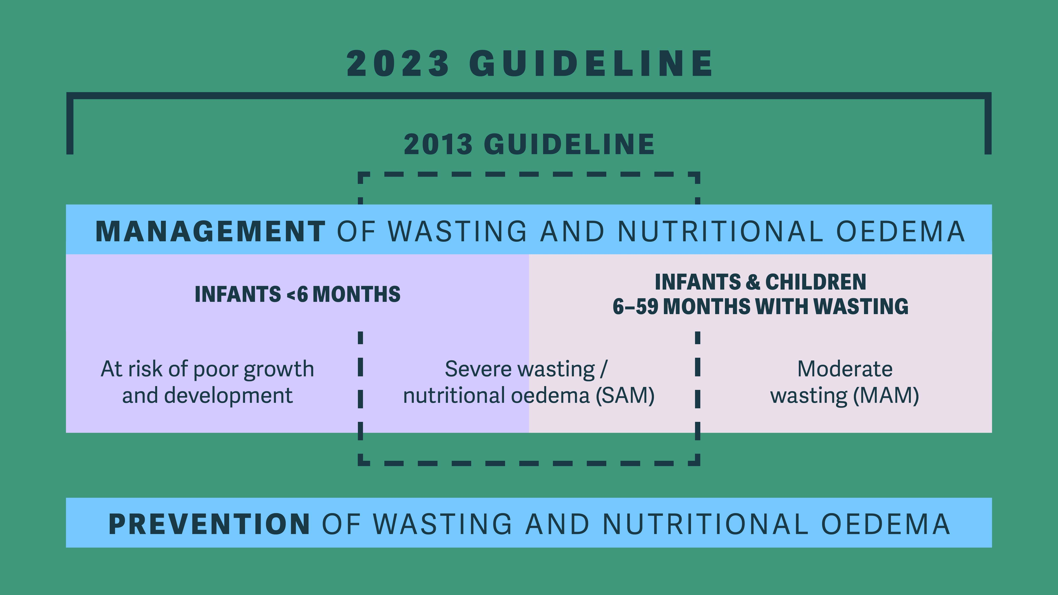

Slide 22

Identification of Malnutrition
Nutritional Status | MUAC* | W/H z-score | Bilateral Edema
Moderate Acute Malnutrition | 115-125 mm | -2 to -3 SD
Severe Acute Malnutrition | < 115 mm | < -3 SD | X
Sample text
*MUAC <110 mm may be used to identify infants between 6 weeks and 6 months at risk for poor growth and development.
W/A Z-score < -2 may be used to identify infants <6 months at risk for poor growth and development.
W/A Z-score < -3 may be used to identify children 6 – 59 months who should be prioritized for specially formulated foods.

Slide 23

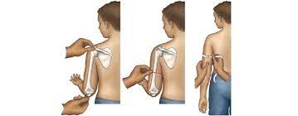
Measuring MUAC

Slide 24
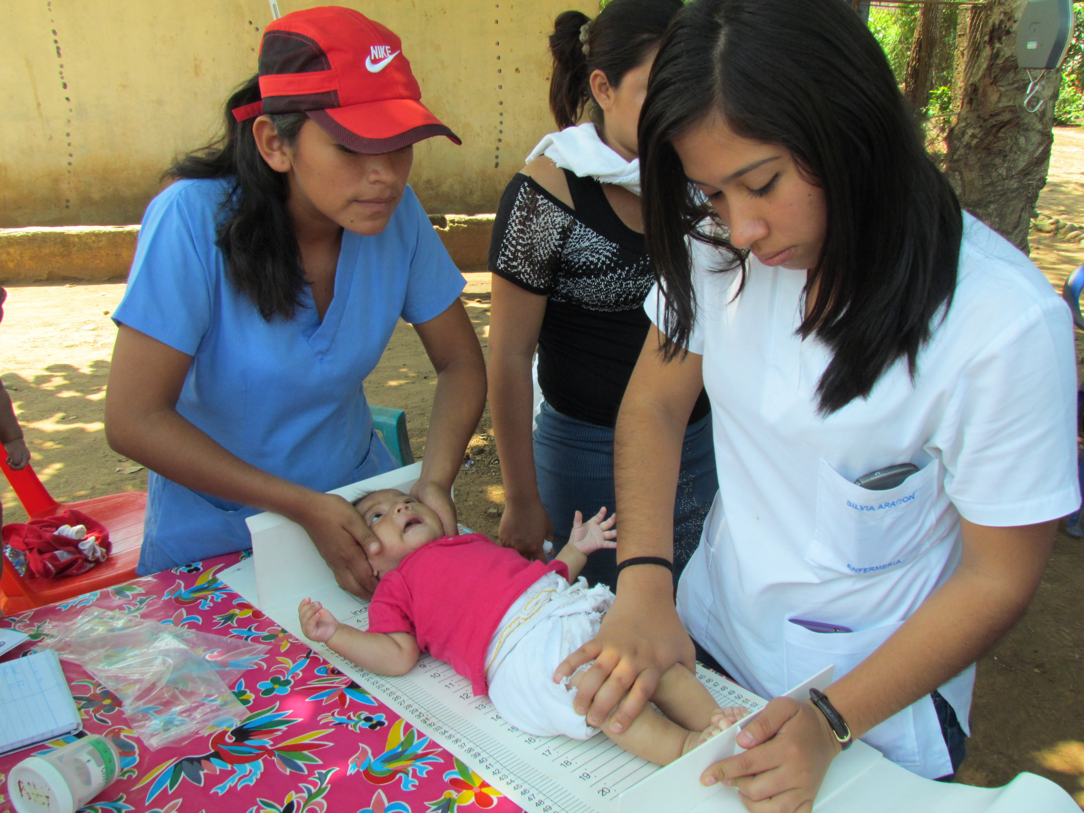

Measuring W/H

Slide 26
Marasmus and Kwashiorkor
Marasmus
Kwashiorkor
Emaciation / wasting
Apathy / Irritability
Appetite Preserved
Edema
Enlarged Liver and Spleen (Hepatosplenomegaly)
Hair and Skin Changes
Decreased Appetite

Slide 27

Treatment of Wasting and Nutritional Edema in children 6-59 months

Slide 28
Good Practice Statement
B1. Infants and children must be triaged as soon as they enter a health facility or have contact with a health worker in order to ensure that those with emergency or danger signs receive immediate life-saving care and that all others receive appropriate care as per their clinical status and classification. Identification of nutritional status is a vital aspect of this initial assessment in order to ensure that children with severe wasting and/or nutritional oedema receive prompt and appropriate interventions.

Slide 29
Meeting Outpatient Criteria?
Meeting Admission Criteria?
CMAM
In-Depth Assessment Needed?
No
Yes
Hospital
ITFC
Meeting Discharge Criteria?
Yes
No
Discharge from Care
Meeting Discharge Criteria?
Yes

Slide 30
Meeting Outpatient Criteria?
One or more IMCI General Danger Signs*; or
Acute Medical Problems**; or
Severe Nutritional Edema (+++); or
Poor Appetite (failed appetite test)
Good Appetite (passed appetite test); and
No danger signs or any acute medical problems; and
No criteria needing in-depth assessment or criteria needing in-depth assessment has been evaluated and no inpatient admission is needed
CMAM
Meeting Admission Criteria?
Medical Problems that do not need immediate inpatient care, but do need further examination and investigation;
Medical Problems needing mid or long-term follow up care and with a significant association with nutritional status;
Failure to gain weight or improve clinically in outpatient care;
Previous episodes of severe wasting and/or nutritional edema.
No
Yes
In-Depth Assessment Needed?
Hospital
ITFC
Meeting Discharge Criteria?
Yes
No
Discharge from Care
Meeting Discharge Criteria?
Yes
Notes:
*IMCI General Danger Signs: Not able to drink or breastfeed; vomits everything; recently had convulsions; lethargic or unconscious; convulsing now
**Acute Medical Problems needing inpatient care per IMCI classification:
shock
hypoglycaemia (measured) persistent after initial emergency corrective treatment
oxygen saturation <90%
pneumonia (with chest indrawing; and/or fast breathing; and, if possible to measure, oxygen saturation <94%)
dehydration (including some or severe dehydration)
severe persistent diarrhoea (diarrhoea for 14 days or more plus dehydration)
very severe febrile illness – in a malaria zone or with a positive rapid diagnostic test (RDT), this is treated as severe malaria
very severe febrile illness – where there is no risk of malaria or with a negative RDT, this is treated as bacterial disease, e.g. meningitis, etc.
severe complicated measles
mastoiditis
severe anaemia (severe palmar pallor or Hb <4g/dL or Hb 4-6g/dL with signs of decompensation)
severe side effects from antiretroviral therapy (for HIV) – skin rash, difficulty breathing and severe abdominal pain, yellow eyes, fever, vomiting
open or infected skin lesions associated with nutritional oedema
other stand-alone “priority clinical signs” not classified as dangers signs: hypothermia (<35°C axillary or 35.5°C rectal) or high fever (≥38.5°C axillary or 39°C rectal).

Slide 31
Meeting Outpatient Criteria?
No Danger Signs for at least 24-48 hours prior to transfer; and
The medical problems that prompted admission have resolved to the point that inpatient care is no longer needed; and
They do not have on-going weight loss (among children with severe wasting only who did not have nutritional edema at any time); and
Nutritional edema is resolving and is no longer +++; and
They have good appetite; and
All attempts have been made to refer children with medical problems needing mid or long-term follow up and significant association with nutritional status to appropriate care/support services and/or the limits of inpatient care have been reached.
Upon deciding to transfer patients from inpatient to outpatient care, caregivers must be linked to appropriate outpatient care with nutrition services.
Additional social and family factors should be identified and addressed before transfer to outpatient care in order to ensure that the household has the capacity for care provision.
CMAM
Meeting Admission Criteria?
WHZ or WLZ > -2 SD and MUAC > 125 mm for at least 2 consecutive visits/measurements; and
There is no nutritional edema for at least 2 consecutive visits/measurements.
Children with medical problems needing mid to long-term follow up and with a significant association with nutritional status and/or additional social factors have also been referred to appropriate care/support services and/or the limit of outpatient care has been reached for severe wasting / nutritional edema.
In-Depth Assessment Needed?
No
Yes
Hospital
ITFC
Meeting Discharge Criteria?
Yes
No
Discharge from Care
Meeting Discharge Criteria?
Yes

Slide 32
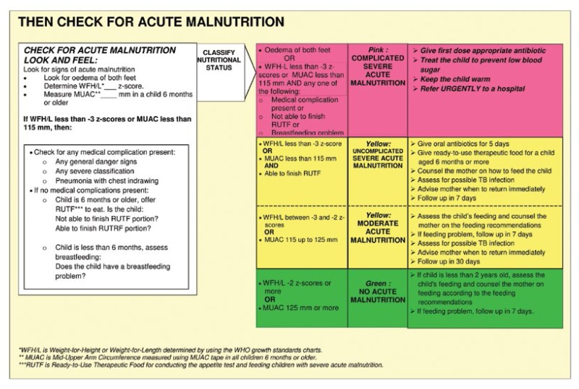

Slide 33
Appetite Test
Notes:
May not be appropriate for children with a disability.

Slide 35
Inpatient treatment
Strong recommendation for , Very low certainty evidence
Phase 1: Stabilization (3-7 days)
  Stabilize and Treat Medical Conditions
    Give parenteral antibiotics to treat possible sepsis and appropriate treatment for other medical complications such as TB, HIV, surgical conditions or disability;
  Start re-feeding at 100 kcal/kg/day (130 mL/kg/day); Protein 1-1.5 mg/kg/day
  Use Low osmolality, low lactose formula (F75)
Phase 2: Transition (1-5 days)
  Transition F75 to F100 or RUTF over 2-3 days
  On 3rd day increase 10 mL of F100 per feed until some remains uneaten

Slide 36
Therapeutic Milk
F75
F100
75 kcal energy, 0.9 g protein per 100 mL
Used for stabilization
Used for initial stage of recovery, not intended for weight gain
‘starter feeding formula’
On average used for 2-7 days
SAM with medical complication
100 kcal energy, 2.9 g protein per 100 mL
Used for growth and recovery
Used for rehabilitation phase for rapid weight gain after appetite has returned
‘catch up’ formula
Used for longer duration
SAM without complications

Slide 37
Outpatient Management
Weight Monitoring
Education - Nutrition and Hygiene
Education - Home –prepared Nutrient Dense Foods
Mental Health
Referral System
Provide Supplemental Food

Slide 38
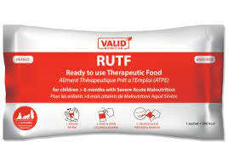
Community Management of Severe Acute Malnutrition in Children 6 – 59 months
Promote rapid weight gain and catch up growth
5 day course of a broad spectrum antibiotic such as amoxicillin
Give RUTF in a quantity that provides 150-185 kcal/kg/day until anthropometric recovery or resolution of nutritional edema; or
Give RUTF in a quantity that provides 150-185 kcal/kg/day until the child is no longer severely wasted and is having resolution of nutritional edema, then the quantity can be reduced to 100-130 kcal/kg/day until anthropometric recovery and resolution of nutritional edema

Slide 39
Good Practice Statement
B11. Infants and children aged 6–59 months of age with moderate wasting (defined as a weight-for-height between 2 and 3 z-scores below the WHO child growth standards median and/or a mid-upper arm circumference 115 mm or more and less than 125 mm, without oedema) should have access to a nutrient-dense diet to fully meet their extra needs for recovery of weight and height and for improved survival, health, and development.
B12. All infants and children 6-59 months of age with moderate wasting should be assessed comprehensively and treated wherever possible for medical and psychosocial problems leading to or exacerbating this episode of wasting.

Slide 40
B13. Prioritizing specially formulated food (SFF) interventions with counselling, compared to counselling alone, should be considered for infants and children 6-59 months of age with moderate wasting with any of the following factors.
Individual child factors:
mid-upper arm circumference (MUAC) 115-119mm
weight-for-age z-score (WAZ) <-3 SD
age <24 months
failing to recover from moderate wasting after receiving other interventions (e.g. counselling alone)
having relapsed to moderate wasting
history of severe wasting
co-morbidity (medical problems needing mid or long-term follow-up care and with a significant association with nutritional status such as HIV and tuberculosis or a physical or mental disability)
Social factors:
severe personal circumstances, such as mother died or poor maternal health and well-being.

Slide 41

B14. In high-risk contexts (where there is a recent or ongoing humanitarian crisis), all infants and children 6-59 months of age with moderate wasting should be considered for specially formulated foods (SFFs) along with counselling and the provision of home foods for them and their families.
© European Union, 2022 (photographer: Eduardo Soteras Jalil)

Slide 42
Supplementary Foods
Specially formulated foods (SFFs)
For the purpose of this guideline, specially formulated foods are defined as foods that have been specifically designed, manufactured, distributed, and used for either: special medical purposes or for special dietary uses, as defined by Codex Alimentarius.
Ready-to-use supplementary food (RUSF) RUSF is a fortified lipid-based paste/spread used for the supplementation of children with moderate wasting. It should not be used for the nutritional treatment of severe wasting and/or nutritional oedema.
Ready-to-use therapeutic food (RUTF) RUTF is a food for special medical purposes (Codex Alimentarius), and includes pastes/spreads and compressed biscuits/bars used for the nutritional treatment of children with severe wasting and/or nutritional oedema.
Fortified Blended Foods (FBFs) FBFs are blends of partially precooked and milled cereals, soya, beans, pulses fortified with micronutrients (vitamins and minerals). Special formulations may contain vegetable oil or milk powder and need to be cooked, sometimes with added sugar, oil and milk.

Slide 43
Conditional Recommendations
Moderate Wasting 6- 59 months of age Specially formulated foods (SFFs) 40-60% of the total daily energy requirements needed to achieve anthropometric recovery. Total daily energy requirements needed to achieve anthropometric recovery are estimated to be around 100-130 kcal/kg/day.

Slide 44
Treatment of Infants < 6 months at risk for poor growth and development

Slide 45
Good Practice Statement
A1. Mothers/caregivers and their infants less than 6 months of age at risk of poor growth and development should receive regular care and monitoring by health professionals. The immediate goal is the early detection of any acute medical or psychological problems and preventing infants from becoming severely underweight or severely wasted. The longer-term goal of this regular care and monitoring is to enable these infants to grow and develop in a healthy way that can lead to them achieving their full potential, whilst simultaneously supporting their mothers/caregivers with their own health and wellbeing. This approach recognizes the importance of acknowledging and caring for the mother/caregiver and infant as an inter-dependent pair for both to survive and thrive.

Slide 46
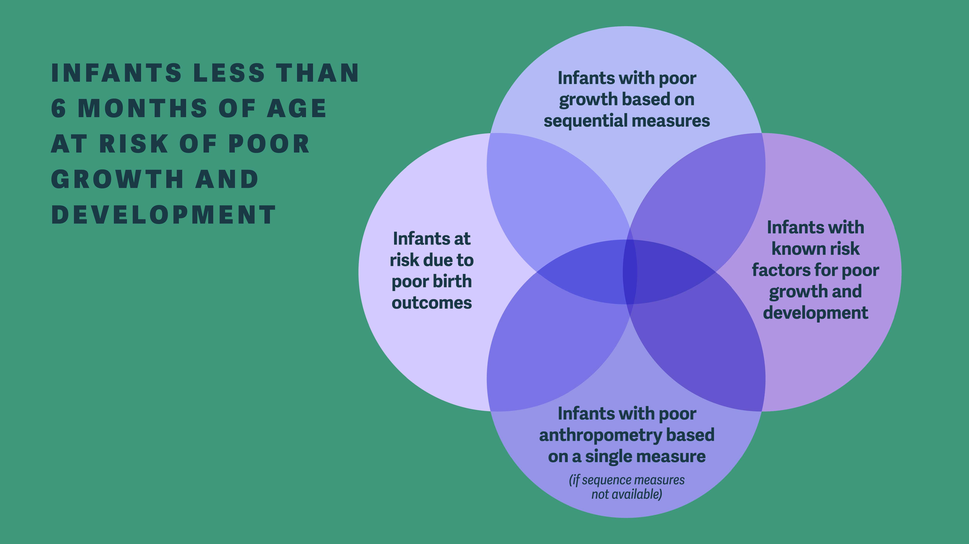
Notes:
Poor growth based on Sequential Measures:
No weight gain or weight loss from one measurement to the next; or
Downward crossing of weight-for-age centile lines1; or
Insufficient weight gain (velocity standards2 or grams/per specific time period3).
Known Risk Factors for Poor growth and Development:
Neurodevelopmental concerns; or
Infant feeding concerns; or
Maternal risk (physical or mental health problem(s) affecting caring practices); or
History of hospitalization.
Infants with poor anthropometry based on a single measure:
Weight-for-age z-score (WAZ) <-2 SD; or
Weight-for-length z-score (WLZ) <-2 SD; or
Nutritional oedema; or
Mid-upper arm circumference (MUAC) <110mm for infants between 6 weeks to less than 6 months of age.
Infants at Risk due to poor birth outcomes:
Preterm birth; or
Low birth weight; or
Small for gestational age

Slide 47
Meeting Outpatient Criteria?
Meeting Admission Criteria?
CMAM
In-Depth Assessment Needed?
No
Yes
Hospital
ITFC
Meeting Discharge Criteria?
Yes
No
Discharge from Care
Meeting Discharge Criteria?
Yes

Slide 48
Meeting Outpatient Criteria?
One or more IMCI danger signs
Acute medical problems or conditions under severe classification as per IMCI
Oedema (nutritional)
Recent Weight Loss
No Danger Signs or any criteria needing admission; No criteria needing in-depth assessment or criteria are present but an in-depth assessment has been completed and determined that inpatient admission is not needed.
Meeting Admission Criteria?
CMAM
Medical problems that do not need immediate inpatient care but do need in-depth assessment
Medical problems needing mid or long term follow up care and have significant association with nutritional status
Anthropometric criteria indicating risk for poor growth and development or failure to gain weight on 2 consecutive visits
Ineffective breastmilk or perceived breast milk insufficiency
Feeding concerns for non-breast fed infants
Maternal related or social issue needing more detailed assessment or intensive support.
No
Yes
Hospital
ITFC
Meeting Discharge Criteria?
In-Depth Assessment Needed?
Yes
No
Discharge from Care
Meeting Discharge Criteria?
Yes

Slide 49
Meeting Outpatient Criteria?
Meeting Admission Criteria?
CMAM
In-Depth Assessment Needed?
No
Yes
Breastfeeding effectively or feeding well with replacement feeds; and
Have sustained weight gain for at least 2 consecutive weekly visits.
* Infants <6 months of age at risk for poor growth and development should be assessed at 6 months of age to determine if they need on-going follow-up or referral to services for infants 6 months of age or older based on their clinical and nutritional status.
Hospital
ITFC
Meeting Discharge Criteria?
There have been no danger signs at least 48 hours prior to discharge; and
All acute medical problems are resolved; and
Nutritional oedema is resolving; and
The infant has a good appetite; and
Documented weight gain is satisfactory on either exclusive breastfeeding or replacement feeding; and
All attempts have been made to refer the infant with medical problems needing mid or long-term follow up care with a significant association with nutritional status to appropriate care / support services and/or the limits of inpatient care have been reached; and
The infant has been checked for immunizations and other routine interventions delivered or plans made for follow-up; and
The mothers / caregivers are linked with needed follow-up care and support.
Yes
No
Discharge from Care
Meeting Discharge Criteria?
Yes

Slide 50
Good Practice Statement
A5. For infants less than 6 months of age at risk of poor growth and development, health care providers should conduct comprehensive assessments of the mother/caregiver-infant pair and follow best practices for the management of breastfeeding/lactation challenges and underlying factors contributing to these challenges.
A6. Decisions about whether an infant less than 6 months of age at risk of poor growth and development needs a supplementary milk in addition to breastfeeding must be based on a comprehensive assessment of the medical and nutritional/feeding needs of the infant, as well as the physical and mental health of the mother/caregiver. This applies to infants who are enrolled in outpatient care or admitted into inpatient care.
Infants who are less than 6 months of age with severe wasting and/or nutritional oedema should receive the same general medical care as infants with severe wasting and/or nutritional oedema who are 6 months of age or older

Slide 51
Inpatient treatment of severe wasting and nutritional edema in infants < 6 mos
Parenteral antibiotics and treatment of any other medical conditions
Prioritize establishing or re-establishing effective breastfeeding
  If infant not breast fed mother / caregiver should be encouraged to re-lactate
  Encourage wet-nursing
Supplementary feeding of infants without edema with EBM, infant formula, F-75 or diluted F-100.
  There is insufficient evidence to recommend switching infants who are not tolerating F-75 or F-100 to hydrolyzed formulas
Supplementary feeding of infants with edema give infant formula or F-75 in addition to breast milk.
  Infants who are clinically unstable or have nutritional edema, diarrhea, or dehydration should NOT be given full strength F-100 due to renal solute load and risk of hyponatremic dehydration.
If no realistic prospect of breast feeding give adequate replacement (infant formula), and relevant support for safe preparation and use after discharge.
Assessment of the physical and mental health status of mothers or caregivers should be promoted and relevant treatment or support provided.

Slide 52
Community Management of Infants < 6 months at risk for poor growth and development
Administer broad spectrum oral antibiotic such as amoxicillin
  Only infants with severe wasting and/or nutritional edema
Prioritize establishing or re-establishing effective breastfeeding
  If infant not breast fed mother / caregiver should be encouraged to re-lactate
  Encourage wet-nursing
Supplementary feeding of infants with EBM, infant formula, F-75 or diluted F-100.
Provide counseling and support for optimal infant and young child feeding.
Weekly weight monitoring
Assessment and support of medical and mental health of caregivers
Refer to inpatient care if infant does not gain or loses weight while the caregiver is receiving breastfeeding support

Slide 53
Other therapies
Vitamin A
  High Dose should be given to children with SAM and eye findings of Vitamin A deficiency, recent measles infection, or who are not receiving adequate (5000 IU) daily as part of therapeutic foods or multi-micronutrient supplementation.
Iron
  Give 3 mg/kg/day x 3 months of elemental iron once children have been on F-100 x 2 days. Do NOT give during the stabilization phase of treatment or if the child is receiving RUTF.
Zinc
  10-20 mg/day in children with SAM and diarrhea (already included in therapeutic foods)
Treatment for intestinal worms
  If there is evidence of infestation delay treatment until the rehabilitation phase.
  Give a single dose of Albendazole or Mebendazole 100 mg twice daily x 3 days.
  If in an area where infestation is prevalent, give Mebendazole to all children after 7 days of treatment.

Slide 54
Other therapies
High dose Vitamin A given on day 1,2 and 14 of treatment
< 6 mos 50,0000 IU;
6-12 mos 100,000 IU;
12+ mos 200,000 IU
Vitamin A
  High Dose should be given to children with SAM and eye findings of Vitamin A deficiency, recent measles infection, or who are not receiving adequate (5000 IU) daily as part of therapeutic foods or multi-micronutrient supplementation.
Iron
  Give 3 mg/kg/day x 3 months of elemental iron once children have been on F-100 x 2 days. Do NOT give during the stabilization phase of treatment or if the child is receiving RUTF.
Zinc
  10-20 mg/day in children with SAM and diarrhea (already included in therapeutic foods)
Treatment for intestinal worms
  If there is evidence of infestation delay treatment until the rehabilitation phase.
  Give a single dose of Albendazole or Mebendazole 100 mg twice daily x 3 days.
  If in an area where infestation is prevalent, give Mebendazole to all children after 7 days of treatment.

Slide 55

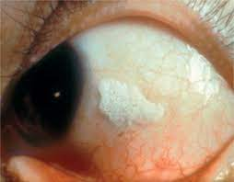
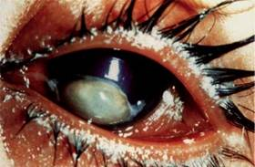
Eye Findings of Vitamin A Deficiency
Xerophthalmia
Bitot’s Spot
Corneal Ulceration

Slide 56
References
Emergency Food Security Assessment Handbook 2nd Edition, World Food Programme, Rome, Italy 2009 https://www.fao.org/publications/sofi/2022/en/
The State of Food Security and Nutrition in the World, Food and Agriculture Organization of the United Nations, Rome, Italy 2022 https://www.fao.org/publications/sofi/2022/en/
The Sphere Handbook, Humanitarian Charter and Minimum Standards in Humanitarian Response 4th ed Geneva, Switzerland 2018 https://spherestandards.org/handbook/
Food and Nutrition Technical Assistance III Project (FANTA). 2018. Training Guide for Community-Based Management of Acute Malnutrition (CMAM). Washington, DC: FHI 360/FANTA.
WHO E-Library of Evidence for Nutritional Actions (eLENA) https://www.who.int/elena/en/
Pocket Book of Hospital Care for Children: Guidelines for the Management of Common Childhood Illnesses 2nd edition, WHO 2013 https://www.who.int/maternal_child_adolescent/documents/child_hospital_care/en/
World Health Organization. WHO guideline on the prevention and management of wasting and nutritional oedema (acute malnutrition) in infants and children under 5 years. 2023.
Levels and trends in child malnutrition, UNICEF / WHO / World Bank Group Joint Child Malnutrition Estimates https://www.who.int/publications/i/item/9789240025257

