Slide 1


Initial Care of the Newborn
Module 7

Slide 2
INITIAL CARE OF THE NEWBORN: OBJECTIVES
Anticipate neonatal resuscitation
(plan, recognize risks, check equipment)
Identify the newborn making a normal transition immediately after birth
Identify the newborn requiring resuscitation
Describe and provide effective neonatal resuscitation interventions
Notes:
These are the goals for neonatal resuscitation. Anticipation of neonatal resuscitation is essential; it includes setting and personnel planning, risk assessment and a review of the equipment needed. Identification of newborns that are not making a normal transition is the previous step to give effective resuscitation therapy.

Slide 3
NEONATAL ASPHYXIA
Accounts for over one million deaths per year
  Intrapartum stillbirths and neonatal deaths
In Latin America ≈ 12% of newborns suffer some degree of asphyxia
A major cause of perinatal and neonatal death
  Risk increased under disaster circumstances
Associated with irreversible neurological long-term complications
Notes:
In Latin America, 12% of newborns suffer neonatal asphyxia, the main cause of perinatal and neonatal death, with a million deaths per year and irreversible neurological sequels in many surviving infants. In a disaster situation, a greater proportion of newborns will need immediate resuscitation because of the adverse context affecting the delivery.

Slide 4
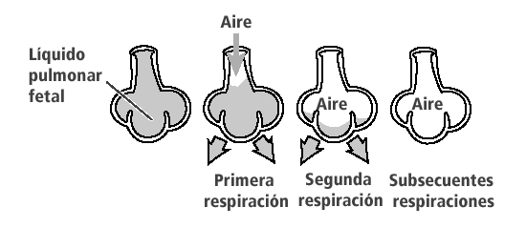
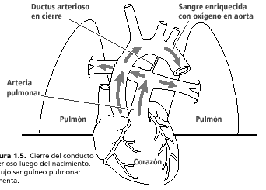
NORMAL TRANSITION
Air
Closed ductus arteriosus
Blood enriched by oxygen from aorta
Ductus arteriosus
Aorta
Fetal lung liquid
Air
Air
Pulmonary artery
Pulmonary
artery
Second breathing
First breathing
First Second Subsequent breath breath breaths
Subsequent breathings
Lung
Lung
Heart
Notes:
This slide shows the respiratory and cardiovascular changes in newborns making a normal transition.

Slide 5
SUCCESSFUL RESUSCITATION
ANTICIPATION—ORGANIZE PLAN
Assume that there will be deliveries in every disaster situation (10% of newborns may require resuscitation)
Identify personnel with skills in neonatal resuscitation- to form a resuscitation team
Review/test equipment, procedures, and teamwork
Plan prompt maternal assessment and identify a referral mechanism (communication and transportation)
Notes:
Always anticipate a problematic scenario in disasters. Prompt maternal assessment. Assume that the infant will need resuscitation (approximately 10% does). Review equipment, procedures, and identify personnel with experience in resuscitation. Ensure that there will be at least one person during delivery whose main responsibility is the newborn. He or she should be capable of initiating and providing a complete resuscitation, including PPV (positive pressure ventilation) administration, cardiac massage, endotracheal intubation and administration of medications.

Slide 6
RISK IDENTIFICATION
Before Delivery- eg. maternal age, maternal illness, preterm gestation, fetal distress
During Delivery- eg. rapid labor, prolonged labor, meconium, excessive bleeding

Slide 7
EQUIPMENT
Hand hygiene products (alcohol, soap and water); clean gloves
Cord ties/clamps, razor blade or scissors
Clean cloths for drying and wrapping the infant (hat)
Self-inflating ventilation bag, masks (preterm, term)
Suction device
Stethoscope
Endotracheal tubes, laryngoscope, intravenous administration sets
A form of identification (e.g. a bracelet)
Notes:
Review and check carefully the equipment needed for a complete resuscitation. For further detail, check the neonatal resuscitation manual from the American Association of Pediatrics.
Always perform adequate identification before cutting the umbilical cord by taking footprints together with the mother’s fingerprint. Provide an identification bracelet, if available. This issue is critical in cases of administrative disorder, as is usually the case in acute humanitarian emergencies. Even if resuscitation is required, show the baby to the mother, at least for a few seconds. When possible, skin to skin contact is desirable.
Use of endotracheal tubes, iv administration sets, and laryngoscope requires skilled personel

Slide 8
IDENTIFY THE NEED
FOR RESUSCITATION
Three primary questions when assessing any newborn
1. Is this a full-term gestation?
2. Is the baby breathing or crying? KEY QUESTION!
3. Is muscle tone appropriate?
Notes:
How do we know if resuscitation is needed? See the following questions:
1. Is this a full-term gestation?
Preterm newborns are more likely to require resuscitation tahn full-term babies
2. Is the baby breathing or crying?
Apnea or inadequate respiratory effort are the most frequent indications for resuscitation.
3. Is muscle tone appropriate?
Poor muscle tone might indicate hypoxemia

Slide 9
NEONATAL RESUSCITATION
SEQUENCE
A (Airway)
B (Breathing)
C (Circulation)
D (Drugs, medications)
Notes:
Different order than the updated ALS/PALS
A fourth element is added to our list: medications.

Slide 10
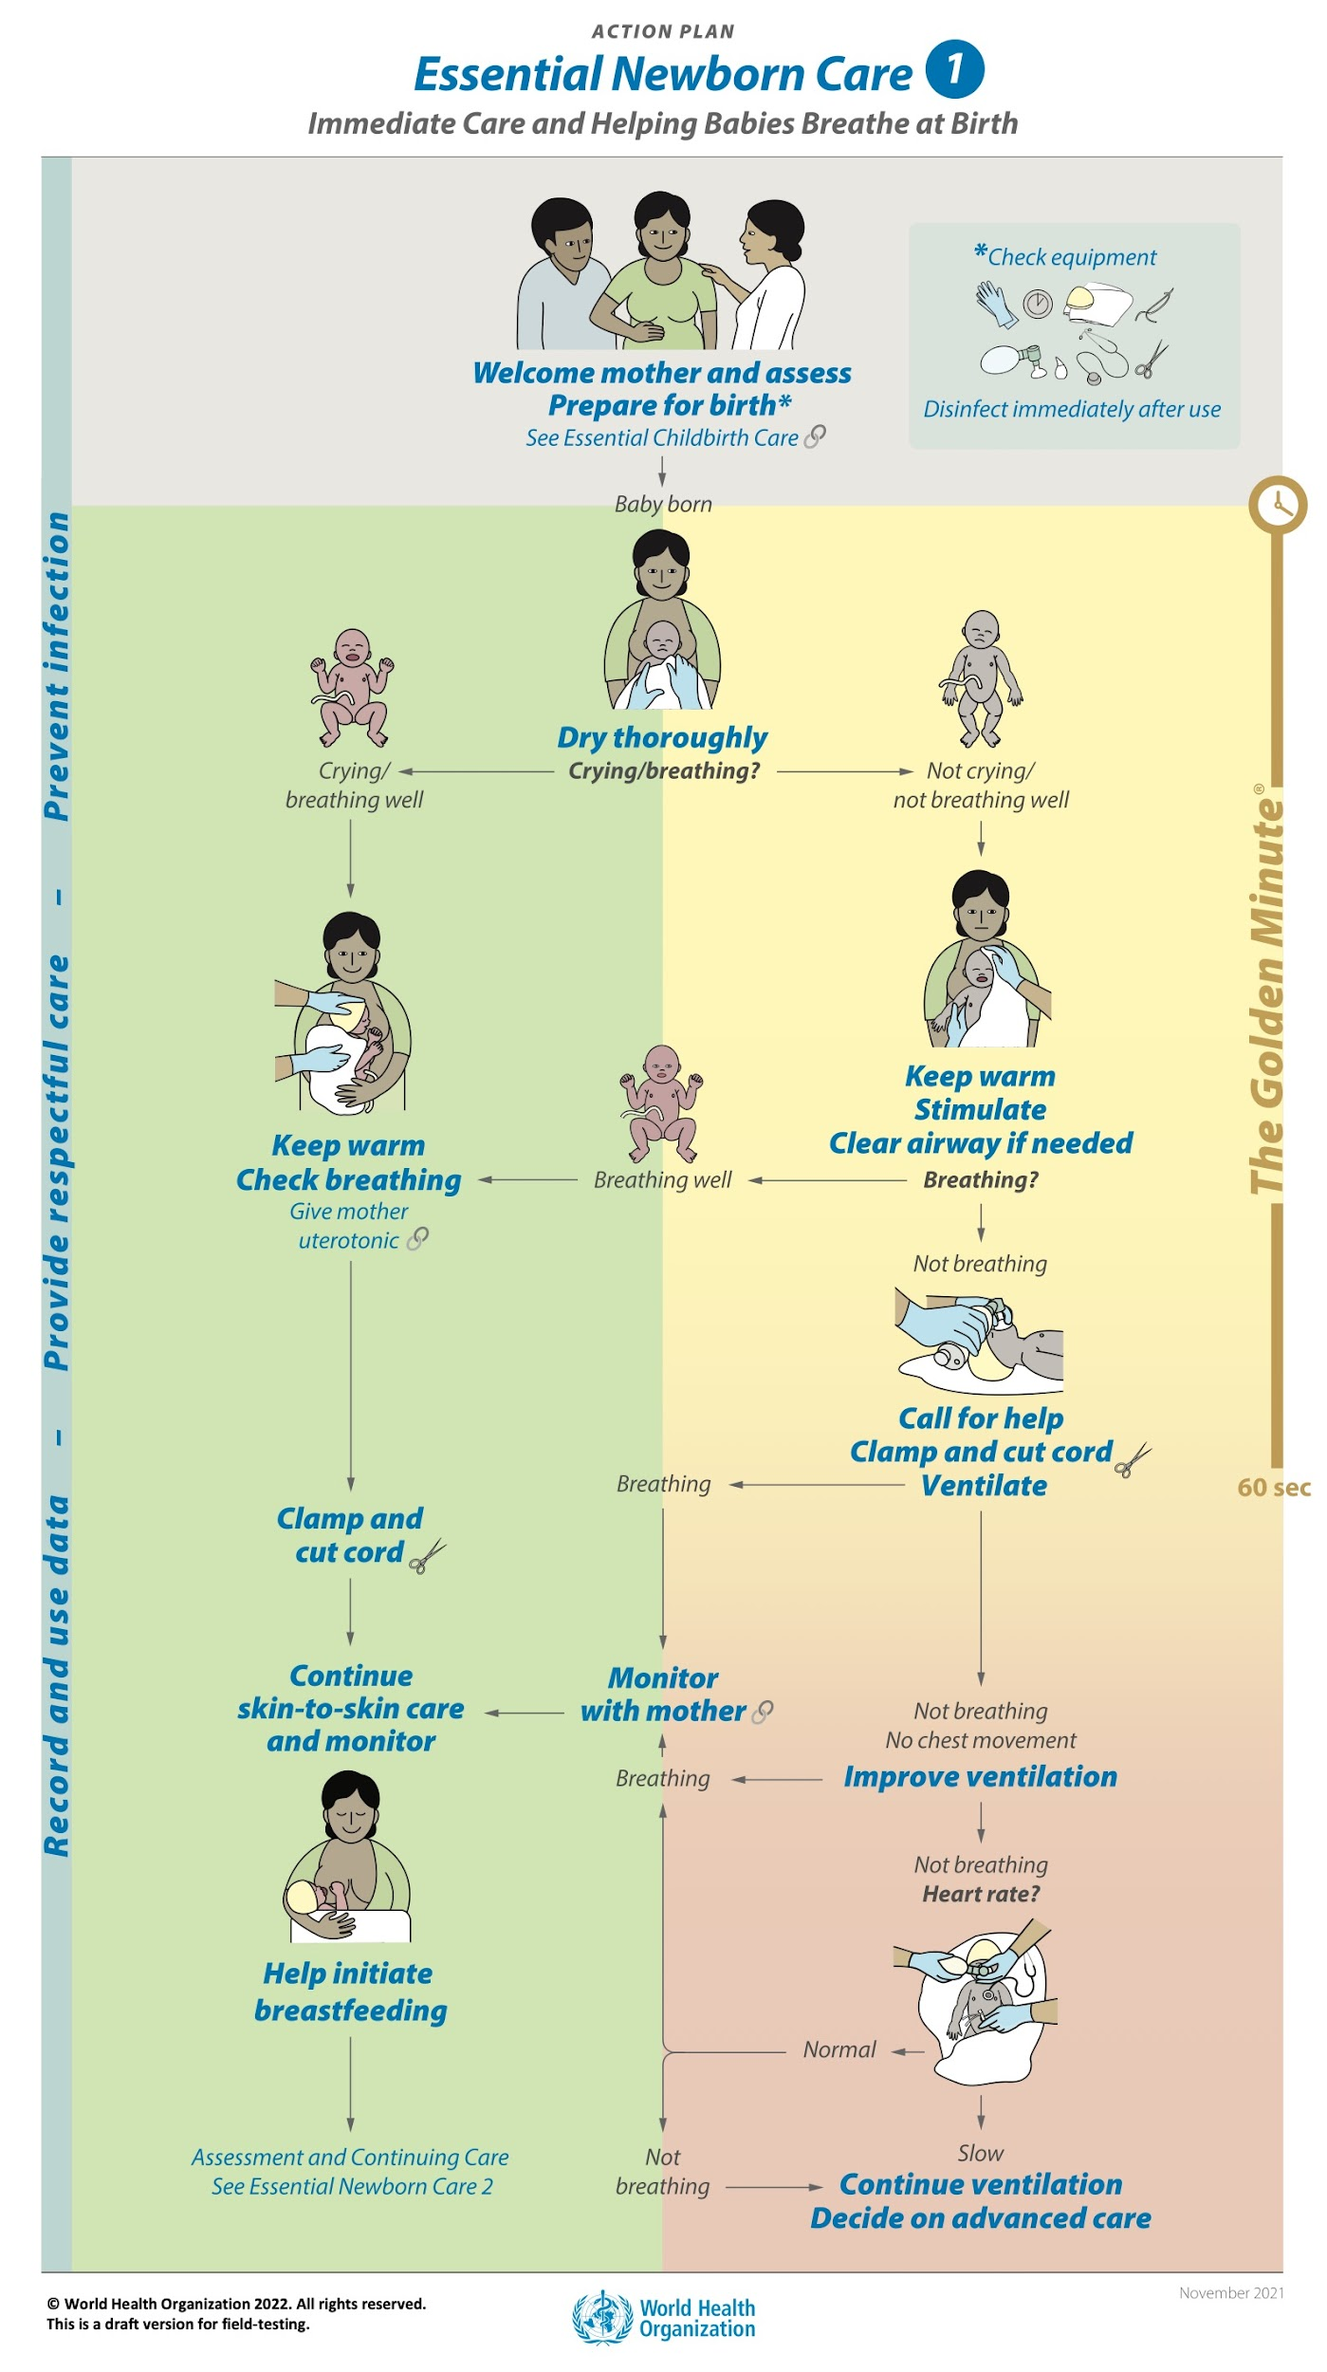

Slide 11
INITIAL NEONATAL RESUSCITATION SEQUENCE
Thermal protection - for all
Drying - for all
Stimulation- as required
Positioning to maintain open airway - for all
Airway clearing- as required
Always maintain good hand hygiene and avoid contamination
Notes:
This is the sequence for neonatal resuscitation. We will examine each step carefully. It will never be overemphasized that hygiene conditions are critical to avoid contaminating the infant. In a disaster situation, conditions may vary greatly, but every effort made in this direction will avoid future problems.

Slide 12
ADDING INITIAL STEPS
If not crying or breathing well or poor muscle tone (or preterm), begin the initial steps of resuscitation
  • Provide thermal control
    - Dry thoroughly and place baby skin-to-skin with mother
    - Cover head and body
  • Position to keep the airway open
    Clear airway (as necessary)
    - Wipe mouth and nose with a clean cloth/suction
    • Stimulate to breathe
Notes:
If the answers to the first 4 questions were “no”, you should proceed with these steps. Control baby’s temperature. Dry the baby and cover him or her with a dry cloth. Clear the airway, if necessary, with a clean cloth. Consider the timing for each resuscitation procedure, and rapidly assess breathing, heart rate and color.

Slide 13
THERMAL PROTECTION
Dry thoroughly
Maintain skin-to-skin contact with mother
Cover head
Use radiant heating - if necessary
Avoid direct contact with heating elements
Notes:
Dry the baby rapidly to reduce evaporation, but avoid hyperthermia. Radiant heating is typically used, if available. If resuscitation is required, wrap the infant in plastic film to reduce cold stress and cover the baby’s head with a cap. Do not cover with clothes or towels while resuscitating. For transportation, a sick baby may be covered (head out) in a plastic bag. Avoid extensive burns, common with inadequate heating elements that need direct contact (pads, bottles or gloves with hot water).

Slide 14
PRETERM: PROVIDE
A WARM ENVIRONMENT
Increase temperature of delivery environment (if possible)
Place skin-to-skin with mother and cover head
Place a thermal mattress below the towels or sheets
In newborns <32 weeks, wrap from the neck down in plastic film or plastic bag
Notes:
Preterms may require more important thermal control. Consider these alternatives to provide the baby with a warm environment. Some of these options may not be available in a disaster setting. If the newborn is healthy, placing it onto the mother’s chest will help, but if resuscitation is needed, cover the baby somehow to avoid cold injury.

Slide 15
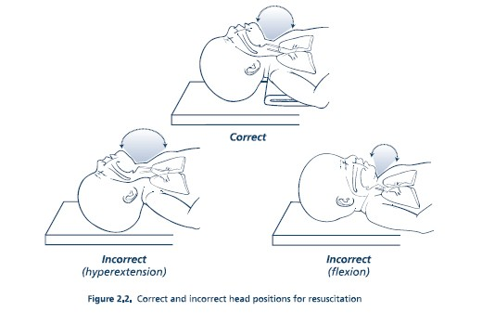
POSITION
  Position the infant on the back with neck extended
  Avoid flexion or hyperextension of the neck
Notes:
The airway of an hypotonic baby is vulnerable to obstruction by either flexion or hyperextension of the neck. Position the head at a right angle by using a small roll of cloth under the baby’s shoulders to achieve a “sniffing” head position.

Slide 16
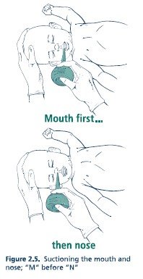
CLEARING AIRWAY
NOT ALWAYS NECESSARY
Amniotic fluid clear but secretions obstructive, or meconium stained amniotic fluid and baby not breathing/crying:
  Gently suction or wipe secretions from mouth and nose if obstructive
  Suction device
    Bulb or tube/reservoir
  Mechanical suction (100 mm Hg)
  Avoid causing apnea or bradycardia by suctioning too deeply or too long
Notes:
If meconium is not present in amniotic fluid, remove secretions by gently wiping the mouth (first) and nose with a cloth or by using a bulb syringe device. If an aspirator is needed, be very careful with pressure settings and the overall procedure. Rough suctioning or touching the posterior wall of the pharynx may cause apnea and/or bradycardia.

Slide 17
STIMULATION
  Drying and suction might be sufficient stimuli
  Rub the back or flick the soles
  Avoid vigorous stimulation
  Avoid prolonged stimulation
Notes:
The regular procedures and circumstances during delivery are enough stimulation for healthy newborns. Additional stimulation (back rubbing, sole flicking) may enhance the initial respiratory effort and continued breathing during the early transitional period if needed. Vigorous or prolonged stimulation may cause great harm to the baby.

Slide 18
INAPPROPRIATE
STIMULATION
PROCEDURE
CONSEQUENCE
Slapping on the back or buttocks
Contusions
Squeezing the rib cage
Fractures, pneumothorax, severe difficult breathing, death
Pressing the lower extremities over the abdomen
Liver or spleen rupture
Dilating anal sphincter
Sphincter lesion
Cold or hot compresses or bathing the newborn
Hyperthermia, hypothermia, burns
Shaking the newborn
Hemorrhages or brain damage
Notes:
These are potentially hazardous forms of stimulation and the complications that may result from them. If a baby is in primary apnea, gentle stimulation will produce a breathing response. In secondary apnea, stimulation will not work, no matter the type or intensity.

Slide 19
ASSESSING
RESUSCITATION
Once the initial steps are completed
(Thermal control, positioning, airway clearing, stimulation)
Then Assess:
  Breathing-Cry/Adequate respirations
  Heart rate
  Color
Notes:
After the initial steps, determine if further resuscitation is required by re-assessing vital signs.

Slide 20
EVALUATION
Breathing
  Observe chest movements, depth of breaths, and
  respiratory rate
Heart rate
  Normal heart rate >100 bpm
  Pulse can be felt at the base of the umbilical cord, or heart beats heard with a stethoscope over the left side of the chest
Color
  The baby should have pink color in the trunk and mucous membranes after 5-10 minutes
  If central cyanosis persists, the child is hypoxemic
Notes:
Check vital signs:
Breathing: look for effective respiratory movements. Gasping is not effective.
Heart rate: check that it is >100 bpm, counting beats in 6 seconds (x 10 = HR)
Baby should have pink colour in the lips and trunk

Slide 21
VENTILATION
  Begin positive-pressure ventilation if
  Apnea, gasping, poor respiratory effort
  Heart rate <100 bpm
  Central cyanosis after 5-10 minutes (if no oxygen)
  If the baby is not breathing, begin ventilation.
  Delaying ventilation prolongs recovery from asphyxia.
Notes:
If the child is apneic, gasping, or has poor respiratory effort, with a HR<100 bpm, resuscitation should be initiated with adequate ventilation.
Some studies suggest that room air (21% oxygen) is at least as safe and effective as 100% oxygen. Prolonged exposure to 100% oxygen after perinatal asphyxia may be harmful. If resuscitation is initiated with room air and no improvement is seen after 90 seconds, 100% oxygen is recommended.

Slide 22
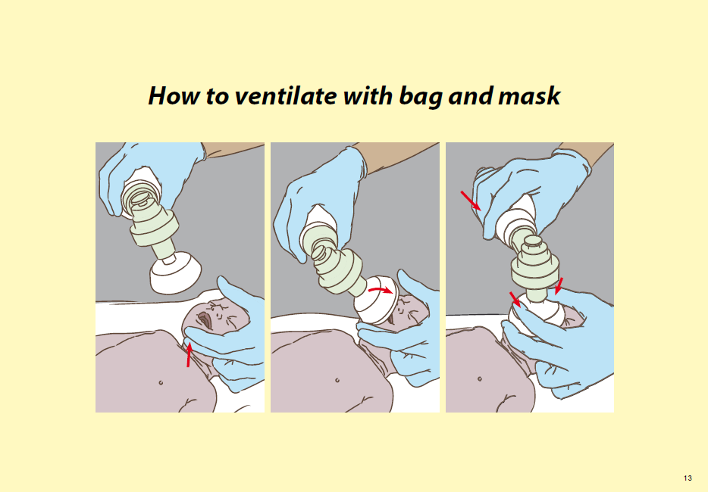

Slide 23
EVIDENCE OF
EFFECTIVE VENTILATION
  Rapid improvement in heart rate
  Breath sounds heard by auscultation over the chest
  Slight rise and fall in the chest (less noticeable)
  Improvement in skin color and muscle tone
Notes:
These signs indicate that ventilation is having the desired effect.

Slide 24
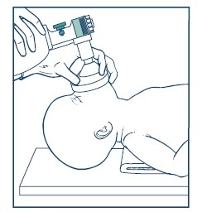
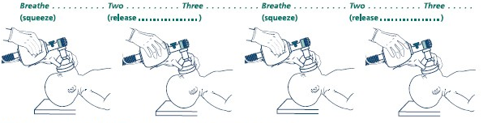
EFFECTIVE USE
OF BAG AND MASK
  Ventilate at 40-60 breaths per minute
  Confirm good seal of the mask on the face
  Monitor head position, secretions
  Verify chest movements
  Take steps to improve ventilation
Notes:
A respiratory rate of 40-60 breaths per minute is recommended, i.e., slightly less than one breath per second.
Good seal between the rim of the mask and the face is critical for effective ventilation. Monitor secretions and chest movements.
You can see below the proper ventilation counting technique. Keeping the desired respiratory rate in mind, divide each ventilation cycle in three: squeeze and count two and three, and squeeze again.

Slide 25
STEPS TO IMPROVE VENTILATION
Mask – reposition for a better seal
Reposition – the head with neck extended
Suction – if secretions are visible in mouth
Open – the mouth to move tongue away from posterior pharynx
Pressure – increase ventilation pressure
Alternative – different airway interface (e.g. intubation, laryngeal mask airway)

Slide 26
THREE KEYS TO NEONATAL RESUSCITATION
VENTILATION!
VENTILATION!
VENTILATION!

Slide 27
OXYGEN USE IF AVAILABLE
Ventilation can be started with room air or O₂ < 100%
Use O₂ if persistently cyanotic with room air
If O₂ not available, continue ventilation with room air
Use free-flow O₂ if baby is breathing spontaneously but persistently cyanotic
  Self inflating bags do not give free-flow O₂
Use O₂ blender and pulse oximetry for resuscitations of newborns < 32 weeks (and for all newborns, if available)
Notes:
You may be already knowledgeable of the AAP neonatal resuscitation guidelines, so let’s review the update made in 2006 to the previous resuscitation guidelines.

Slide 28
INTENSIVE CARE
Birth weight < 1500 g
Difficult breathing
Unstable temperature
Persistent cyanosis
Recurrent apnea
Pallor
Seizures
Notes:
These are indications for referral of the newborn to an intensive care facility.

Slide 30
What comes next…
What next to watch for in early newborn period:
  Jaundice
  Thermal stability
  Feeding
  Infection prevention
  Recognition of danger signs

Slide 31
THANK YOU !

Slide 32
Contact Us
Website: coloradosph.cuanschutz.edu
Facebook: @ColoradoSPH
Instagram: @Colorado.sph
Twitter: @ColoradoSPH
LinkedIn: @Colorado.sph

