Slide 1


Management of Prevalent Infections in Children Following a Disaster
Module 5

Slide 2
Learning Objectives
Describe the strategy of the Integrated Management of Childhood Illness (IMCI) program
Identify key clinical signs used to assess a child with cough or difficulty breathing
Define the appropriate management strategies of important acute infections in disaster settings
List other infectious considerations in disaster settings
Describe outbreak situations that require the use of vaccines and/or prophylaxis in outbreaks
Define concepts of outbreaks and pandemic management

Slide 3
Infectious Diseases Concepts

Slide 4
Definition
Illness caused by an infectious agent that can enter the body and cause infection
Infectious agents:
Bacteria
Prions
Viruses
Parasites
Fungi

Slide 5




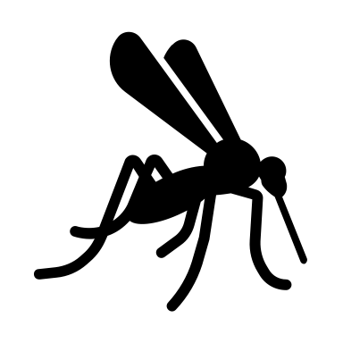
Modes of Transmission
Airborne
Droplet
Contact
  Very small particles that can remain in air for a long time
  e.g., Measles, Tuberculosis
  Large droplets that do not remain suspended in air
  e.g., Influenza, Meningococcus
  Direct contact with agent (skin-to-skin, sexual transmission)
  e.g., Herpes
Fecal-Oral
Vector-borne
  Indirect or direct contact with infected stool, contaminated water or food
  e.g., Hepatitis A, Salmonella
  Spread via insects
  e.g., Malaria

Slide 6
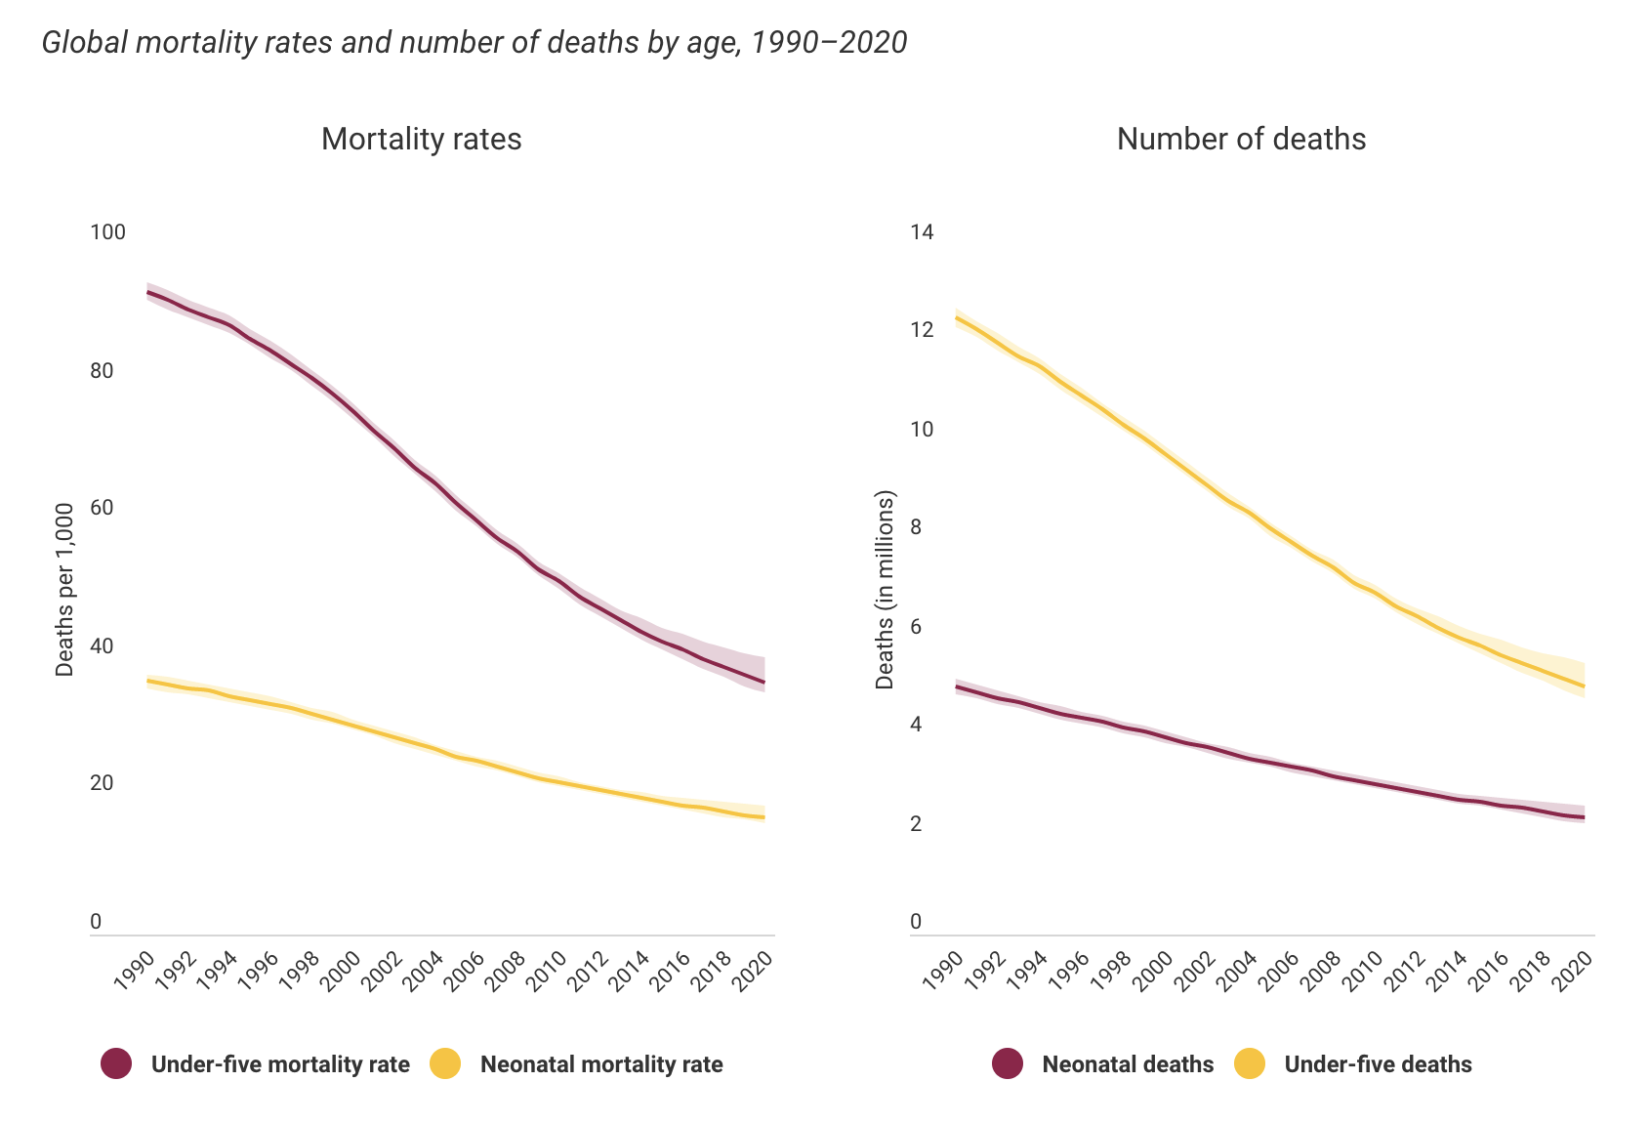
Importance
Under-five mortality: probability of a child dying between birth and 5 years of age
Declined 61% from 1990 to 2020
But,13800 under-five deaths still occur every day
https://data.unicef.org/topic/child-survival/under-five-mortality/

Slide 7
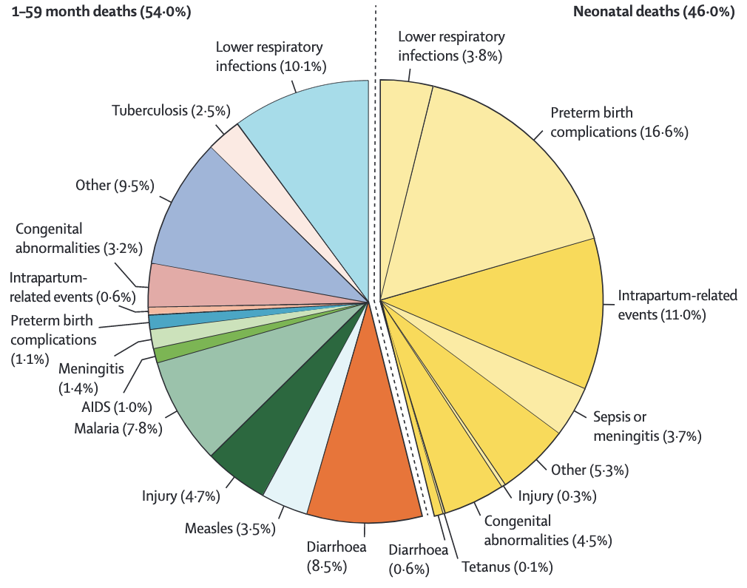
Global Causes of Under-Five Deaths (2019)
Perin et al. The Lancet, 2022.
Notes:
“Figure 1: Global causes of under-5 deaths in 2019. Deaths of neonates (aged 0–27 days) are on the right-hand side and deaths of children aged 1–59 months are on the left-hand side.”

Slide 8
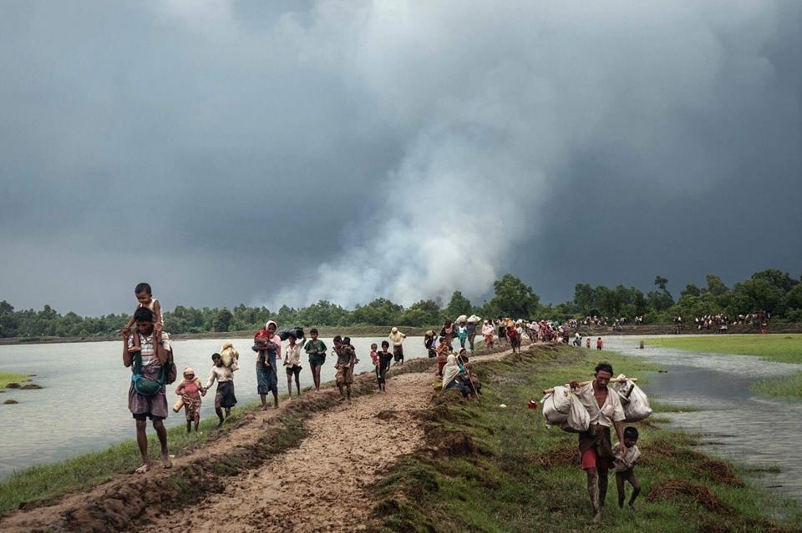
Infections in Disaster Situations
High baseline under-five mortality in low-middle income countries (LMIC)
Humanitarian emergencies/disasters exacerbate already heavy disease burden
New diseases related to complications of disaster
Care provision suffers
Co-morbid malnutrition
Collapse of public health infrastructure
Notes:
-New diseases related to complications: Crowding, compromised hygiene, contaminated water, poor sanitation
-Care provision suffers: little care for chronic disease and non-infectious disease
-Collapse of public health: immunization rates drop

Slide 9
Integrated Management of Childhood Illness (IMCI)

Slide 10
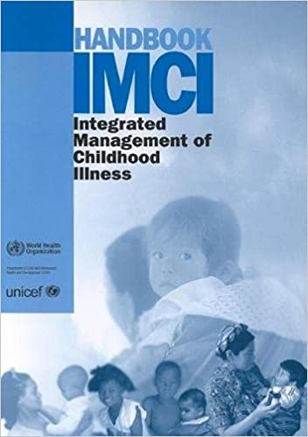
IMCI
Designed by World Health Organization (WHO) and United Nations Children’s Fund (UNICEF) in 1990s
Strategy to reduce mortality and morbidity from most prevalent diseases in LMIC using simplified algorithmic approach
  1) Improve management skills of healthcare providers
  2) Improve health systems
  3) Improve family and community health practices
Early Diagnosis -> Early Treatment -> Timely Referral
Notes:
Strategy to reduce morbidity and mortality from most prevalent diseases in LMICs based on simple clinical signs and procedural algorithms
Community-based approach
Improves parenting skills and practices associated with home care
Integrates aspects of nutrition, immunization, health promotion, and disease prevention

Slide 11
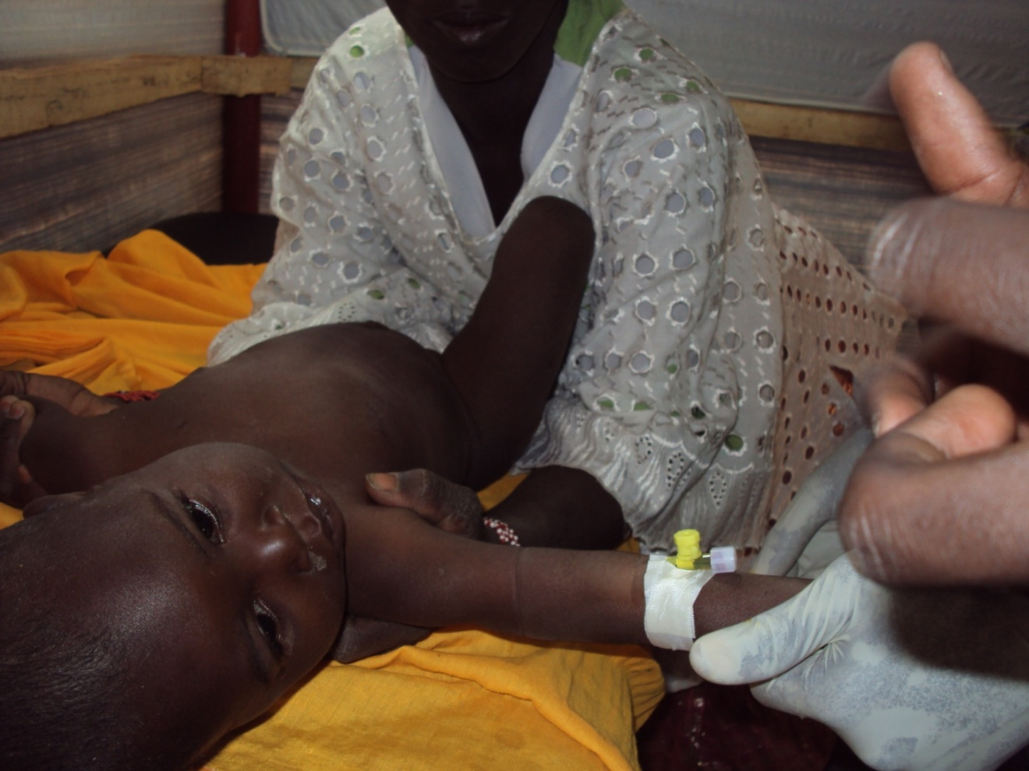
IMCI Management
A combination of individual signs leads to a child’s classification rather than a diagnosis
  Guides: management, follow-up, parental counseling, return instructions, referral indications
Classification:
  Pink = Urgently refer to a higher level of care
  Yellow = Requires specific treatment
  Green = Can be safely managed at home
  Care pathways match color-coding

Slide 12


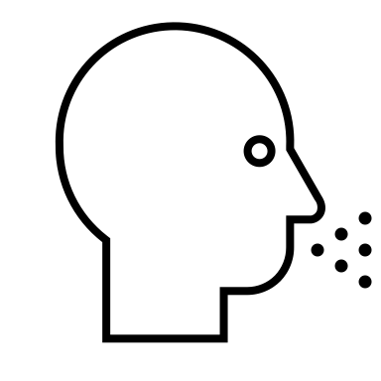




IMCI Assessment
  Take a history and talk with the caregiver about the child's problem
  Check for danger signs
  Asses major symptoms
  Evaluate nutritional status
  Assess child's feeding
  Check Immunization status
  Look for other problems
Notes:
Major Symptoms: Assess for a few carefully selected clinical signs
Birth– 2 months: serious bacterial infection and diarrhea
2 months – 5 years: cough or difficulty breathing, diarrhea, fever, ear problems
Chosen based on sensitivity/specificity to detect disease

Slide 13
IMCI Danger Signs
Sick Children 2 months to 5 years
Sick Young Infant < 2 Months
Not able to drink or breastfeed
Vomits everything
Had convulsions
Lethargic or unconscious
Now convulsing
Not feeding
Convulsions
Fast breathing
Severe chest indrawing
Fever or low temperature
Lack of movement

Slide 14
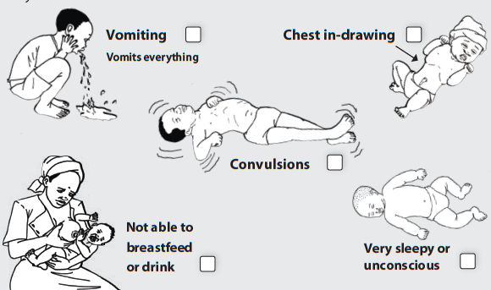
IMCI Danger Signs

Slide 15
FIRST-LEVEL OUTPATIENT HEALTH FACILITY
FIRST-LEVEL REFERRAL HEALTH FACILITY
“PINK” - PRE-REFERRAL
TREATMENT AND
REFERRAL
EMERGENCY TRIAGE ASSESSMENT AND TREATMENT
(ETAT+)
DIAGNOSE AND TREAT COMMON SERIOUS
CONDITIONS
MONITOR PATIENT PROGRESS
Ask about CHILD’S PROBLEMS
Check for
GENERAL DANGER SIGNS
ADVISE
parents about REFERRAL
ASSESS for MAIN SYMPTOMS:
COUGH OR DIFFICULT BREATHING
DIARRHOEA
FEVER
CLASSIFY CHLID’S CONDITIONS
AND
IDENTIFY
TREATMENT
“YELLOW” - SPECIFIC TREATMENT AT FIRST LEVEL FACILITY
TEACH
parents about
treatment
COUNSEL
them about feeding and when to
return
HOME
ASSESS for
MALNUTRITION AND ANAEMIA
GIVE ORAL DRUGS
AND/OR
TREAT LOCAL INFECTION
“GREEN” - HOME
MANAGEMENT
Check for OTHER PROBLEMS
GIVE FOOD AND FLUIDS
(follow feeding recommendations)
RETURN TO HEALTH FACILITY
WHEN NEDED
Give FOLLOW-UP care when the child returns, and if necessary, reassess for new problems
Notes:
To give an idea of the flow, color-coding, initial questions

Slide 16
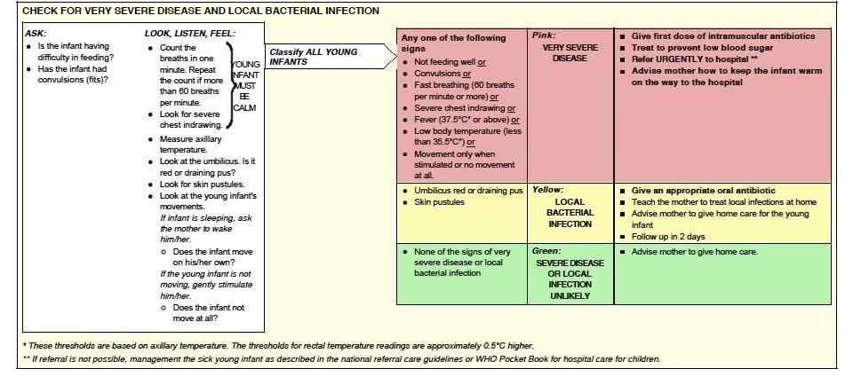
Notes:
Example of one of the algorithms

Slide 17
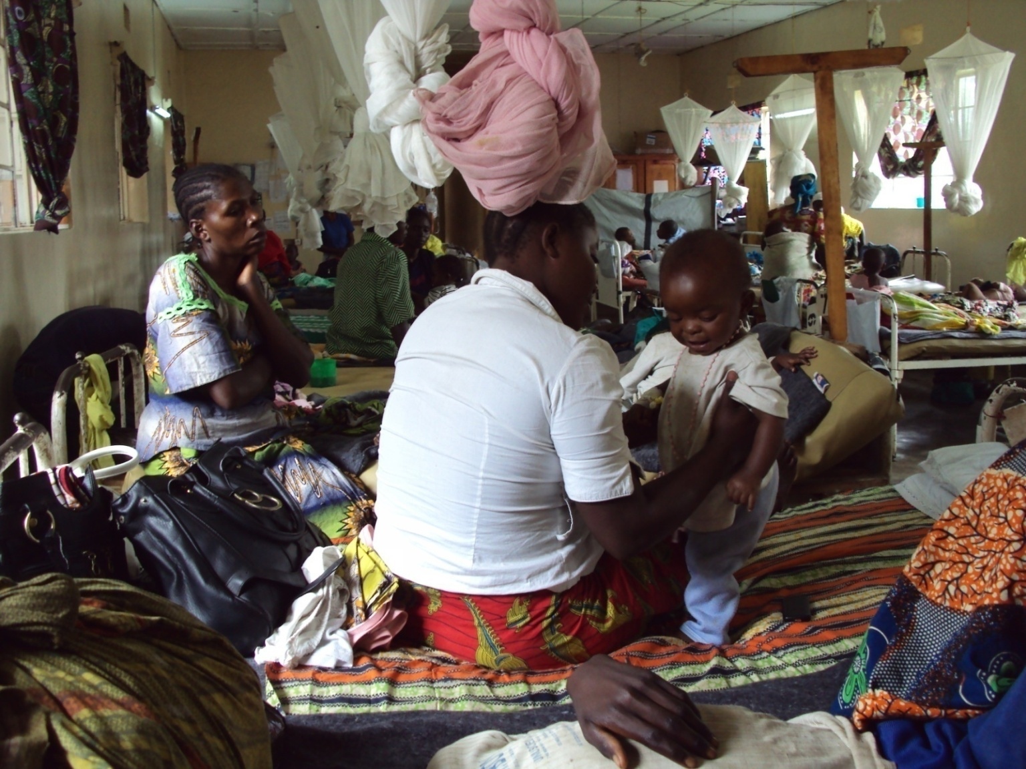
IMCI Management
Addresses most common illnesses
  Certain chronic or less common illnesses require further care
Uses limited number of essential drugs
Encourages active participation of caretakers
  Essential focus on counseling of caretakers (feeding, fluids, return precautions, etc)

Slide 18
Acute Respiratory Infections (ARI)

Slide 19
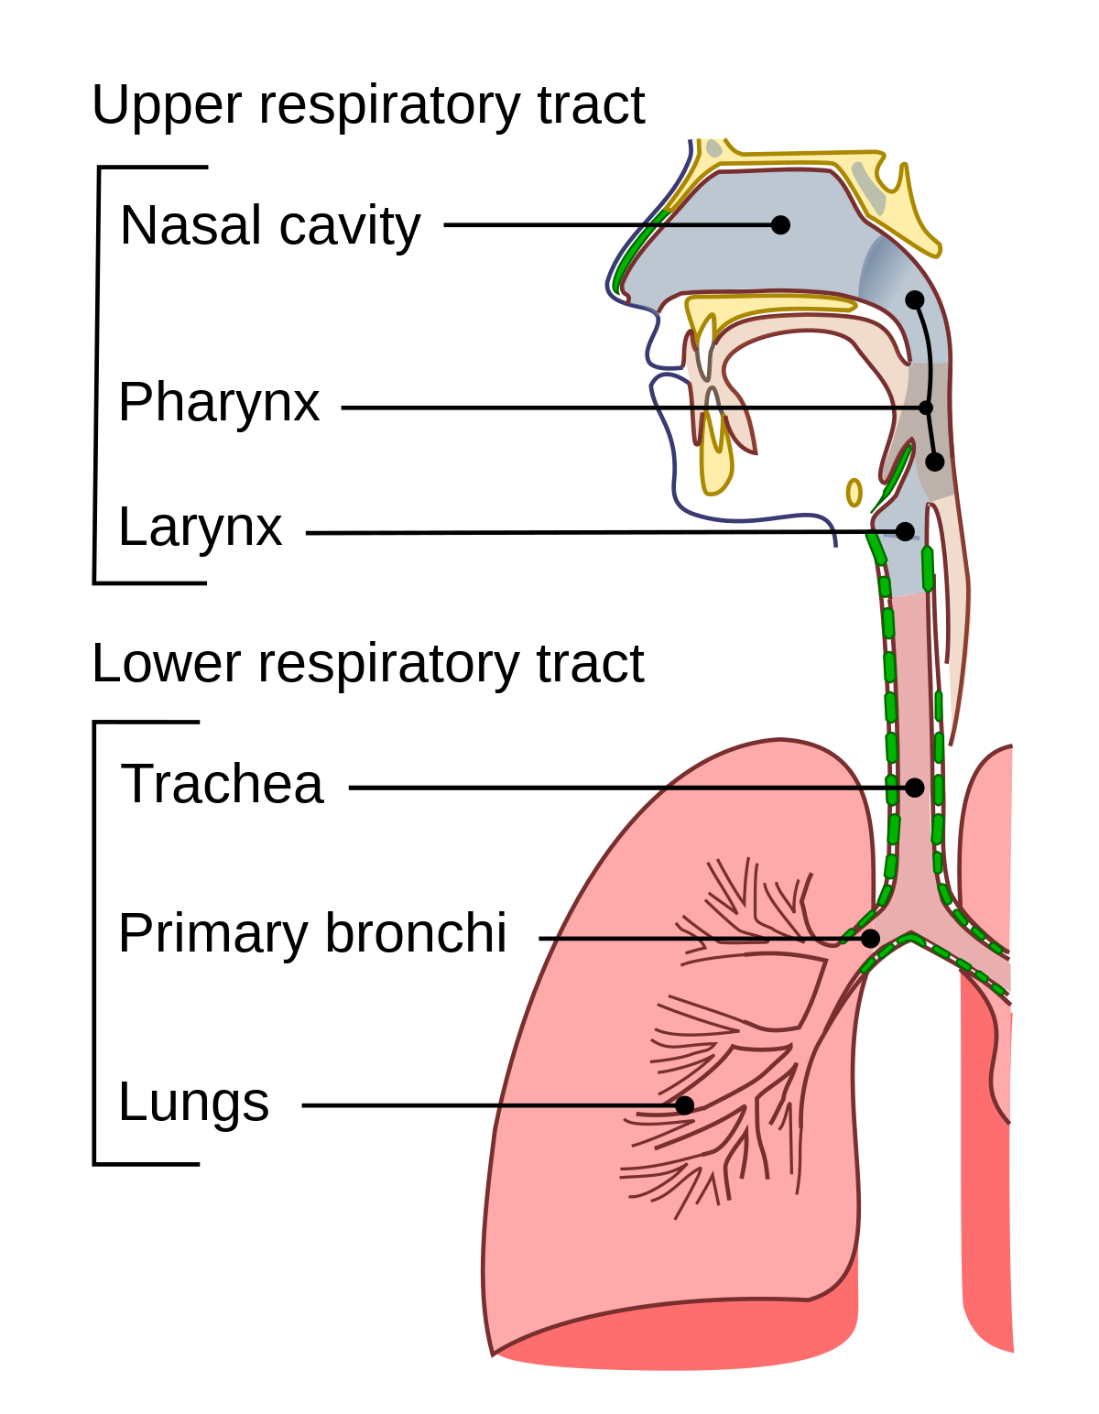
ARI
Infections can occur in both the upper and lower respiratory tract
Commonly caused by viruses but some are caused by other infectious agents (e.g., bacteria)
Pneumonia is a major cause of childhood mortality and morbidity
https://commons.wikimedia.org/w/index.php?curid=10296586
https://en.wikipedia.org/wiki/Respiratory_tract_infection#/media/File:Illu_conducting_passages.svg

Slide 20
Assessment of a Child with an ARI
Evaluate for
  Respiratory rate
  Chest indrawing
  Noisy breathing
    Stridor: Upper airway obstruction
    Wheezing: Lower airway obstruction
TABLE 1. Respiratory rate
Child’s age | Cutoff rate for fast breathing (tachypnea)
2 week to < 2 months | ~60 breaths per minute or more
2 months to < 12 months | ~50 breaths per minute or more
12 months to < 2 years | ~40 breaths per minute or more
2 years to < 5 years | ~30 breaths per minute or more
5 years to < 12 years | ~25 breaths per minute or more
12 years to <18 years | ~20 breaths per minute or more
https://en.wikipedia.org/wiki/Respiratory_tract_infection#/media/File:Illu_conducting_passages.svg

Slide 21
Pneumonia
In 2019, pneumonia accounted for 14% of all deaths of children under 5
Can be caused by viruses, bacteria, fungi
Most common causes in children
  Streptococcus pneumoniae
  Haemophilus influenza (including type B (Hib))
  Respiratory syncytial virus (RSV)
https://en.wikipedia.org/wiki/Respiratory_tract_infection#/media/File:Illu_conducting_passages.svg

Slide 22
Pneumonia
Classification and management of child with cough and/or difficulty breathing per IMCI:
Pink: Severe pneumonia or very severe disease
    Parental antibiotics and refer
Yellow: Pneumonia
    Oral antibiotics
Green: No pneumonia
    Home care advice
https://en.wikipedia.org/wiki/Respiratory_tract_infection#/media/File:Illu_conducting_passages.svg
Notes:
Pink-Presence of general danger sign (not able to drink, persistent vomiting, convulsions, lethargic/unconscious), stridor in calm child, severe malnutrition
Yellow-Fast breathing and/or chest indrawing without danger signs
Green-Cough and cold

Slide 23
Important Acute Infections in Disaster Settings

Slide 24
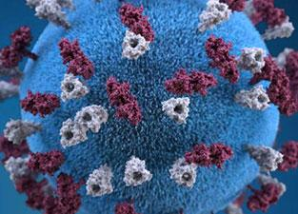
Measles
Single-stranded RNA virus
Case fatality rates of all measles infections <0.1% in developed countries but exceeds 1-2% in developing countries
Extremely important pathogen to pay attention to in disaster situations
https://en.wikipedia.org/wiki/Respiratory_tract_infection#/media/File:Illu_conducting_passages.svg

Slide 25
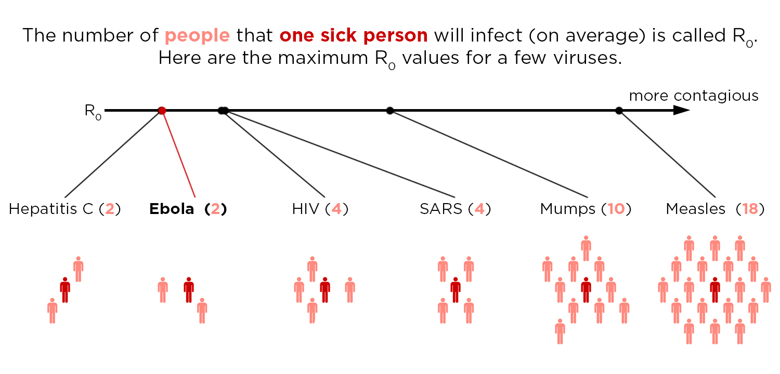
Measles: Epidemiology
Extremely contagious
  Nearly 100% of susceptible contacts develop infection
Transmission: Via respiratory secretions
Incubation Period: 10-14 days
https://www.npr.org/sections/health-shots/2014/10/02/352983774/no-seriously-how-contagious-is-ebola
Notes:
Mortality rate ⇒ Nutrition / crowding / inoculum
After population assessment, vaccination against measles is 2nd step in managing gathering populations in a disaster
Mortality rate is directly related to the number of cases of malnourished children in the population and degree of crowding. Secondary cases with a greater inoculum of the virus have more severe disease as well.

Slide 26
Measles: Natural History of Infection
Incubation
10-14 days
Day 1 Day 2 Day 3 Day 4 Day 5 Day 6 Day 7
Exposure
Fever ------------- FEVER--------------------]
Cough ---------------------------------------------------- - - -
Conjunctivitis ----------------------------------------- - - -
Coryza ------------------------------------------------- - - -
Koplik spots---]
Rash ---------------- - - -
Notes:
26
Exposure is followed by an incubation period of 10-14 days.
The first symptoms are: mild to moderate fever and dry or barking cough, non-purulent conjunctivitis, and a runny nose or coryza. These prodromic manifestations are often mild, and many people will not consult their physician during this stage.
Koplik spots are considered pathognomonic for measles. However, they only occur temporarily. They can be seen as painless tiny blue-white spots of 1 mm on the buccal mucosa, usually surrounded by a red ring. They typically appear opposite the lower molars but can be found anywhere on the buccal mucosa or the palate. As the lesions develop, they become confluent and disappear.
In days 3-5 after infection, it develops a significant change in the progression of the disease. Fever rises (may reach up to 40-41ºC) as more respiratory symptoms appear; rash appears during the fever peak. Rash and Koplik spots may coexist, but only during a short period (1 day).
Measles diagnosis is made clinically without the need for laboratory confirmation. Therefore, it is essential to know clinical manifestations of the disease. Identification of measles in a refugee camp or settlement is a public health emergency and should speed up vaccination process.

Slide 27
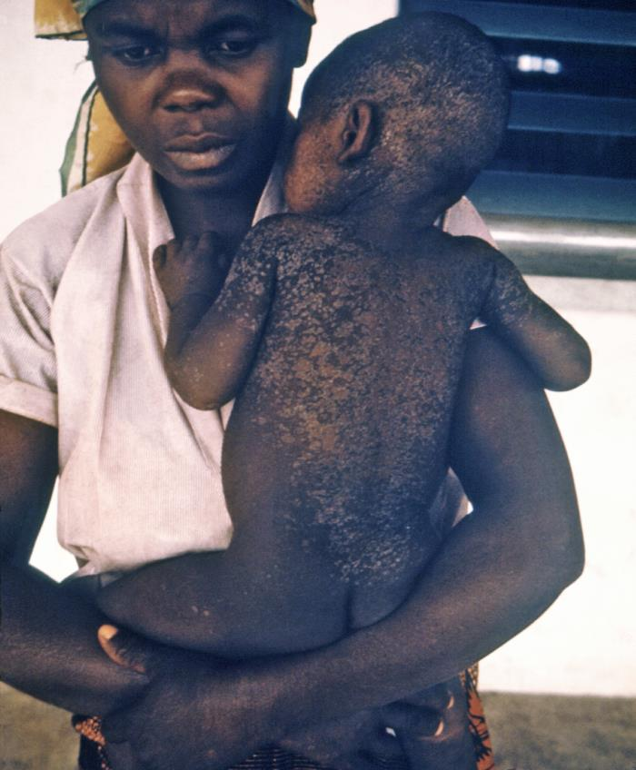
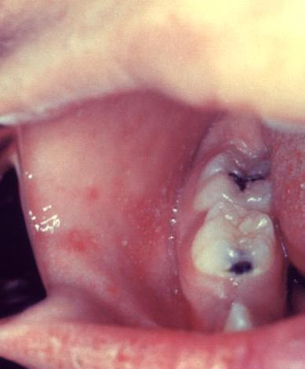
Measles: Koplik Spots and Rash
Rash: Develops on face, and then moves downward
Koplik Spots
https://www.cdc.gov/measles/symptoms/photos.html
Notes:
27

Slide 28
Measles & Vitamin A
SYNERGIC EFFECT
MEASLES
Unmasks an underlying Vitamin A deficiency
VITAMIN A DEFICIENCY (even subclinical) Increases measles-associated morbidity
and mortality
Measles-associated morbidity and mortality may be reduced by administering Vitamin A to high risk populations
Notes:
28
In disaster settings – frequent co-morbid and/or complicating malnutrition
There is a particularly deleterious synergic effect between vitamin A deficiency and measles. This disease unmasks the debilitating effect of vitamin A deficiency, i.e., damage to corneal tissue and fatality rate.
Vitamin A deficiency, even with no clinical manifestations, substantially increases morbidity and mortality due to measles. Although this synergic effect is widely known, the underlying physiological mechanism is still unknown. Vit A important for maintaining epithelization and recovery process after infection; key role in immune defenses
Measles-associated morbidity and mortality may be reduced by administering Vitamin A to high risk populations.

Slide 29
Measles Management
Severe Complicated Measles
Measles with Eye or Mouth Complications
Measles Without Complications
  Child with danger signs, cornea clouding, deep mouth lesions
  Give vitamin A, antibiotic, eye ointment
  Refer urgently
  Presence of eye drainage or mouth lesion without signs of serious illness
  Give vitamin A, eye ointment, encourage oral hygiene
  Close follow up
  Give vitamin A only

Slide 30
Measles: Complications
Pneumonia
Croup
Otitis media
Diarrhea
Long term sequelae
  Blindness
  Malnutrition
  Chronic lung disease
https://www.npr.org/sections/health-shots/2014/10/02/352983774/no-seriously-how-contagious-is-ebola

Slide 31
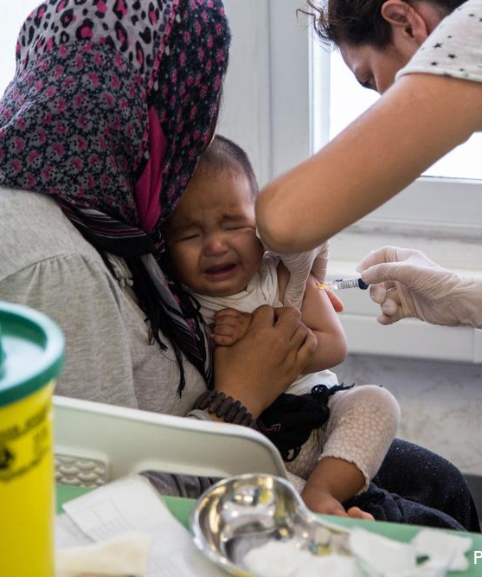
Measles Outbreak Mitigation
Child with Fever
and Rash Consistent
with Measles
Report Case to
Alert System
Case Confirmation
Laboratory tests
Local Response
Guarantee Vaccines
Vitamin A Administration
National Response Team
Search for Other
Cases
Start Response
and
Prevention
Vaccinate
Priority Groups 1st
Photo credit MSF-Australia
Notes:
31
This slide shows a practical algorithm to diagnose and treat measles. When a child or an adult develops fever and rash compatible with measles, it is important to look for confirmation through laboratory studies and report the disease as a possible measles case. Search for other cases, since if it is measles, they are most likely to exist. Work jointly with authorities in order to administer vaccines and Vitamin A to the population. Priority groups include younger children, malnourished children, and those with chronic diseases, especially cardiorespiratory conditions.

Slide 32
Vector-Borne Diseases

Slide 33
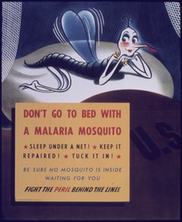
Malaria
Caused by protozoan blood parasite
There are four species that commonly cause infection in humans:
  Plasmodium falciparum
  Plasmodium malariae
  Plasmodium ovale
  Plasmodium vivax
  Plasmodium knowlesi is the other that primarily infects non-human primates
Transmitted by Anopheles mosquito
https://en.wikipedia.org/wiki/Respiratory_tract_infection#/media/File:Illu_conducting_passages.svg

Slide 34
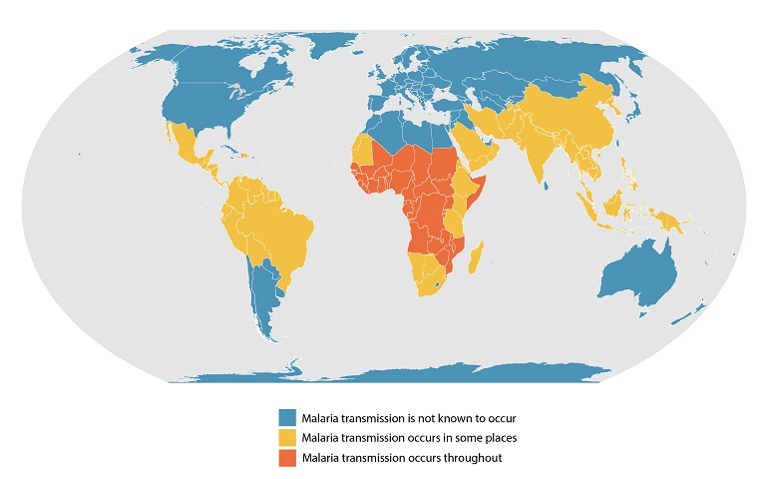
Malaria Geographic Distribution
https://www.cdc.gov/malaria/about/distribution.html

Slide 35
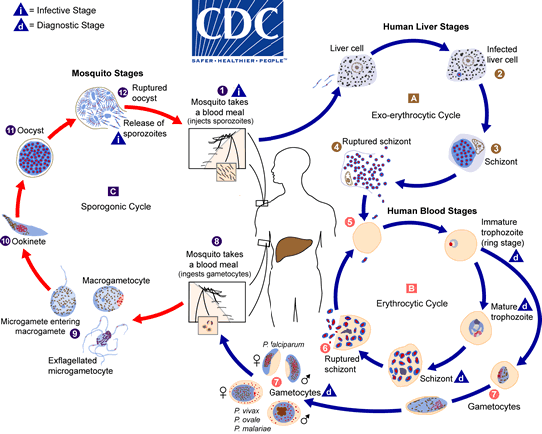
Malaria Life Cycle

Slide 36
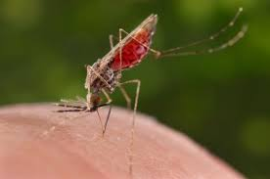
Malaria: Epidemiology
In 2020, there was an estimated 241 million cases of malaria worldwide with an estimated 627,000 deaths
Transmission: Vector-borne
Incubation Period: 7-30 days
Risk factors for severe disease:
  Infants and young children
  Pregnant women
  Malnourished individuals
  Those infected with P.falciparum

Slide 37
Malaria: Signs & Symptoms
Uncomplicated Malaria | Severe, Complicated Malaria
Fever, chills, headaches, myalgias, diarrhea, anemia Paroxysms of fever and shaking chills lasting 8-12 hours and every 2-3 days Coincide with cyclical release of parasites from ruptured blood cells | Impaired consciousness Prostration Multiple convulsions Acute pulmonary edema and acute respiratory distress syndrome Circulatory collapse or shock Electrolyte derangements Acute kidney injury Clinical jaundice Abnormal bleeding Hyperparasitemia

Slide 38
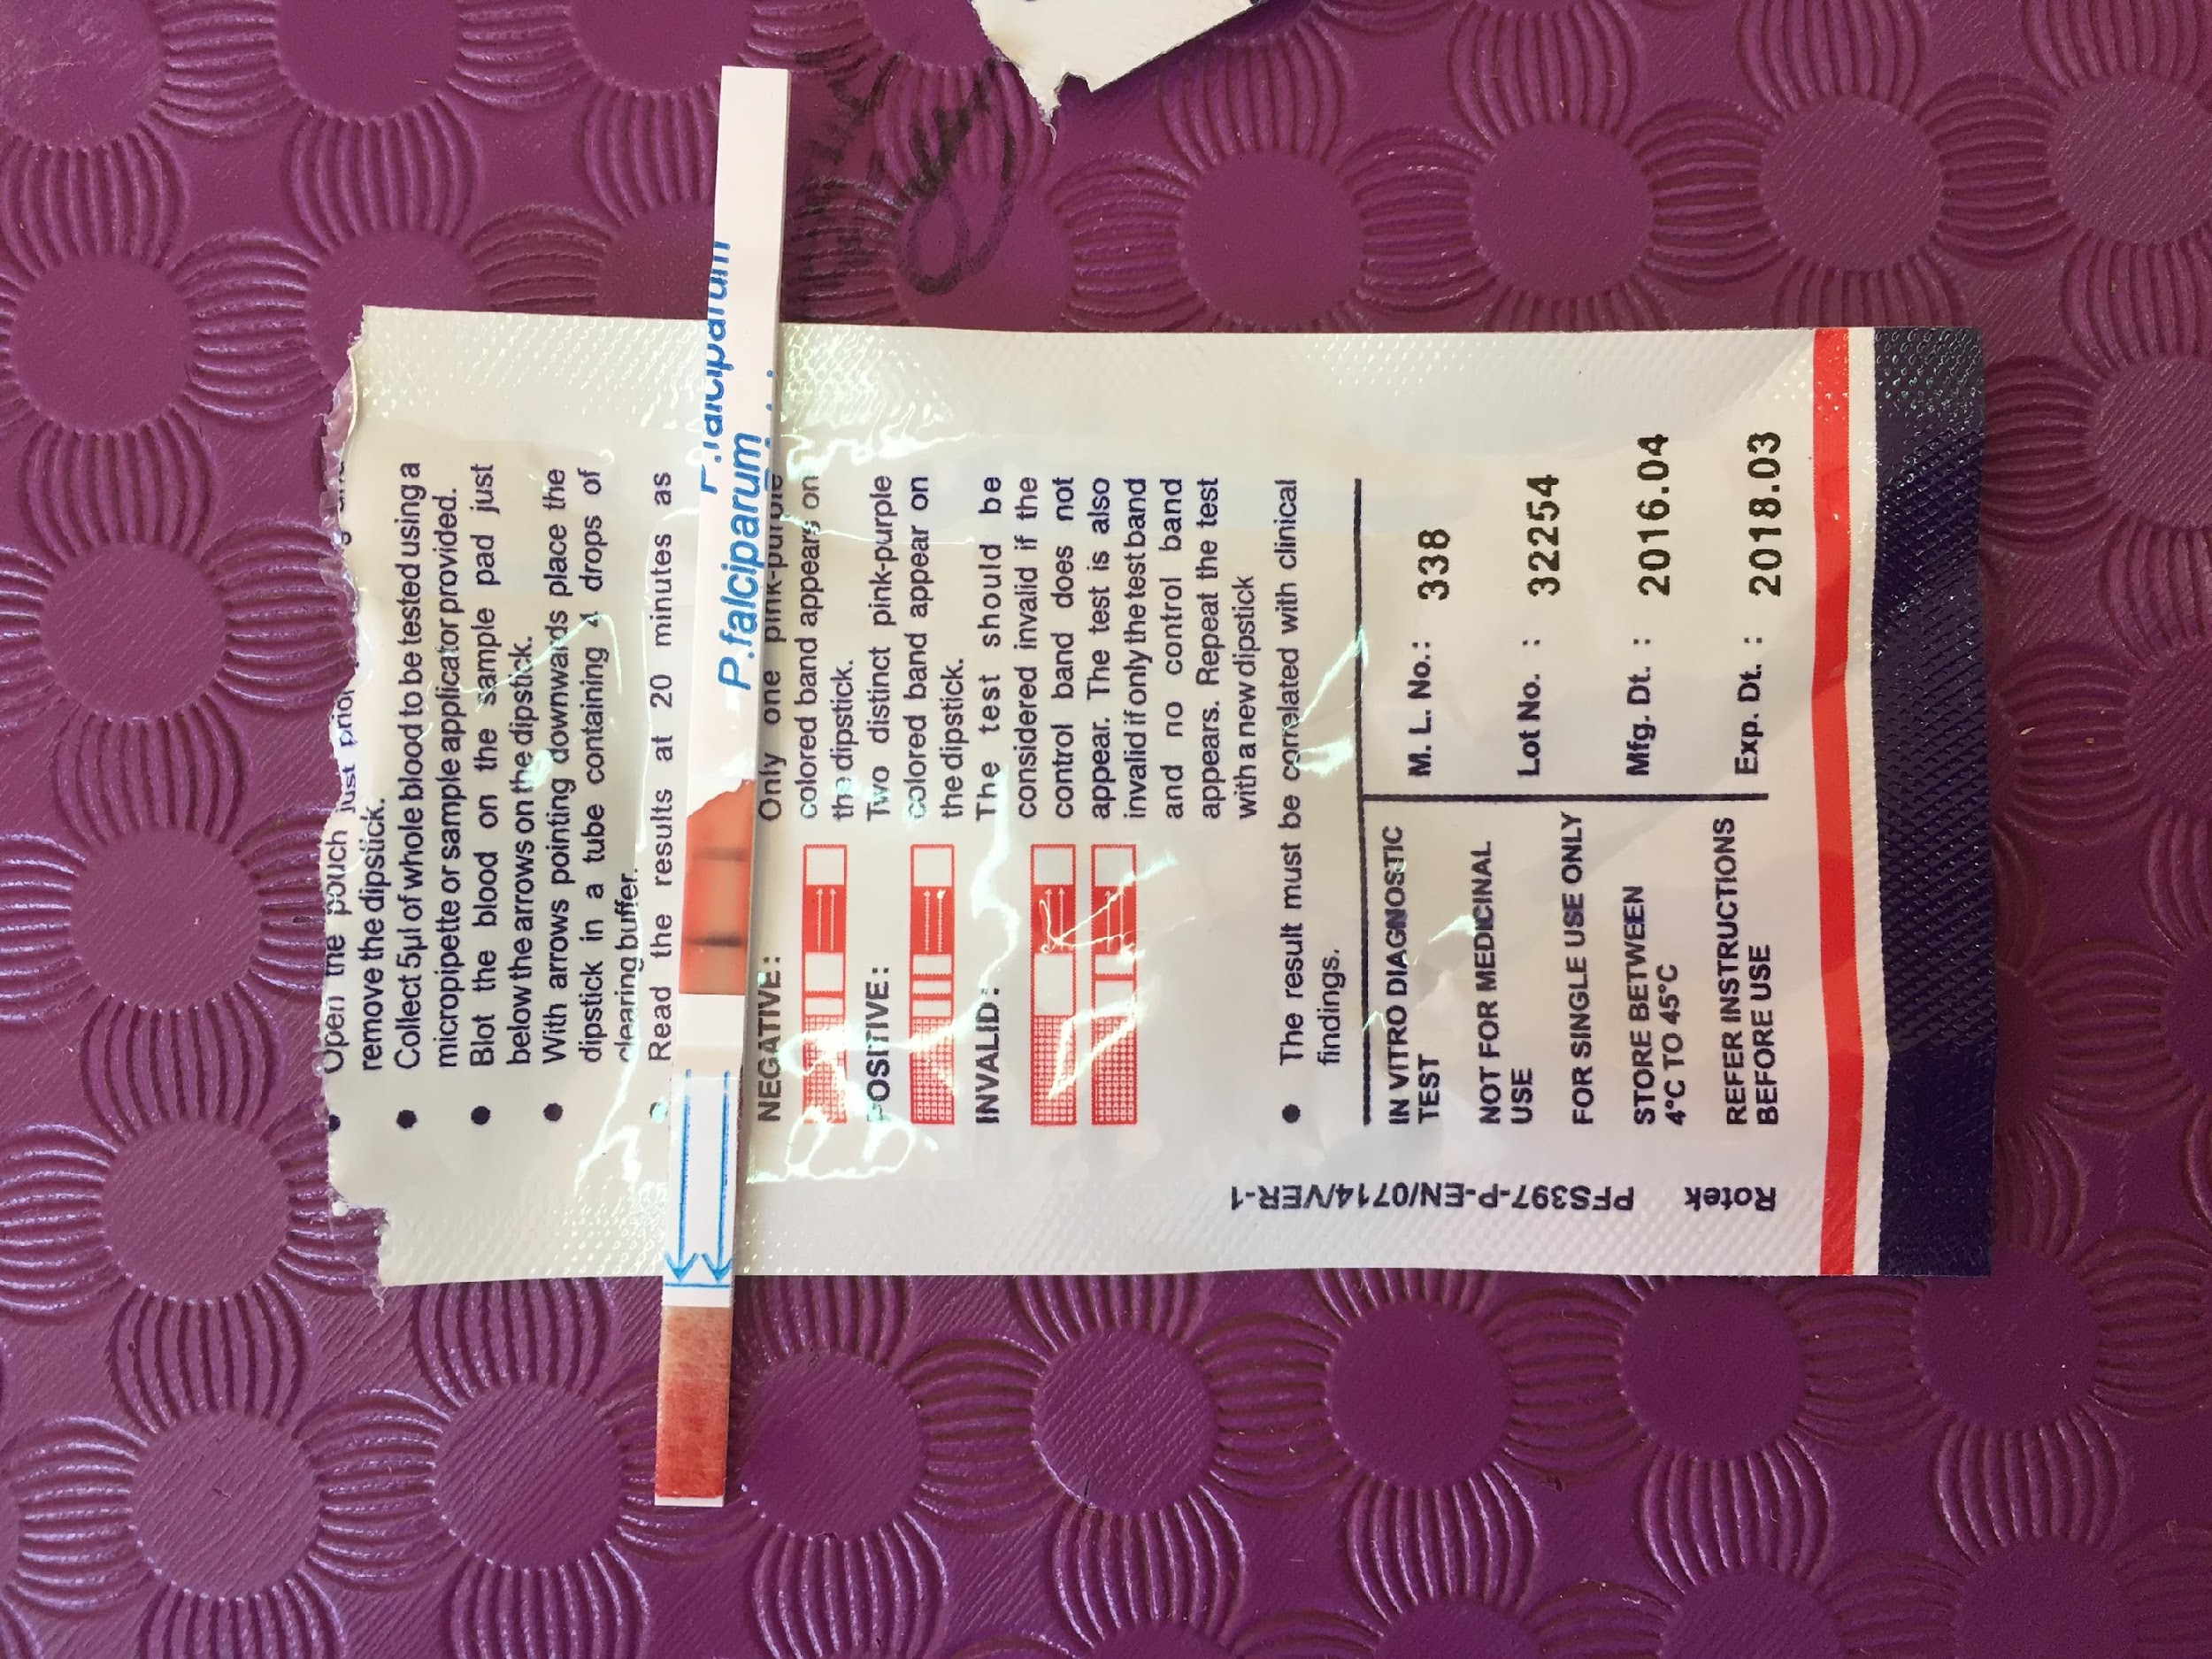
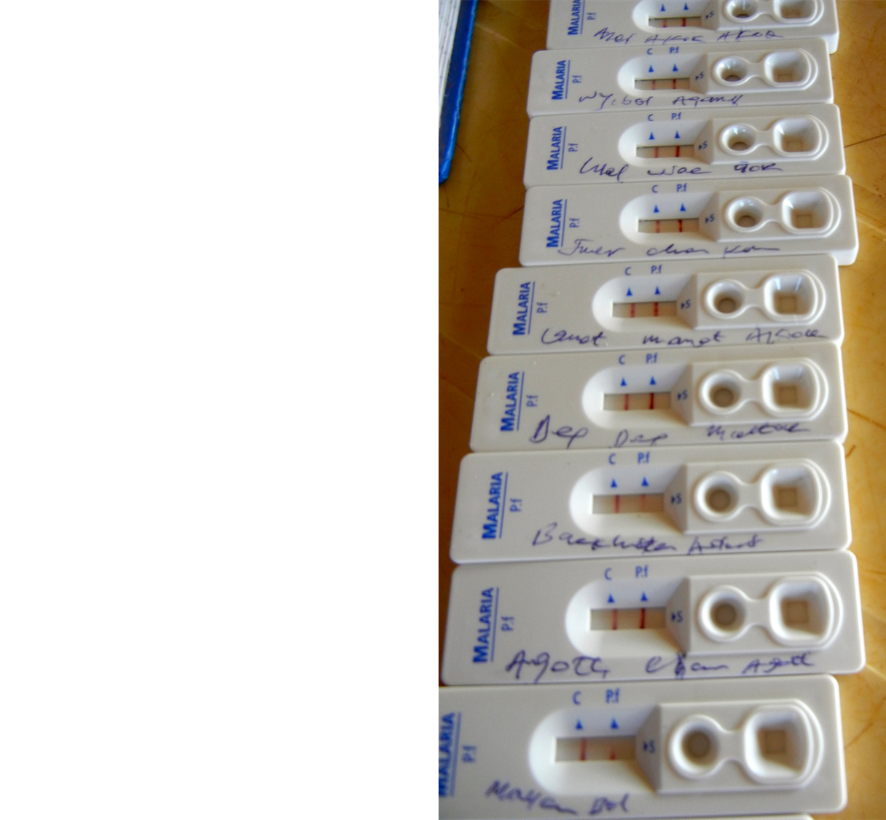
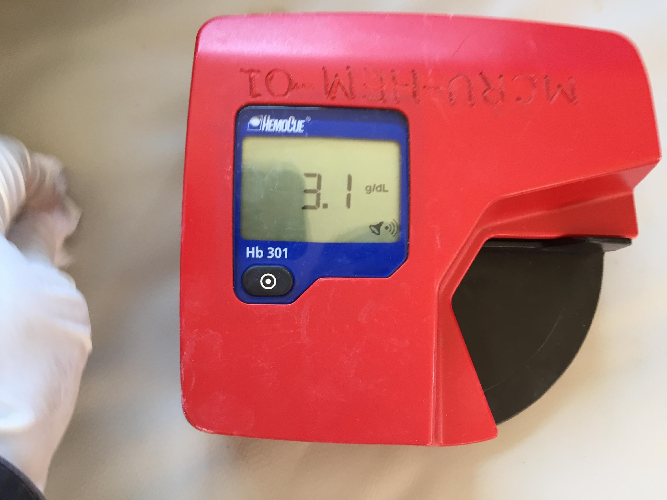
Malaria: Diagnosis
Rapid diagnostic tests
  Point-of-care antigen detection
Microscopy (thin/thick smears)
  Hard in disaster settings
Supporting Rapid Tests
  Hemoglobin

Slide 39
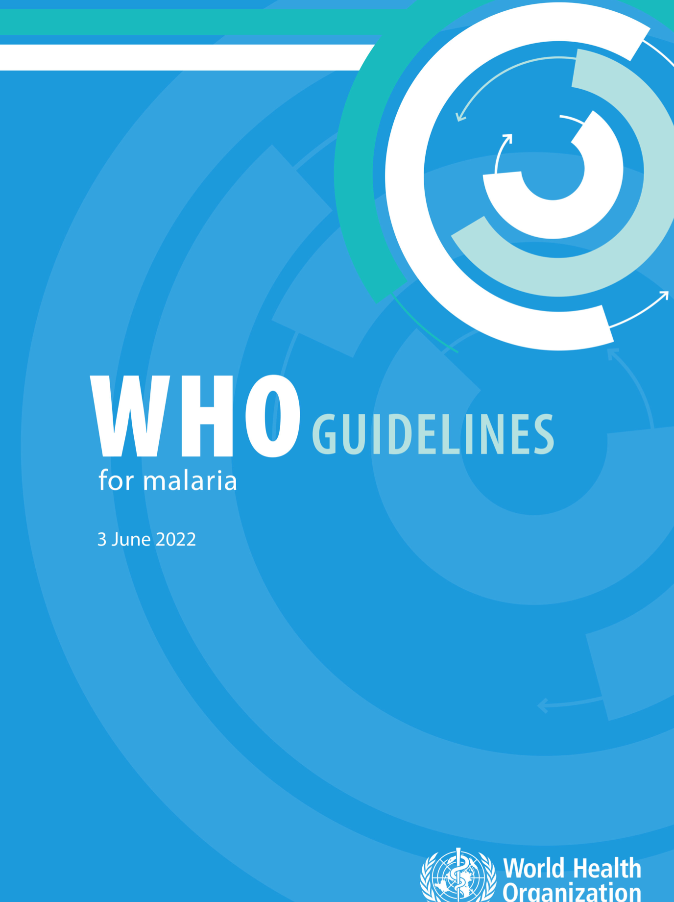
Malaria: Treatment
Anti-malarial medications
  Based on local guidelines
  WHO guidelines available
Supportive cares
  Glucose!
    Hypoglycemia major cause of mortality
  Fever control
  Hydration
  Evaluate for secondary bacterial co-infections

Slide 40
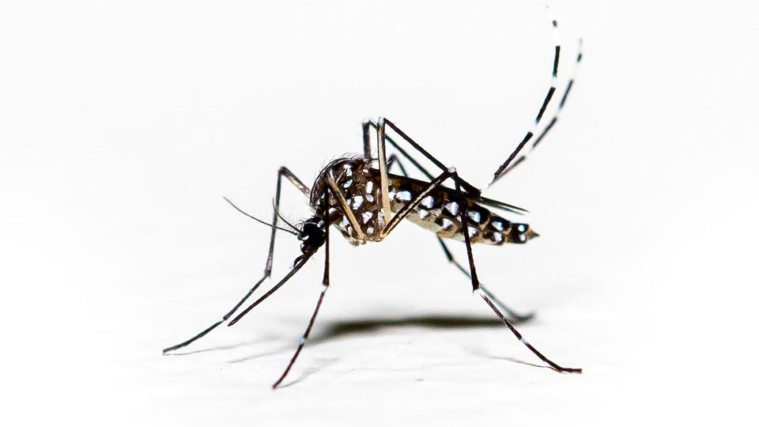
Dengue
Caused by dengue virus
Four closely related serotypes
Estimated 100-400 million infections occur each year
  Most children (~80%) asymptomatic
Transmission: Vector-borne
  Transmitted by Aedes mosquito
Incubation Period: 4-10 days
Aedes mosquito
https://en.wikipedia.org/wiki/Respiratory_tract_infection#/media/File:Illu_conducting_passages.svg

Slide 41
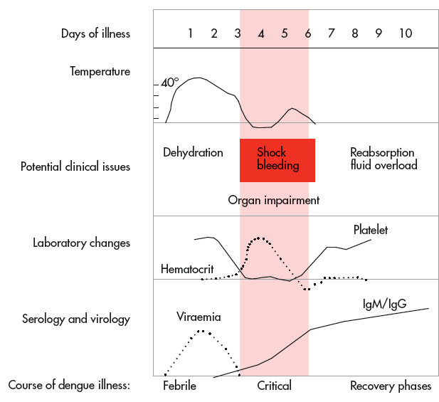
Dengue: Phases
Notes:
Febrile phase: 2-7 days, high fever, skin erythema, myalgias, arthralgia, emesis, anorexia, conjunctival injection, bleeding
Critical phase: 24-48 hour period when increase in capillary permeability, plasma leakage, bleeding, shock
Recovery phase: 24-48hour after critical phase, reabsorption of fluid, rash may desqumate
41

Slide 42
Dengue: Treatment
Supportive cares
  Rest
  Acetaminophen/paracetamol
  No aspirin or NSAIDS
    Risk of bleeding
  Hydration

Slide 43
Meningitis
Inflammation of “membranes” (meninges) that surround the brain and spinal cord
Caused by many different types of pathogens but most commonly viruses and bacteria
Neisseria meningitidis is a particular concern in disaster settings given its outbreak potential
https://en.wikipedia.org/wiki/Respiratory_tract_infection#/media/File:Illu_conducting_passages.svg

Slide 44
Meningitis
Clinical Manifestations | Management
Change in mental status Change in level of activity Irritability Unresponsiveness Seizures Meningeal irritation signs (may not be present in all) | Antibiotics for bacterial meningitis Supportive cares Close monitoring of complications Consider need for prophylaxis for contacts
https://en.wikipedia.org/wiki/Respiratory_tract_infection#/media/File:Illu_conducting_passages.svg

Slide 45
Other Infectious Diseases:
Key Considerations

Slide 46
Other Key Considerations
  Many other clinical entities may need to be triaged and managed during disaster settings
    Tuberculosis (TB) secondary to Mycobacterium tuberculosis
      Leading cause of death in some parts of the developing world
      Treatment typically not part of emergency relief response, but need to recognize in displaced population
    Human Immunodeficiency Virus (HIV)
      At risk for common childhood infections and opportunistic infections
      Ensure that antiretroviral therapy (ART) is continued during a disaster setting and re-started if interrupted
    Diarrheal infections
      Common cause of illness in children and can be caused by multiple pathogens
      Hydration crucial to treatment and some require specific antimicrobials
https://en.wikipedia.org/wiki/Respiratory_tract_infection#/media/File:Illu_conducting_passages.svg

Slide 47
Vaccination in Disaster Settings

Slide 48
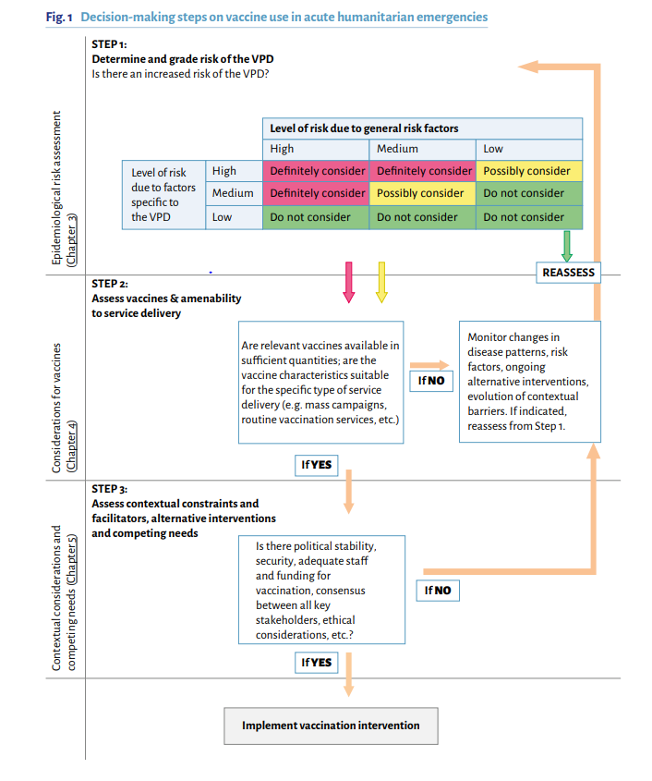
Strategies for Immunization Programs
Vaccination in acute humanitarian emergencies: a framework for decision making. Geneva, Switzerland: World
Health Organization; 2017. Licence: CC BY-NC-SA 3.0 IGO.
https://en.wikipedia.org/wiki/Respiratory_tract_infection#/media/File:Illu_conducting_passages.svg

Slide 49
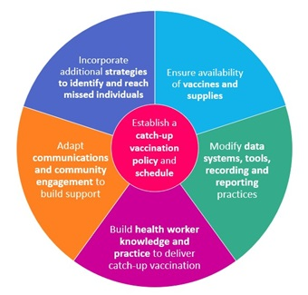
Catch-up Vaccination Considerations
https://www.who.int/teams/immunization-vaccines-and-biologicals/essential-programme-on-immunization/implementation/catch-up-vaccination
https://en.wikipedia.org/wiki/Respiratory_tract_infection#/media/File:Illu_conducting_passages.svg

Slide 50
Disease Specific Situations Requiring Prophylaxis
  There are certain diseases generally covered by routine childhood vaccinations in which prophylaxis with a vaccine and/or medication (chemoprophylaxis) is recommended to prevent infections in outbreak settings
    Diphtheria
    Haemophilus influenzae Type b
    Hepatitis A
    Measles
    Meningococcus
    Pertussis
    Tetanus
    Varicella-zoster virus
https://en.wikipedia.org/wiki/Respiratory_tract_infection#/media/File:Illu_conducting_passages.svg

Slide 51
Outbreak Management

Slide 52
Definitions
  Endemic
    Level of disease occurrence that is present constantly in a population
  Epidemic (Outbreak)
    Occurrence of more cases of a disease than normally expected in a place/group of individuals over a given period of time
  Pandemic
    Epidemic/outbreak that has spread over several countries or continents
https://en.wikipedia.org/wiki/Respiratory_tract_infection#/media/File:Illu_conducting_passages.svg

Slide 53
Definitions
  Isolation:
    For those who have the disease and attempting to separate from those who are not sick with the disease
  Quarantine:
    For those who were exposed to the disease and attempting to separate from others and to monitor for illness
https://en.wikipedia.org/wiki/Respiratory_tract_infection#/media/File:Illu_conducting_passages.svg

Slide 54
Considerations for Outbreak Management
  Screening, surveillance, identification of cases
  Prevention strategies (e.g., quarantine, isolation, PPE, vaccinations)
  Preparation for surge capacity and ensuring adequate supply of tests, vaccines, medications, and healthcare supplies
  Clear, effective communication
  Collaboration and support
https://en.wikipedia.org/wiki/Respiratory_tract_infection#/media/File:Illu_conducting_passages.svg

Slide 55
Summary
Many infectious diseases contribute to significant morbidity and mortality in children and then are exacerbated during a disaster
IMCI is a focused, simple community-based approach to task-shift management of biggest causes of pediatric morbidity and mortality
  Promotes home care and timely referrals
  Integrates aspects of nutrition, immunization, health promotion, and disease prevention
Prompt recognition of contagious infectious diseases is important for mitigation strategies to prevent further spread

