Slide 1


Module 4 – Pediatric Trauma
(In disaster settings)
Kristin Kim, MD, PhD
Pediatric Emergency Medicine
CU Anschutz / Children’s Hospital Colorado

Slide 2

Kids are at higher risk of injury in disasters

Slide 3

Kids are vulnerable to trauma
Big heads and weaker necks – increased head injuries, different C-spine injury pattern
Increased body surface area for weight – lose heat, water quickly
Abdominal organs are close together and less protected by rib cage
Increased compliance of the chest wall makes injury to lung (and abdominal organs) more likely
Shock is more subtle – elevated HR may be only sign, BP preserved until very late
Hypovolemia occurs quickly – less blood volume

Slide 4
Initial evaluation – on scene or in the ED
”Trauma is cookbook medicine”
Primary survey –
  X-ABCDE
  identify and treat immediately life threatening injuries
Secondary survey –
  Head to toe physical exam
  identify other serious injuries that may need attention
Tertiary survey –
  complete and detailed physical exam often done after initial interventions and before patient is released to home
  Identifies any other injuries that may have been missed due to other distracting injuries

Slide 5
TRAUMA -
PRIMARY SURVEY
Goal = identify and treat threats to life
X- Exsanguinating hemorrhage
A - Airway patency (and protect the C-spine)
B - Breathing and ventilation
C - Circulation with hemorrhage control
D - Disability: Mental status
E - Exposure: Completely undress patient
Notes:
5
Management of trauma requires a systematic approach. The initial ABCDE assessment is widely accepted. This approach prioritizes stabilization and giving immediate treatment for life threatening conditions, followed by secondary assessment and triage. All this is done before knowing in detail any personal background or data from a complete physical examination.
Read
A - Airway patency also includes cervical spine control
E – If patients need to be undressed because of exposure issues, don’t let them get cold

Slide 6
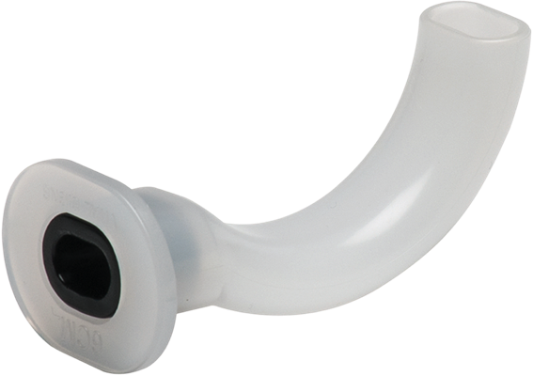
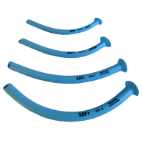
A – AIRWAY (primary survey)
“Does the patient have a stable and patent airway?
If YES – move on to Breathing
IF NO - Then address airway NOW
  Position airway while maintaining C-spine protection
    Midline positioning
    jaw thrust to open airway and protect c-spine
    Head tilt and chin lift are contraindicated
  Remove obstructions
  Consider placing airway adjunct (NP, OP airway)
  Attempt BVM ventilation
  Consider intubation or emergent cricothyrotomy
Notes:
6
The objective of airway clearing is to promote adequate gas exchange. Recognize and clear any obstruction, and try to prevent aspiration of gastric contents. Keep a midline position, do jaw thrust to open airway. Consider possible lesions in the cervical spine: in these cases, head tilt and chin lift are contraindicated. Spine immobilization must include a hard cervical collar.

Slide 7
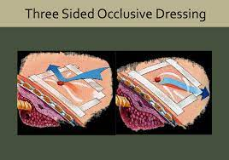
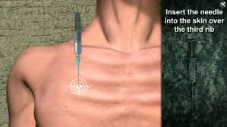
B - BREATHING
Assess minute ventilation
Assess chest expansion
Breath sounds
Heart sounds
Chest percussion
Address any tension pneumothorax or ”sucking chest”
Notes:
Tital volume in a minute = minute ventilation

Slide 8
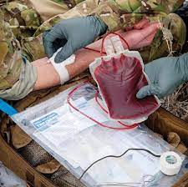
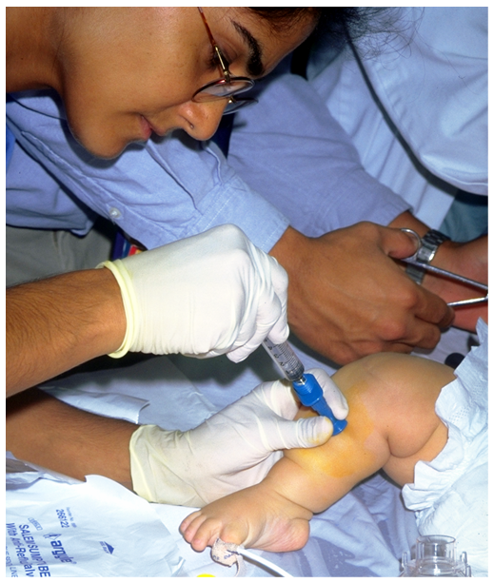
C - CIRCULATION
Control external hemorrhage first!
Assess pulse, end organ perfusion
  capillary refill, temperature/appearance of extremities, CNS function
  Check distal and femoral pulses
  Assess for tachycardia as BP will lag
  Place IV/IO
Treat blood loss by giving blood products!
  Crystalloid doesn’t replace blood – just helps with fluid pressure
If inadequate circulation remains after 2 units of pRBC (10cc/kg = 1 unit for kids) start MTP if available.
Key Point: Hypotension in children will not be evident until 25% to 30% of blood volume is lost
Notes:
8
C stands for Circulation. Adequate circulation may be determined by examining pulse pressure and rate, both peripheral and central. Document blood pressure, but keep in mind that in children circulation might be compromised with normal BP. Hypotension in children will not be evident until 25% to 30% of blood volume is lost, so begin aggressive fluid resuscitation immediately. Tachycardia is an earlier marker for hypovolemia. Look for external hemorrhages and control them by applying direct pressure to wounds. Thin pressure dressings are advisable, rather than bulky dressings. Fluid expansion with intravenous liquids, although challenging and requiring special equipment, may save lives.

Slide 9
SHOCK RELATED TO TRAUMA
(it’s not all bleeding)
Classify
Cause
Hypovolemic
Hemorrhage
Burns
Cardiogenic
Myocardial contusion
Obstructive
Massive hemothorax
Tension pneumothorax
Tamponade
Distributive
Spinal cord injury

Slide 10
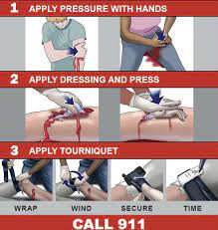
Hemorrhage control – STOP THE BLEED
Stop active and massive hemorrhage quickly
Direct pressure – hold pressure on hemorrhages you can’t tie off (head, hip, shoulders)
Extremities:
  Apply tourniquet – tight, fast, leave it in place
Pack the wound
  Clean (ideally) cloth/bandage
  Hold or tape pressure

Slide 11
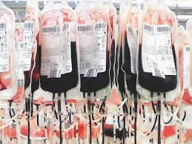
Massive transfusion protocol – Replace the blood
Initial treatment for shock from trauma is BLOOD
Start with pRBC (unmatched) – 2 boluses
  Adult = 2 units
  Kids = 10cc/kg x 2
Then move to MTP
  1:1:1 pRBC:platelet:FFP
  May not be available
    In an MCI with overwhelmed blood supply
    In under-resourced medical environments
    Far from urban areas
MTP is pre-batched and is sent automatically from the blood bank
Allow very fast transfusion for ongoing bleeding with shock

Slide 12
D - DISABILITY
Determine mental status with rapid assessment
Is the child responsive?
Pupil and motor exam
AVPU evaluation: (Alert, responsive to Voice, responsive to Pain, Unresponsive)
Glascow Coma Score –
  Used commonly but difficult to actually calculate
    Verbal – 6
    Motor – 5
    Eye opening -4
Notes:
12
D stands for Disability. Rapidly assess mental status and carry out a minimal neurological exam (pupils, motor). Assess if the child is alert, responsive to verbal or painful stimuli, or unresponsive. In addition, the pupils should be assessed for size, equality, and response to light. A quick motor exam can determine if all four extremities show motor activity. To determine conscious level, use the AVPN evaluation (Alert, responsive to Verbal stimuli, responsive to Pain, Non responsive). Once at the hospital, you can determine the score for the Glasgow coma scale.

Slide 13
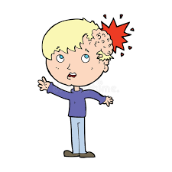
Intervention for AMS / head injury
Signs of increased intracranial pressure
bradycardia,
hypertension,
hypoventilation
Intervention for increased ICP:
Consider mannitol or 3% NS if suspected increased ICP
Keep head of bed slightly elevated
Avoid hypoventilation
Avoid systemic shock to maintain cerebral perfusion
Sedation as needed
Consider intubation to protect airway if unresponsive or GCS < 8
Not all AMS in trauma is head – consider and treat shock, drugs, toxins, sepsis

Slide 14
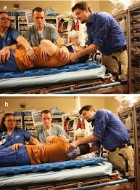
E - EXPOSURE
Completely undress patient
  If blunt trauma – protect the spine
Perform complete visual examination
  log roll and check the back, buttocks and palpate entire spine
Don’t let the patient get cold
  Warm blankets
  Active warming
“Get’em neked and then cover’em up”
Notes:
14
E stands for exposure. Completely undress the patient and perform a complete physical examination. Do not let the patient get cold. Infants may quickly become hypothermic, especially if they are wet.

Slide 15
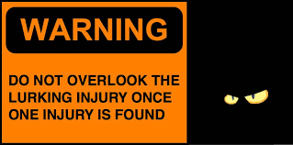
Secondary Survey
Perform after primary survey is complete and issues are addressed
Head to toe examination
  Vital signs
  Looking for any signs of injury
  Include back (with a log-roll to protect the spine) and perineum
  Palpate everything!
AMPLE history:
  Allergies
  Medications
  Past medical/surgical history
  Last meal / LMP
  Events leading up to the trauma

Slide 16
Supporting studies
If resources allow but don’t replace primary or secondary survey
Radiology
  Xray – Chest, Pelvis, C-spine and injuries
  CT – if indicated and available
Labs
  “Trauma labs” might not be available or appropriate in MCI
  CBC – shows initial state and doesn’t reflect recent bleeding
  LFT – useful for liver injury
  TEG / Coag studies – helpful for DIC and to guide MTP
  Lipase/amylase – useful for pancreatic injury

Slide 17
Specific injury patterns in MCI

Slide 18
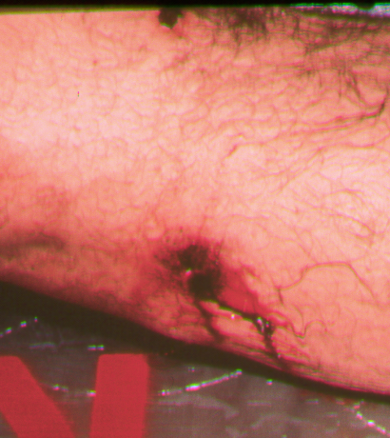
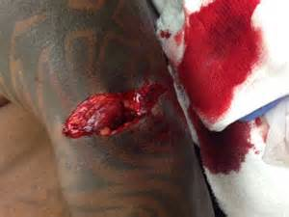
Penetrating Trauma
~10-20% of all trauma (US)
  0-18 years (~7.4%)
  gunshot > stab wounds
  More heavily armed society
Injuries related to velocity
  Bullets can divert in the body
  Shock wave can cause trauma
  Vascular injuries common
Treatment consists of hemorrhage control
Notes:
Xx% - look up your countries penetrating trauma statistic and insert
Nigeria 40-60%
USA 20%
A total of 748,347 pediatric trauma patients were assessed. Blunt trauma was identified as the cause in 601,898 (80.43%) patients compared with 55,597 (7.4%) patients with penetrating trauma. Blunt trauma patients were younger on average and more likely to be female. Despite having a slightly higher mean injury severity scores, blunt trauma patients had shorter length of stay in the hospital (2.9 versus 4.3 d, P < 0.001), fewer complications (34.8% versus 38.6%, P < 0.001), and a much lower mortality rate (1.3% versus 7.1%, P < 0.001). Blunt trauma patients were more likely to undergo computed tomography scanning but less likely to receive transfusions (1.79% versus 5.5%, P < 0.001) and to undergo exploratory laparotomy (0.9% versus 9.4%, P < 0.001) and thoracotomy (0.07% versus 1.7%, P < 0.001). Variations in outcome and resource use were also noted by age.

Slide 19
Penetrating trauma – hemorrhage is key threat
Torso
Extremity
Silent hemorrhage reservoirs
Ongoing blood products needed - MTP
Will need a surgeon
High index of suspicion for injury even with small entry wound
If Active, pulsatile bleed – need tourniquet for control, then surgical care
Expanding Hematoma
Absent pulses or ABI/ API <0.9
Control bleeding
If large vascular injury will need surgical repair

Slide 20
Traumatic Brain Injury
Primary injury
  Can be blunt or penetrating
  May have no external signs of injury and be severe
  Blast injury may be severe
  Concussion, cerebral contusion, diffuse axonal injury, intracranial hemorrhage
Secondary injury
  Metabolic injury
  Reperfusion injury
  Ischemic injury from shock

Slide 21
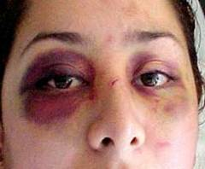
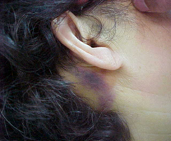
Initial evaluation of head injury
Vital signs
Level of consciousness – GCS /AVPU
Brief neuro exam with CN, motor, sensory, coordination
If resources allow:
  CT head for moderate/severe injury
  Immobilize and image C-spine
Use clinical signs if under-resourced
  Battle sign/raccoon eyes
  Serial neuro exam
  Check pupils frequently

Slide 22
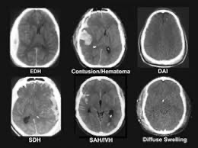
Management of head injury
Elevate head of bed – 30deg
Ensure adequate oxygenation / ventilation
Normothermia – avoid fever/hyperthermia
Avoid hypotension
  Give volume
  Consider vasopressors
Sedation to allow rest
If signs of increased ICP
  3% NS (5cc/kg)
  Mannitol
Surgical intervention for space occupying hemorrhage

Slide 23
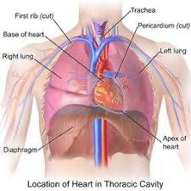
Thoracic injuries
Pulmonary contusion/laceration (53%)
Pneumothorax/hemothorax (38%)
Rib/sternal fractures (36%)
Other injuries
  Cardiac (5%)
  Diaphragm (2%)
  Major blood vessels (1%)
Remember kids have compliant chest wall and may have significant injury with less force

Slide 24
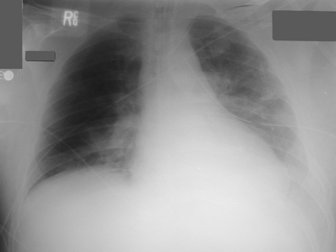
Pulmonary contusion
Most frequent injury
May not have visible signs
  Decrease breath sounds, rales
  tachypnea
Pulmonary hematoma:
  Blood and fluid in the alveoli
Hypoxemia, hypercarbia
Give oxygen 100%
  May also need pressure support

Slide 25
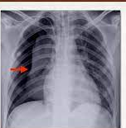
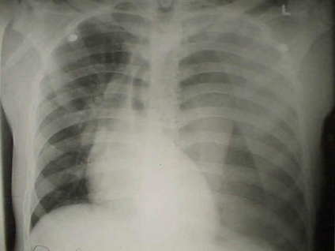
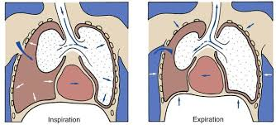
Simple PTX
Open PTX
Tension
  May require chest tube
  Place on O2
  May change
  “sucking chest wound”
  Pleural space is open to outside
  Occlusive (3 sides only!) dressing
  Fatal quickly
  Negative pressure will fill pleural space with air
  Treat with needle decompression and thoracostomy tube

Slide 26
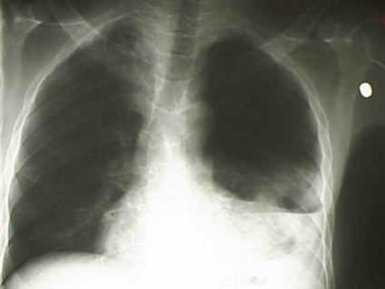
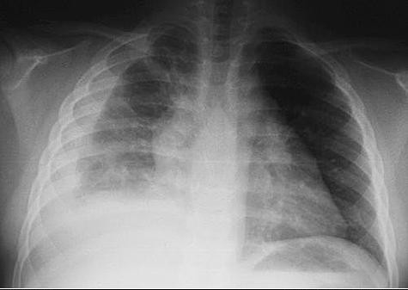
Hemothorax
Blood accumulates in the pleural space
  Lung compression
  Hypoxemia and respiratory distress
Type of injury
  Large pulmonary injury
  Large vessels injury
  Can lead to hypovolemia / shock

Slide 27
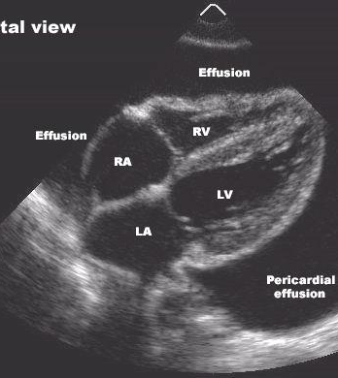
Pericardial Tamponade
Fluid / blood in the pericardial sac
  Compresses heart and ↓ cardiac output
  Impairs venous return
  Arrhythmias
Beck’s triad:
  narrow pulse pressure,
  neck vein distention,
  muffled heart tones
Treat with Pericardiocentesis

Slide 28
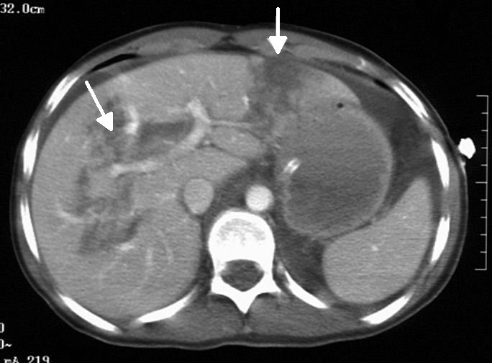
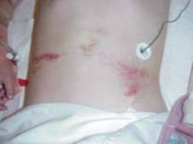
Abdominal injuries
Third leading cause of death in children, after head and thoracic injuries
  Weak abdominal wall
  Poorly protected spleen/liver (no fat, compliant ribcage)
Silent hypovolemia
  - elevated HR
  tender /distended abdomen
Solid organ vs hollow viscous
  Spleen most common

Slide 29
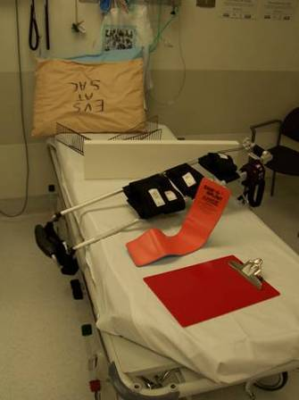
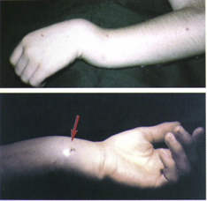
Fractures and extremity injuries
SPLINT, splint, splint…
  Clean and cover wound
  Splint to joint above and below the injury
Pain management !
  Ibuprofen/acetaminophen (paracetamol)
  Opiates
  Nerve block

Slide 30
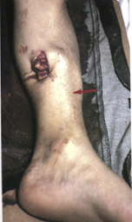
Open fractures
Implies significant force
  - Look for other injuries
Increased complications
  - Infections, nerve impingement
Management
  - Clean, cover, do not suture
  IV antibiotics if available (PO if not)
  immobilize
May need surgical debridement/irrigation/fixation

Slide 31
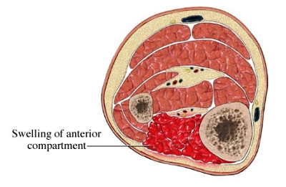
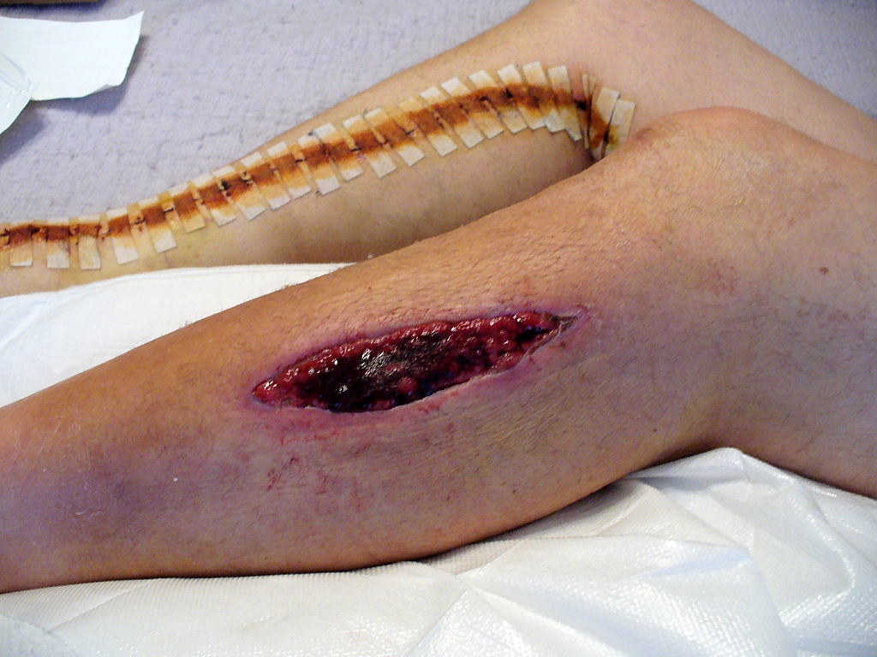
Compartment syndrome
↑ Intracompartment pressure→ ischemia → muscle necrosis and nerve palsies
Trauma does not have to be severe – crush, fracture, burn
  Severe trauma interrupts compartment
↑ Pain, especially with passive extension
Absent Pulse, Paresthesia, Pallor, Paralysis/Paresis
May need fasciotomy

Slide 32
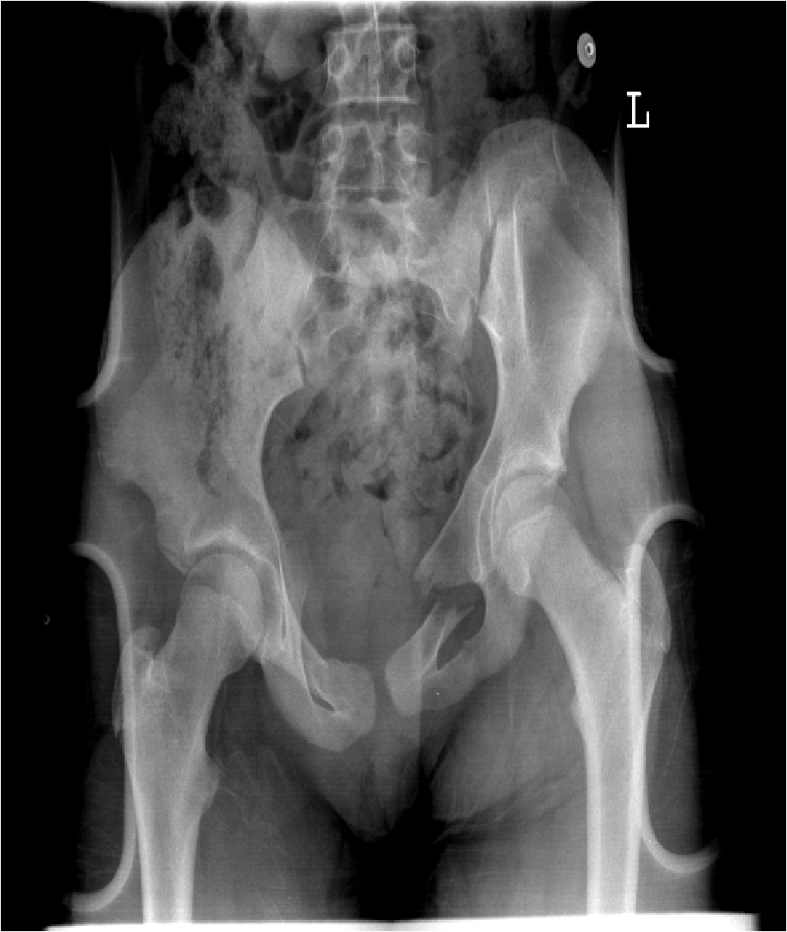
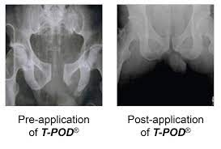
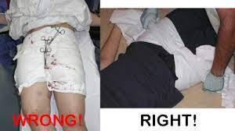
Pelvic fractures
Associated with high energy accidents
  Blood loss can be significant with “open book” fracture
Pelvic ring fracture: single fracture usually stable
Multiple fractures: unstable
  Genitourinary injuries
  Abdominal injuries
  Vascular abnormalities (pelvic vein section)

Slide 33
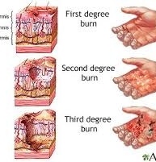
Burn Classification
Superficial (1st degree)
  Red, painful
  Sunburn
Partial thickness (2nd degree)
  Red, painful
  Forms blisters
  Injury to the dermal layer –but can recover
Full thickness (3rd degree)
  White or black
  Not painful
  Full injury to the dermis, may involve the subQ or deeper
  Skin doesn’t have layer to regenerate from

Slide 34
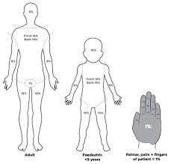
Who needs a burn center?
Minor = Nope
  No hands, feet, genitals/nipple or circumferential burn
  < 10% body surface area (BSA) partial thickness
Moderate = Yes, but likely can delay by hours if low resource
  10-30% BSA second-degree, 1-10% third-degree
  Any involvement of hands, feet, face, major joints or genitalia
  Very young, very old
Critical = Yes, needs one now
  Inhalational injury
  > 30% BSA second-degree, > 10% third-degree
  Complicating fracture
  Circumferential burns
  Extensive electric or chemical burns

Slide 35
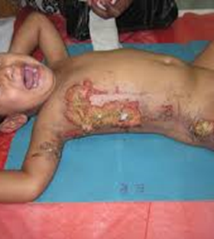
Initial burn management
Remove clothing
Dilute\ wash away offending chemicals
Cover burns with clean dry dressing or sheet
  Can use bacitracin/Vaseline to cover burn
Pain medication
  Prevents contamination, decreases pain
  Bacitracin / Vaseline if available
Keep warm
Replace fluids based on body surface area (BSA)
  >10% BSA in children
  IV vs. oral (may attempt up to 25%BSA)
  Parkland formula, monitor UOP – 1cc/kg/hr

Slide 36
Burn: inhalation injury
Patient was in enclosed area with fire or smoke
Suggested by:
  Soot around the mouth or nose
  Singed eyebrows, eyelashes
  Burns around the face or neck
Signals airway and/or lung injury
Can progress quickly and over time (usually 6-24 hours)
Management:
  Remove the patient from the area/smoke
  Early obstruction of the upper airway is managed with intubation
  Oxygen 100% (non-rebreather mask or controlled airway)
  Consider CO and CN exposure

Slide 37
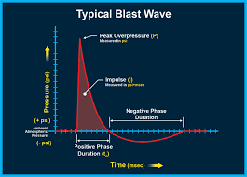
Blast and explosion injuries
Unique injuries due to the blast wave
  Compression/ decompression of gasses
  shock wave
Penetrating, blunt and shear wave injuries
Blast lung is the most common lethal injury

Slide 38
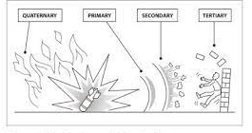
Blast injury classification
Primary – from the blast wave
Secondary – shrapnel/projectile
Tertiary – being thrown into something
Quaternary – other injuries (burn, toxic, flood, exposure)

Slide 39
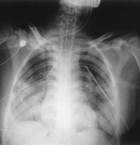
Blast Lung (primary)
Over-pressurization wave
  Tears the airway
  Vascular injuries
Most common fatal injury
  CXR: butterfly pattern
  Progresses over time
Pulmonary contusions, hemo/pneumothorax, fistula’s, air emboli
Treatment:
  Judicious fluids
  High oxygen
  Minimize pressure support
  Permissive hypercarbia
  Thoracentesis
  If flight transport, consider early chest tube

Slide 40
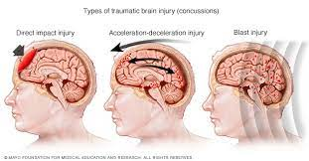
Blast: Brain injuries
Severe head injury is a leading cause of death
  Subarachnoid, subdural hemorrhage most common (fatalities)
  Both from blast wave and from secondary / tertiary injuries
Mild TBI’s are common, but may be subtle
  Signs and symptoms may be subtle
  Memory problems, headaches, dizziness, uneven gait, blurred vision, irritability, confusion…
  Greater number concussions in the military from blast exposures then from trauma
  Can be very severe consequences with minimal external appearance and normal imaging

Slide 41
Blast: Abdominal injury
GI gas-containing structures affected
  Colon: most common site of injury
Intestinal Injuries:
  Common: petechiae, hemorrhages, hematomas
  Severe overpressure leads to intestinal laceration and perforation
Ruptures may occur acutely or several days later
Tension pneumoperitoneum may develop
Any interface of gas/tissue/liquid can be injured

Slide 42
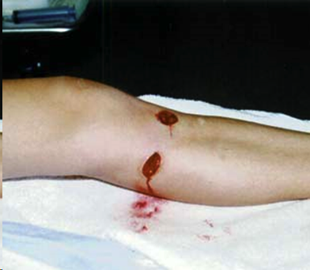
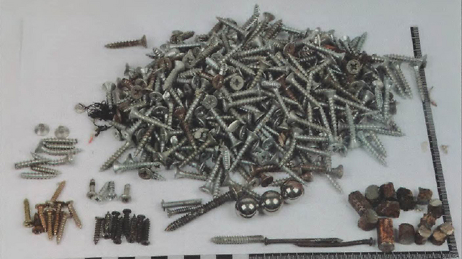
Blast: secondary injuries
Blast wind = flow of superheated air
Secondary injury mechanism
  Flying debris = projectiles
  Blunt and/or penetrating injuries
  Small hole ….. Big injury
  High velocity and force

Slide 43
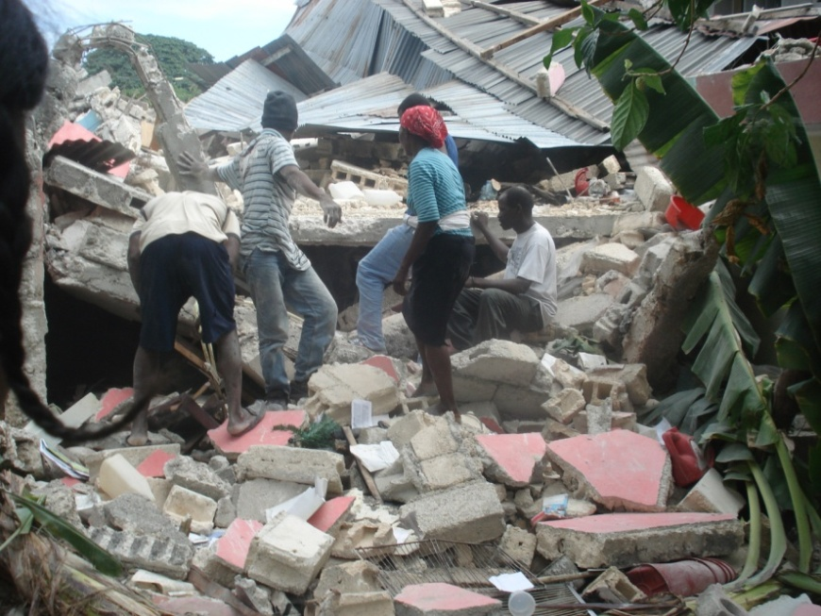
Structural collapse: Crush injury
Traumatic rhabdomyolysis, ischemia
Prolonged compression (2-6hr)
Severe hypovolemic shock
Metabolic abnormalities
  Hyperkalemia
  Hypocalcemia
  Metabolic acidosis
Acute myoglobinuric renal failure …..dialysis
Arrhythmias, DIC, Sepsis, ARDS
Treatment:
Massive volume replacement
Start IV/IO in field prior to evacuation
Alkaline diuresis, mannitol

Slide 44
Transport considerations
Ideally transport to (pediatric) Trauma Center:
  Blunt injuries: with significant injury and /or physiologic compromise
  Penetrating injuries to the thorax, abdomen, head and neck
  Multiple extremity injuries
  Head injury with any altered mental status
Transport to Burn Center: (high risk burns)
  > 10% second degree
  > 5% third degree
  Any inhalation injury

Slide 45
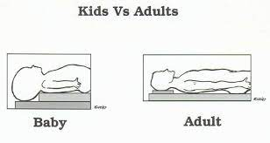
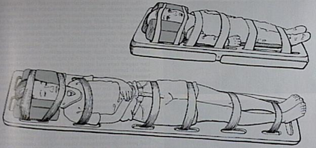
To immobilize or not to immobilize?
Spine immobilization can CAUSE injuries:
  Backboard = pressure ulcer
  Poor C-spine immobilization can impair airway
  Extraction C-collar = pressure ulcer
Spine immobilization usually not needed for penetrating trauma
C-spine injuries do occur in kids (but less….)
  Use proper technique, alignment
  Pad any extraction equipment
  Remove backboard as soon as possible (roll and slide) (less than 1 hour)
  Laying flat on stretcher is good TLS spine precaution (board only for changing beds and transport)

Slide 46
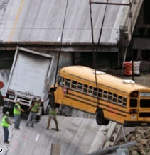
Summary
Trauma in a disaster setting can be overwhelming
  Primary survey – XABCDE
    Find the threats to life
    Fix it first then move on
  Secondary survey
    Find the other injuries
Kids are different
Re-evaluate frequently
Use your resources

Slide 47
Secondary Survey
Perform after primary survey is complete and issues are addressed
Head to toe examination
  Vital signs
  Looking for any signs of injury
  Include back (with a log-roll to protect the spine) and perineum
  Palpate everything!
AMPLE history:
  Allergies
  Medications
  Past medical/surgical history
  Last meal / LMP
  Events leading up to the trauma

