Slide 1


Planning & Triage
MODULE 3
Notes:
This course is designed to train participants in the management of the physical and emotional needs of children impacted by disasters. Each of the 10 modules have been carefully planned and some of the topics may not be appropriate for all participants, especially non clinicians such as public health students. Don’t worry about these clinical topics and their related sessions. Just being exposed to these concepts will be beneficial.

Slide 2
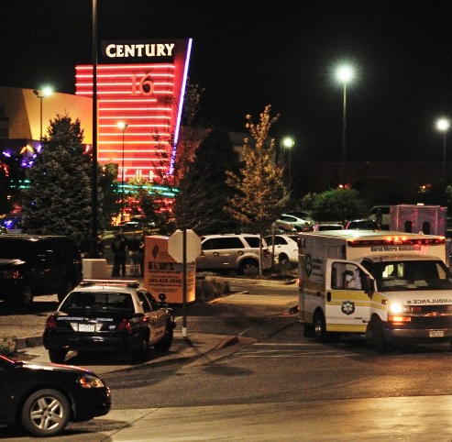
At 0030, July 20, 2012
A gunman dressed in black gear walks into the back exit door of the Aurora Mall Century 16 midnight showing of Batman: The Dark Knight Rises, throws 2 gas canisters in the aisles and opens fire.
70 people are injured.
12 would die.

Slide 3
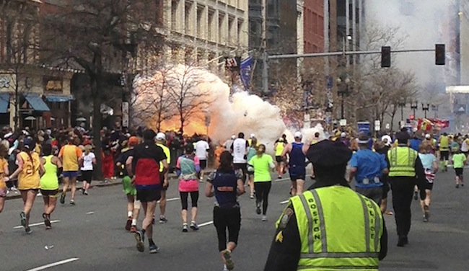
Boston Marathon Bombing
April 15, 2013 at 2:49pm
2 bombs, 12 seconds apart.
264 injured.
3 dead.
Patients sent to 8 hospitals.

Slide 4
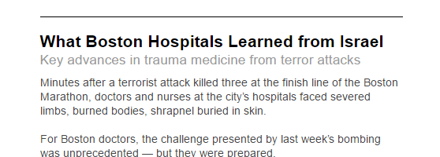
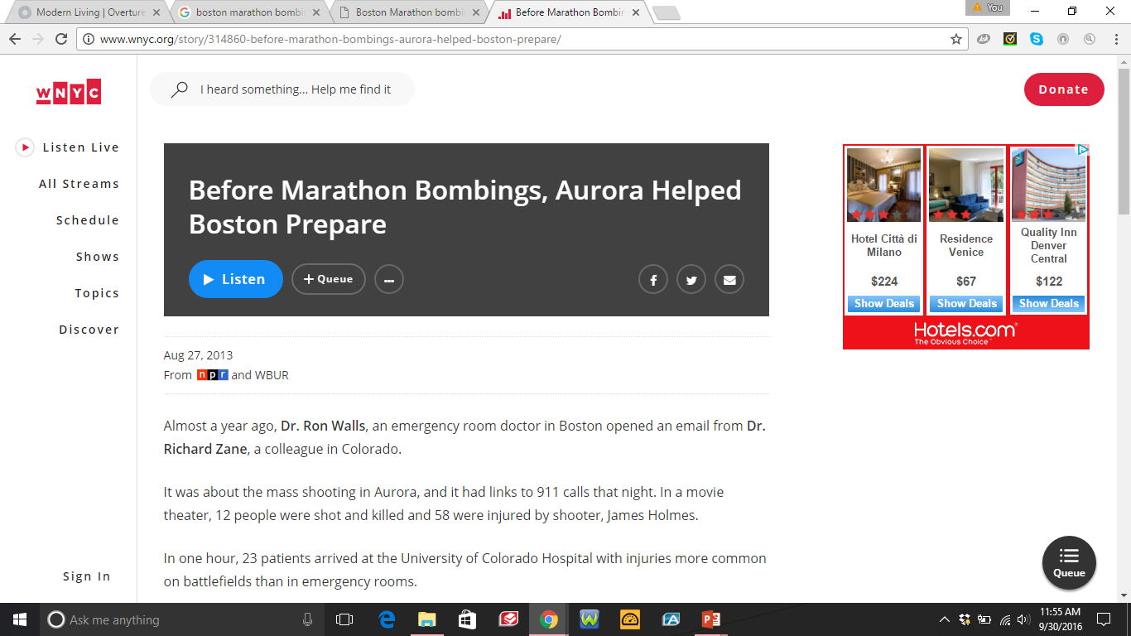
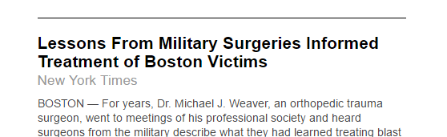

Slide 5
PLANNING
“By failing to prepare, you are preparing to fail”
Benjamin Franklin
Notes:
5

Slide 6
OBJECTIVES
Discuss the components of disaster planning
Review the levels of planning
Discuss the emergency response and organization needed for mass casualty incidents (MCI)
Learn about START and jumpSTART triage algorithms
Understand basic hospital response in MCI

Slide 7
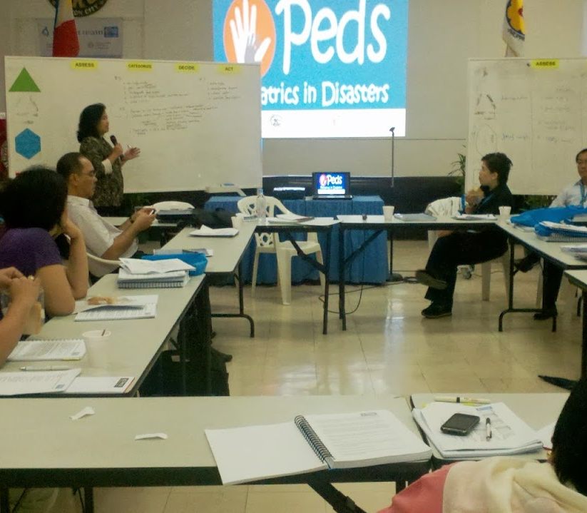
PLANNING IS A PROCESS
Defines the aims and purposes, and the strategies and actions necessary to achieve the aims by using available resources and filling gaps.
Notes:
7

Slide 8
PLANNING PHASES & OBJECTIVES
PREVENTION
RECOVERY
MITIGATION
RESPONSE

Slide 9
KEY PLANNING CONCEPTS
CLEAR
  Simple wording
  No room for misinterpretation
CONCISE
  Able to be read quickly
COMPLETE
  Include all necessary components
KNOWN
  Distribute the plan

Slide 10

EMERGENCY PLAN: SPECIFIC COMPONENTS
Incident command
Information management
Risk assessment
Objectives and goals
Organization
Roles and responsibilities
Communication and coordination
Resources
Training
Notes:
10

Slide 11
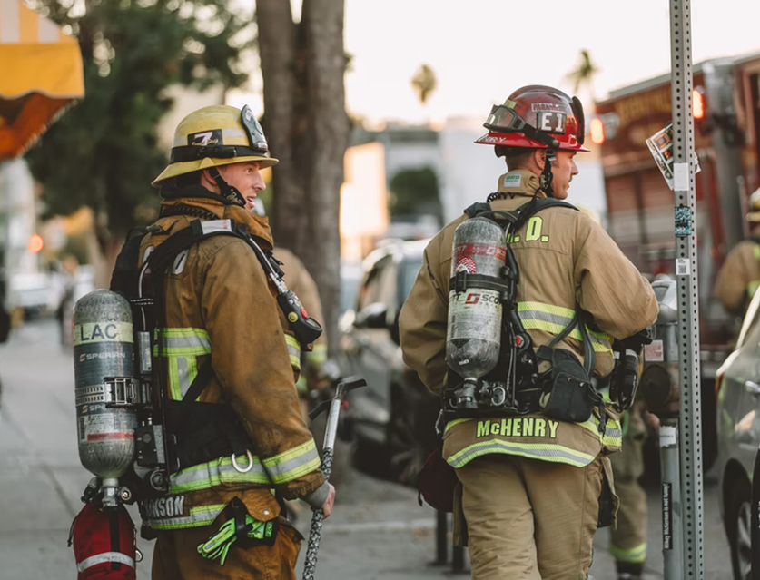
BASIC COMPONENTS OF EMERGENCY PLANNING
Risk assessment and vulnerability analysis
Assessment of existing response system, operative capacity
Identify partners
Resource availability

Slide 12
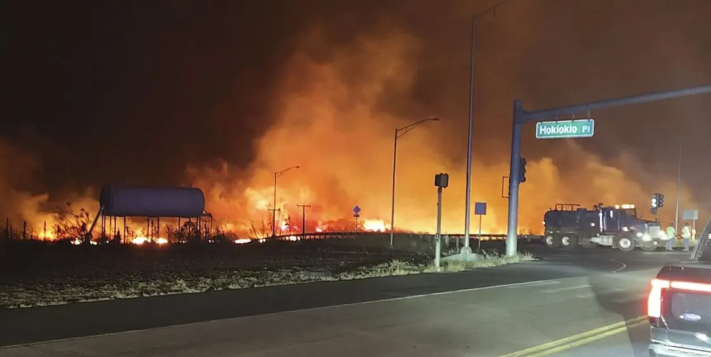
EMERGENCY PLAN: RISK ASSESSMENT
Threat analysis
Natural
Man-made
Contamination
Secondary hazards
Fire and smoke the sky on the intersection at Hokiokio Place and Lahaina Bypass in Maui, Hawaii, on Tuesday, Aug. 8, 2023. Zeke Kalua / AP
Notes:
12

Slide 13
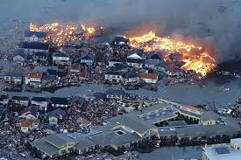
RISKS ASSESSMENT
Damage to infrastructure
Breakdown in security
Breakdown in essential services
Loss of property
Injury
Disease (mental and physical)
Dead and missing
Displaced populations

Slide 14

VULNERABILITIES
Access to health care
Access to safe water
Access to sanitation
Access to adequate housing
Access to regular source of income
Under 5 malnutrition & mortality
Female literacy rates
Measles vaccination coverage

Slide 15
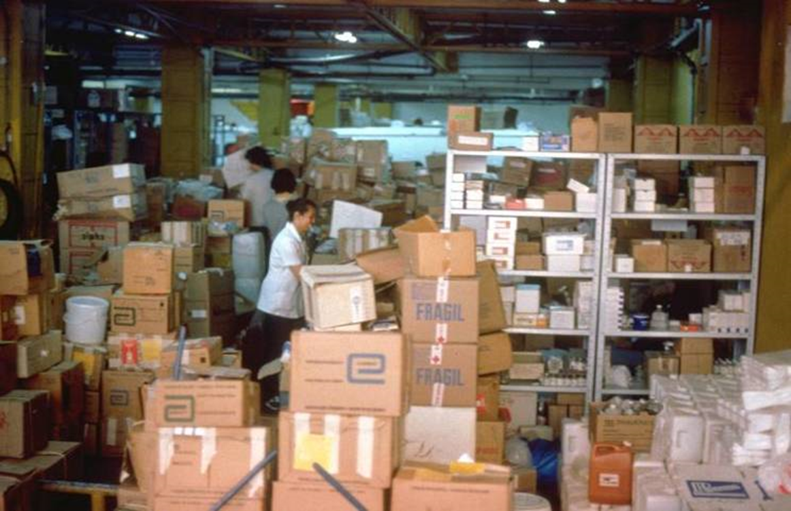
EMERGENCY PLAN: OBJECTIVES & RESOURCES
Priorities
Feasibility
Operative capacity
  Human resources
  Infrastructure and equipment
  Critical supplies
Notes:
15

Slide 16
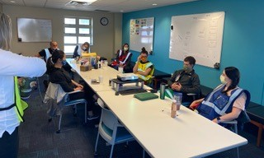
EMERGENCY PLAN: ORGANIZATION
Emergency Operations Committee (EOC)
Plan activation
Hierarchy of authority
Roles and responsibilities
Multi-sector participation
Communication coordination
Media relations
Community Involvement
Notes:
16

Slide 17











MULTISECTOR INVOLVEMENT
HEALTH EOC
INFRASTRUCTURE
AND ENVIRONMENT
FOOD AND NUTRITION
SECURITY
PREHOSPITAL AND HOSPITAL CARE
LOGISTICS
MOTHER-CHILD
COMMUNICATION
AND
COMPUTER TECHNOLOGY
MENTAL HEALTH
PUBLIC
RELATIONS
EXTERNAL
HELP
MANAGEMENT AND CONTROL OF SHELTERS
HEALTH SURVEILLANCE
HEALTH DAMAGE AND
NEEDS ASSESSMENT
Notes:
17

Slide 18
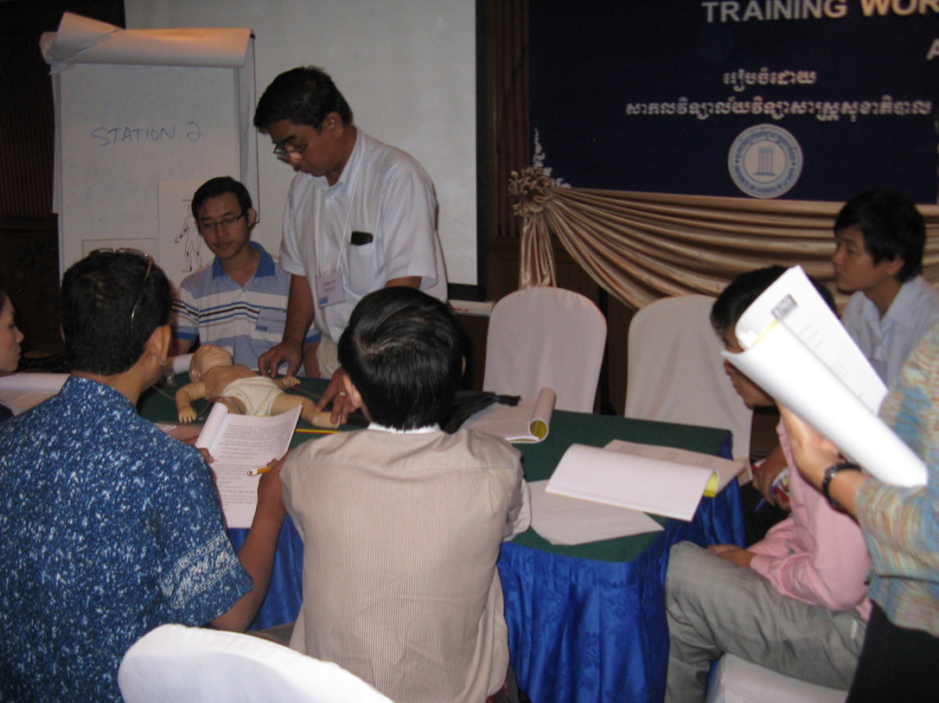
EMERGENCY PLAN: ROLE ASSIGNMENTS
Who does what?
When?
How?
With what?
Notes:
18

Slide 19
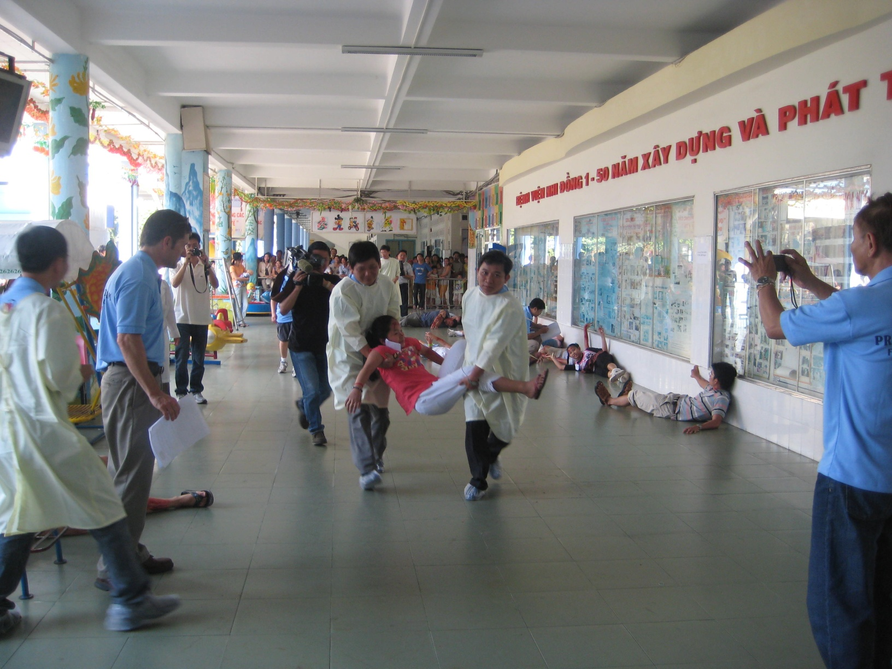
EMERGENCY PLAN: TRAINING
Notes:
19

Slide 20
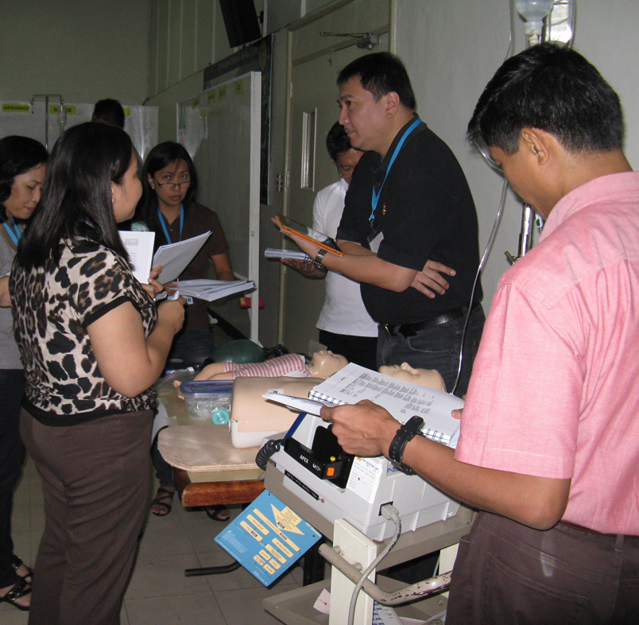
EMERGENCY PLAN: TRAINING
Utilize and test knowledge of basic concepts
Identify gaps
Target group
Simulation
Repetition
Notes:
20

Slide 21
PLANNING LEVELS
NON-GOVERNMENTAL
GOVERNMENT
FAMILY
SCHOOLS
SHELTERS
CLINICS
HOSPITALS
LOCAL
REGIONAL
NATIONAL

Slide 22

THE PEDIATRICIAN’S ROLE
Preparedness and risk reduction
Disaster response participant
Specialist input
Awareness of local emergency plans
Advocacy
Notes:
22
22

Slide 23
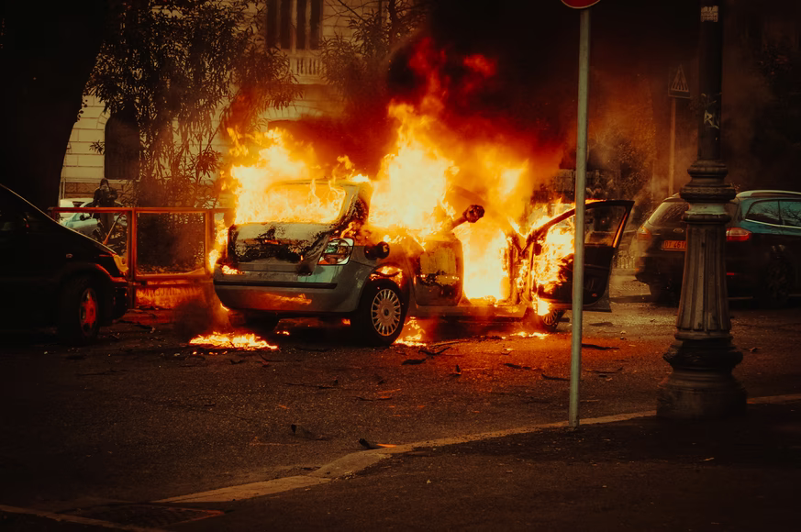
CHALLENGES
  State of social behavior
  Unknown hazards or vulnerabilities
  Response capability
  Lack of resources
  Damage and disruption
  Communication failures

Slide 24
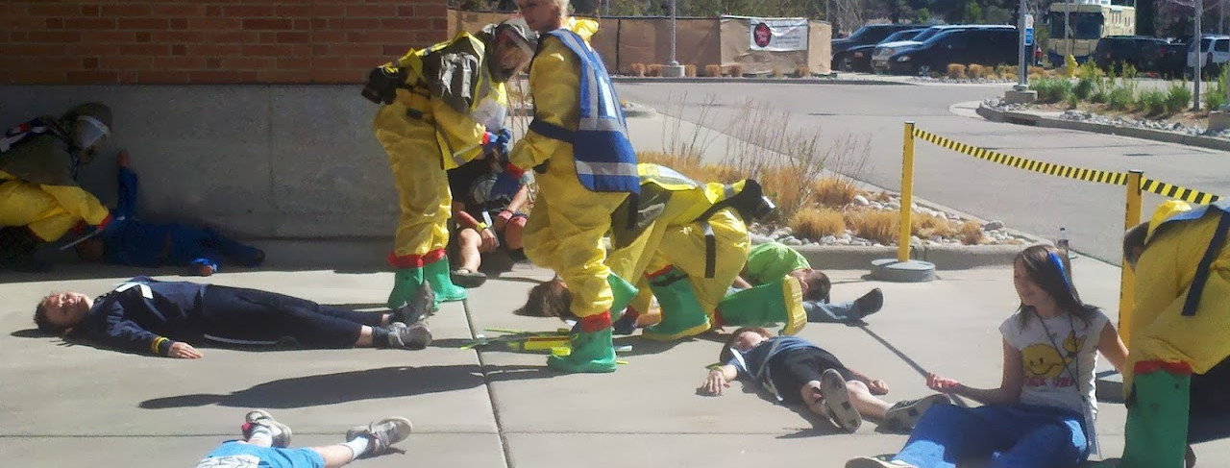
Mass Casualty Management & Triage

Slide 25
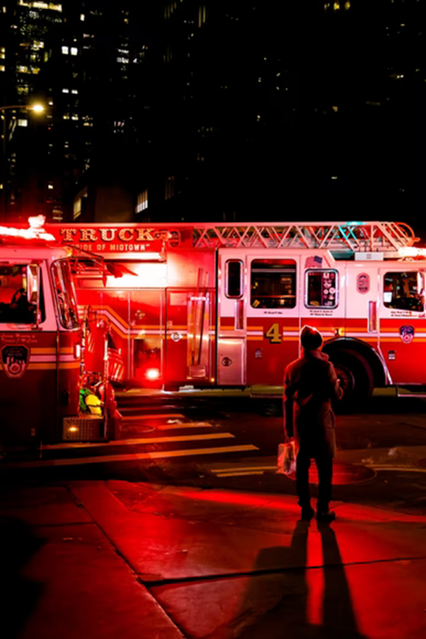
MASS CASUALTY MANAGEMENT SYSTEM
Adequate response to mass casualty incidents (MCI)
Preparation, response, communication
Pre-established procedures for:
  Resource mobilization
  Field activities
  Coordinated reception at hospitals
Based on specific training of responders
Avoid system and function overlapping
Notes:
25
25

Slide 26
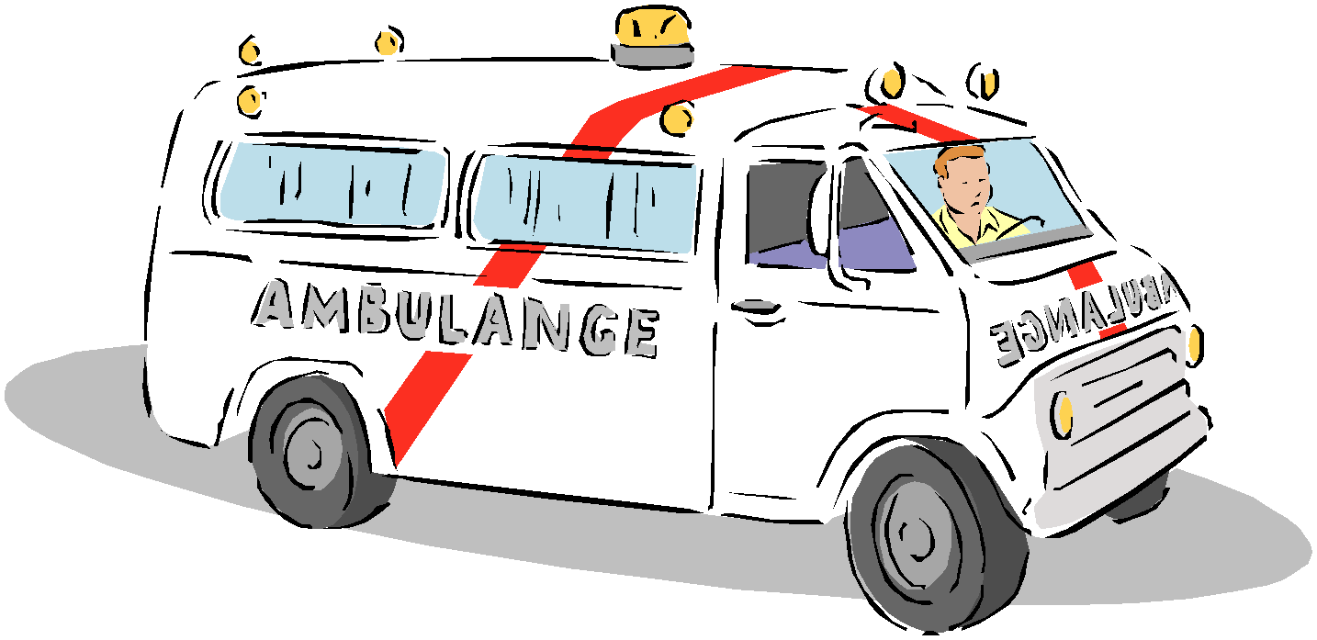
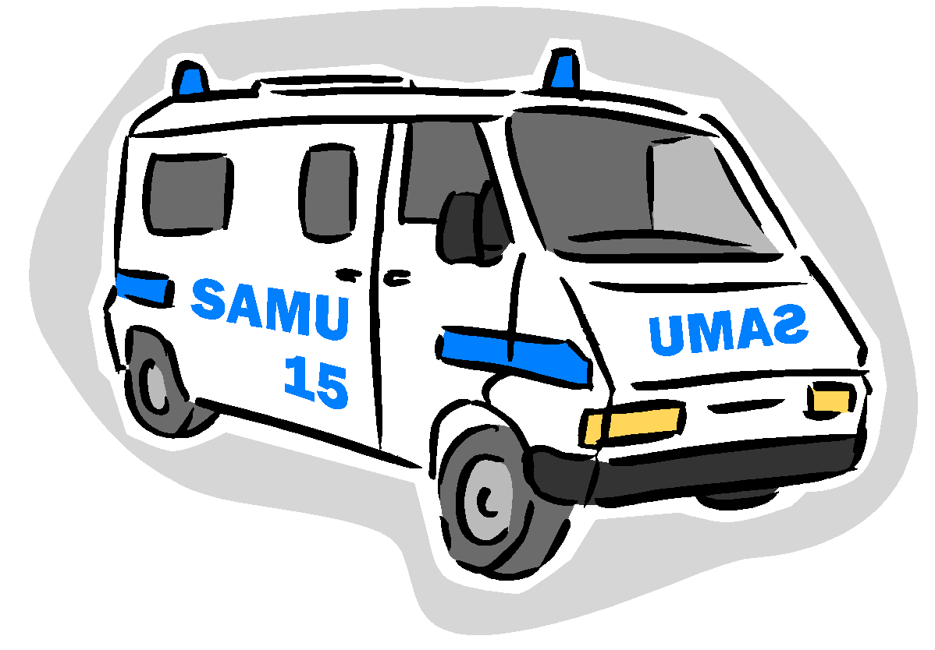
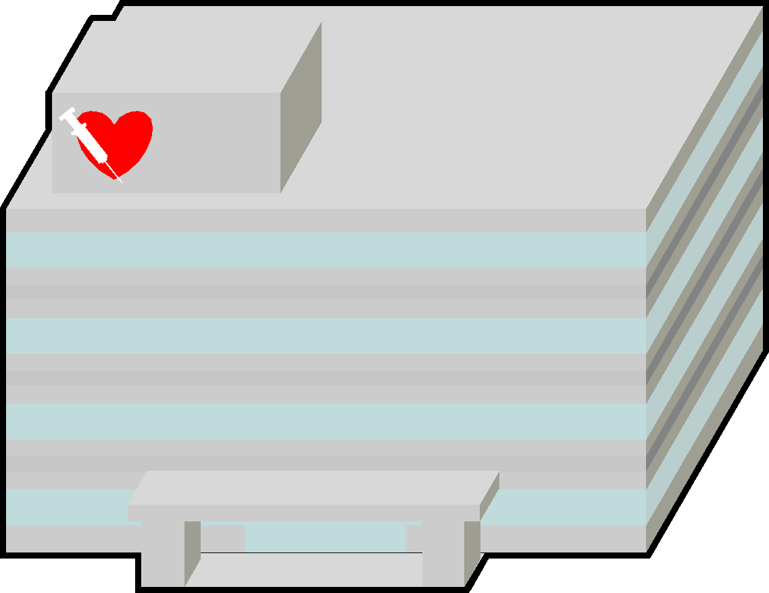
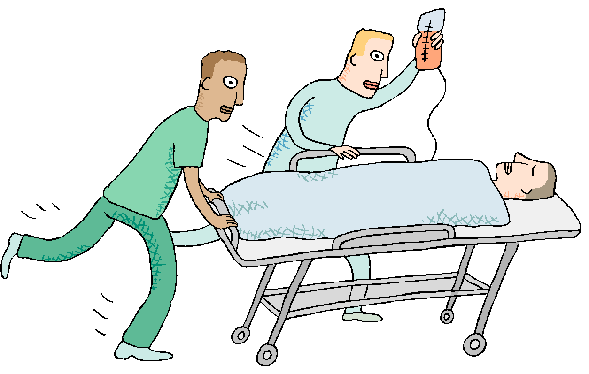
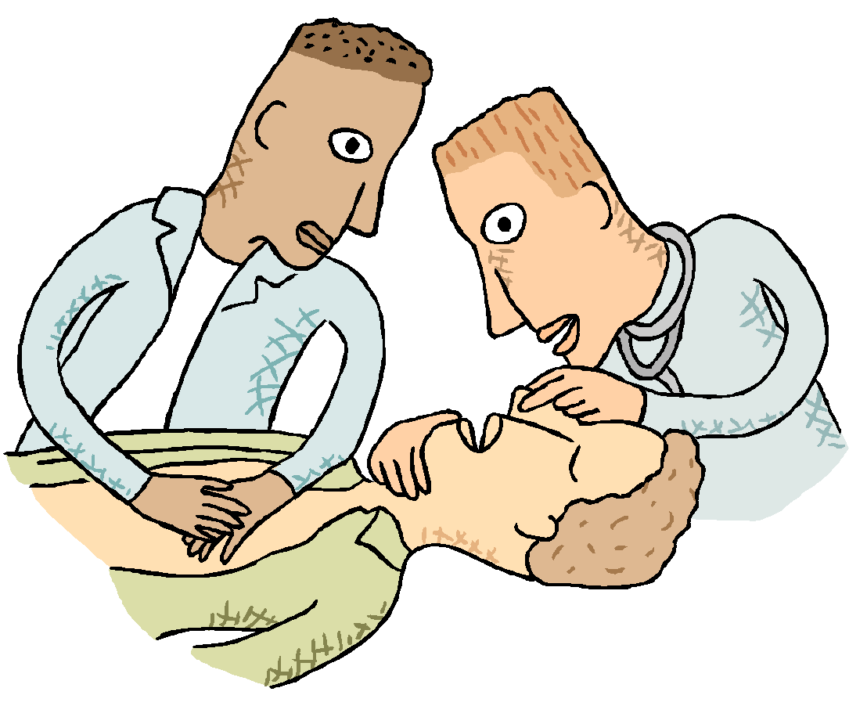



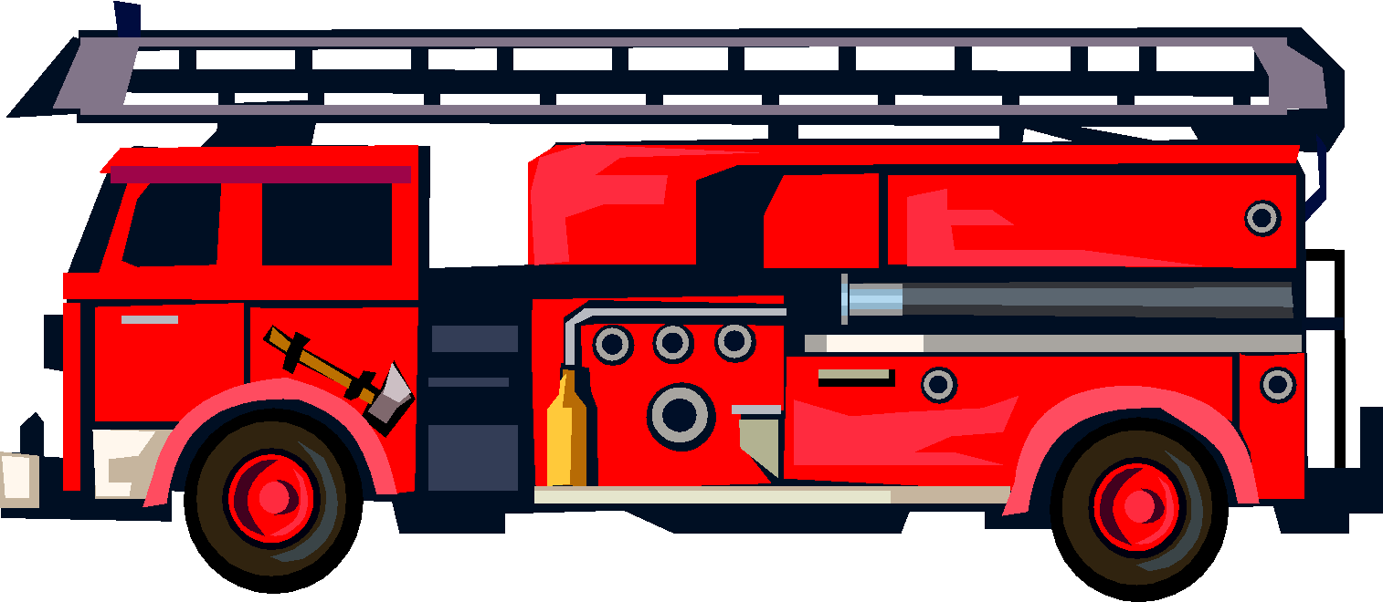

MASS CASUALTY MANAGEMENT SYSTEM
IMPACT ZONE
HOSPITAL DISASTER RESPONSE PLAN
COMMAND POST
Emergency Department
Search
Rescue
Triage
Traffic control
Regulation of evacuation
Triage
First aid; Stabilization
Evacuation
Triage
PRE-HOSPITAL ORGANIZATION
HOSPITAL ORGANIZATION
Multi-sector rescue chain

Slide 27
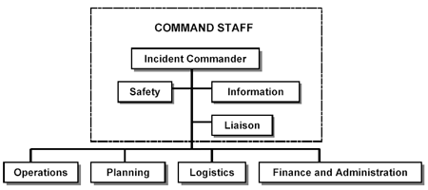
INCIDENT COMMAND SYSTEM
List of needed positions with specific tasks
Create task Check Lists for each person/position
Each person may need to undertake more than one task
Notes:
27
27

Slide 28
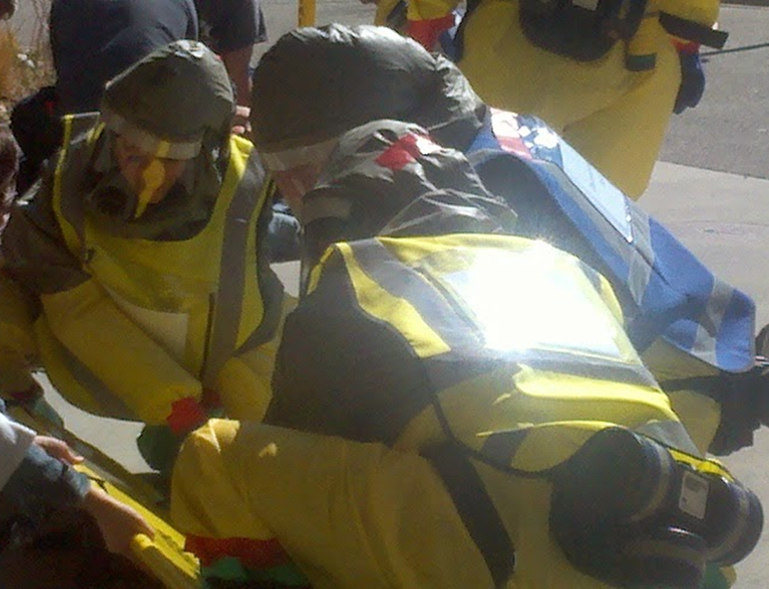
TASK ASSIGNMENTS
Command Post – on-site
Search and Rescue – on-site
Triage – on-site
Treatment Areas – on-site Advanced Medical Post
Transportation / Evacuation
Hospital – Triage and Treatment Areas

Slide 29
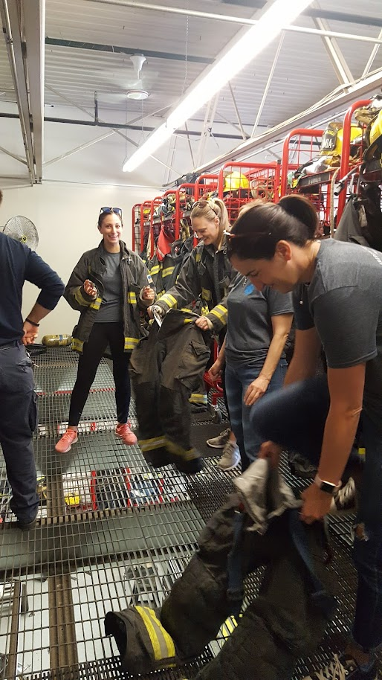
SCENE ASSESSMENT
Is the scene safe and can a Command Post be established?
Do we have Personal Protective Equipment (PPE)?
Are there available supplies for an Advanced Medical Post?
How many patients need to be evacuated?
What other resources are necessary?
Has the Emergency Medical Service been notified?
Notes:
29
29

Slide 30
ORGANIZATION AT THE DISASTER SITE
Collecting zone
Collecting zone
Impact zone
Hospital
Triage
Evacuation
AMP
Command post
Access
Strictly restricted
Restricted / reserved
Patient flow
Transport resource flow
(“conveyor belt” management)
FIELD MASS CASUALTY MANAGEMENT
Notes:
30
30

Slide 31
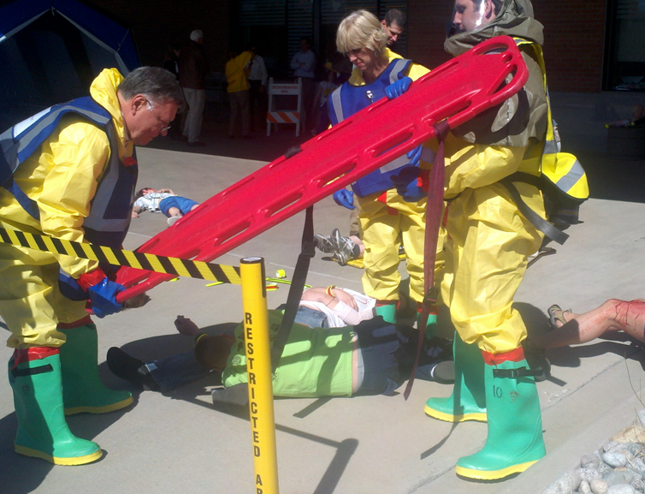
RESCUE & SECURITY ON-SCENE
Most physicians are not trained for on-scene rescue... Let the experts do it!
Risks for the rescuer
  Structural instability/ collapse
  Fire, carbon monoxide, cyanide
  Dirty, chemical (neurotoxic) bombs, radiation
  Blood exposure
Notes:
31

Slide 32
TRIAGE AND STABILIZATION
IMPACT ZONE
HOSPITAL DISASTER RESPONSE PLAN
COMMAND POST
Emergency Department
Search
Rescue
Triage
Traffic control
Regulation of evacuation
Triage
First aid; Stabilization
Evacuation
Triage
PRE-HOSPITAL ORGANIZATION
HOSPITAL ORGANIZATION
Multi-sector rescue chain

Slide 33
ON-SITE TRIAGE IN MCI : GOALS
Establish Treatment Priority
Determine Evacuation Priority
On-going Reassessment

Slide 34
TRIAGE
Needs >>> resources
Necessity of categorization to ensure the greatest good to the greatest number
Ensures most efficient use of limited resources
Quick and limited assessment of victims
  Determine priority of treatment for survivable injuries
  “Golden hour” vs. “The 10 platinum minutes”
Primary triage concerned only with clinical condition regardless of age
Notes:
34

Slide 35
TRIAGE
Emotional and psychological stress can be confused with medical disease
START (Simple Triage and Rapid Treatment): focus on objective signs in patients > 8 yrs
Psychologically affected casualties triaged as “minimal”
Unique issues with children
Notes:
35

Slide 36
START TRIAGE
Classification Categories
Green or “minimal” | “Walking wounded” – Victims who can relocate on their own
Yellow or “delayed” | Injured who are not able to relocate on their own
Red or “immediate” | Injured who need immediate attention or evacuation
Black or “expectant” | Cannot be saved
Notes:
36
The remaining victims will be further evaluated. This should take no longer than 1 minute per patient and will focus on three primary areas:
Respiratory status
Perfusion
Neurological status.
As the responder moves through each level of assessment, any condition that is deemed immediate (red ) stops the evaluation process. Some minimal interventions such as airway repositioning and pressure bandage application may be completed. Once the patient is tagged, the responder moves on to the next patient.. A yellow tag indicates a patient whose medical care may be delayed, and a black tag indicates a patient who has died or has nonsurvivable injuries.

Slide 37
START Triage
Respiratory Status
No respiratory efforts
Abnormal breathing
Normal breathing
Expectant
Immediate
Move to next step
Abnormal <10 RR >30
Airway support

Slide 38
START Triage
Perfusion Status
No radial pulse or
CR > 2 secs
Radial pulse present or
CR< 2 secs
Immediate
Move to next step

Slide 39
START Triage
Neurologic Status
Altered level of consciousness
Obeys commands
Immediate
Delayed

Slide 40
TRIAGE CATEGORIES
Patient Status | START/SALT | Military / International | Color Code | Priority
Critical | Immediate | Immediate | Red | 1
Stable | Urgent / Delayed | Delayed | Yellow | 2
Good | Minimal | Minimal | Green | 3
Deceased | Expectant | Expectant | Black | 4
 | Dead
Contaminated

Slide 41
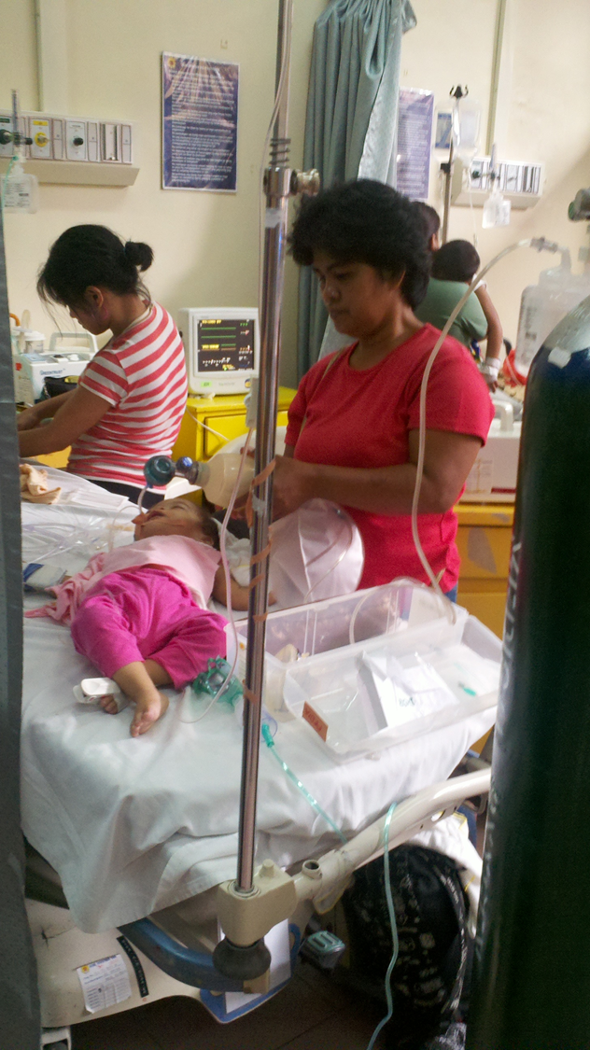
START: POTENTIAL PROBLEMS
WITH CHILDREN
Apnea: A primary respiratory problem?
Perfusion maintained: The child may be saved
Respiratory rate cut-off of 30 is too low
Capillary refill: Not useful in cold environments
Response to orders: Not useful in young children
Notes:
41

Slide 42
TRIAGE IN CHILDREN
Pediatric triage system JumpSTART®
Similar to START algorithm
DIFFERENCES
Decisions are based on physiological criteria with normal pediatric ranges
Identifies the apneic child who still has some degree of perfusion, before an irreversible cardiac injury secondary to anoxia develops
Notes:
42
42

Slide 43
JumpSTART©
Categories
  Minimal: Able to walk
  Delayed: Respiratory rate (RR): 15-45 and alert or responsive to voice.
  Immediate: RR <15 or >45 after airway positioning and/or 5 rescue ventilations and pulse present
  Deceased: No breathing or pulse after airway repositioning & rescue ventilation
Notes:
43

Slide 44
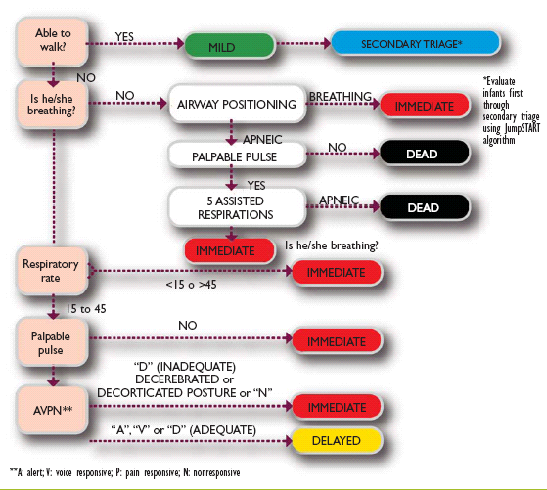
JumpSTART©
Notes:
44

Slide 45
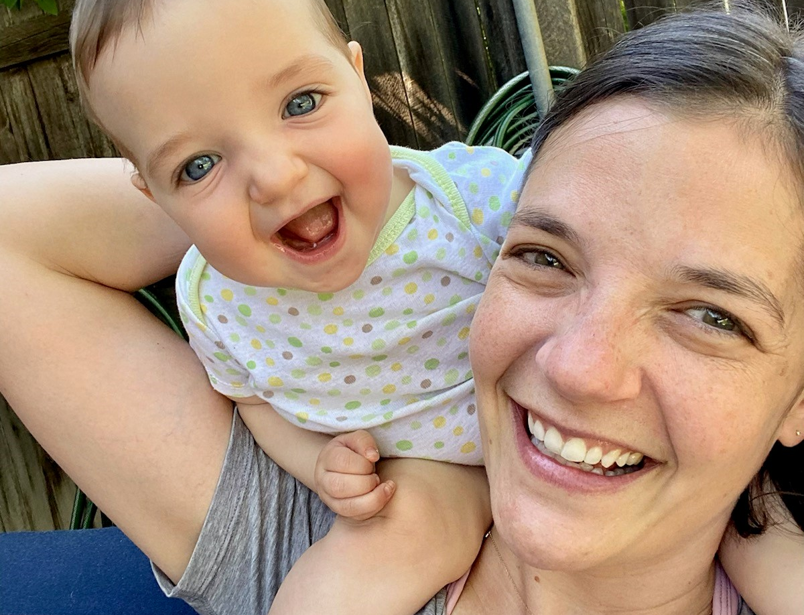
MODIFICATION: CHILDREN WHO DO NOT WALK
All non-ambulatory, young children should be assessed first by the medical staff and triaged at least initially as YELLOW.
Notes:
45

Slide 46
SALT Triage Algorithm
Sort, Assess, Life-saving intervention, Treatment/Transport
Step 1: Global Sorting
Walk
Wave/Purposeful movements
Still/Obvious life threat
Assess 3d
Assess 2nd
Assess 1st

Slide 47
SALT Triage Algorithm
Obeys commands or purposeful movements?
Peripheral pulse?
Not in resp distress?
Major hemorrhage controlled?
Step 2: Individual assessment
Life saving interventions:
Hemorrhage control
Open airway (if child, consider 2 rescue breaths)
Chest decompression
Auto-injector antidotes
Yes
Any No
All Yes
Breathing
Likely to survive given current resources?
Minor injuries only?
No
No
Yes
Dead
No
Yes
Expectant
Immediate
Delayed
Minimal

Slide 48
TRIAGE IN MCI
On-site Triage
  Classify victims on-site, in the casualty collecting point
  If personnel do not have experience in MCI, use only two categories:
  Acute (Yellow & Red) & Not Acute (Green & Black)
On-site Evacuation Triage
  Classifies victims in terms of their priority for transportation to a hospital that can receive them
Medical Triage
  Determines the required level of care

Slide 49
ROLES OF THE ADVANCED MEDICAL POST
Triage
Treat
Transport
3 T’s Principle
Notes:
49
49

Slide 50
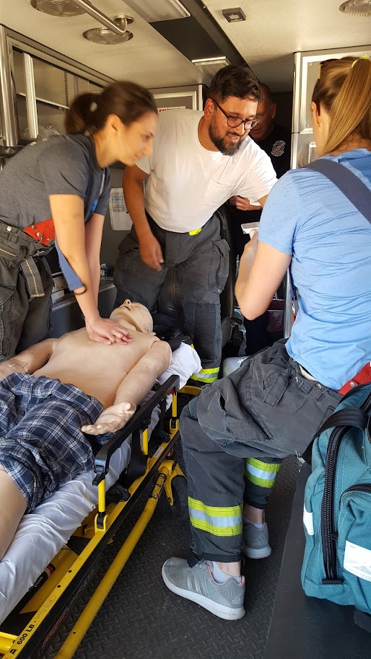
TRANSPORT OF VICTIMS
Control number and destination to avoid overwhelming hospitals
Medical officer in Incident Command or AMP:
  Receives data about patient status
  Contacts hospitals
  Confirms there is space available in the hospital
  Notifies transport

Slide 51
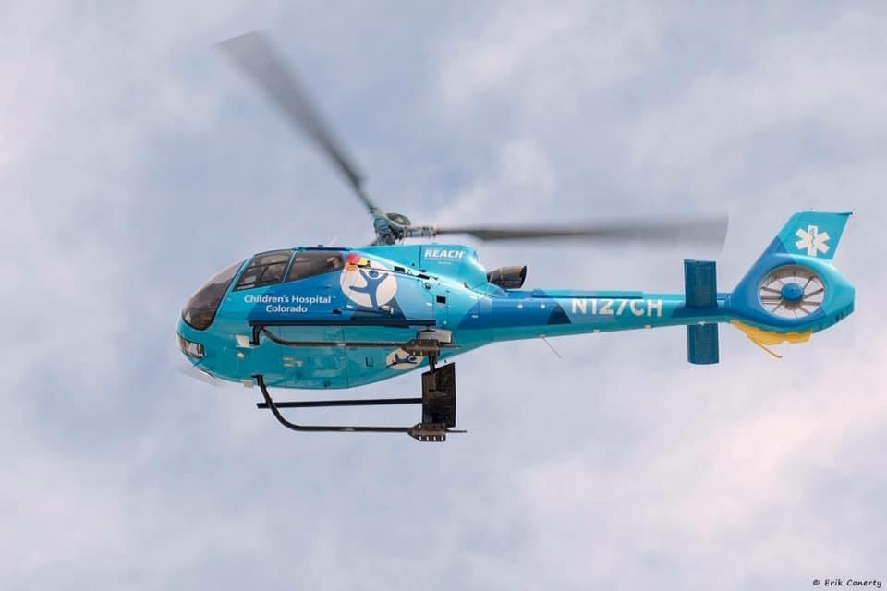
TRANSPORT OF VICTIMS
Evacuation Post:
  Assess the patient’s stability
  Evaluates the security of the equipment
  Records patient’s data
Use the “Noria” principle
Hospital:
  Constant monitoring of space availability

Slide 52
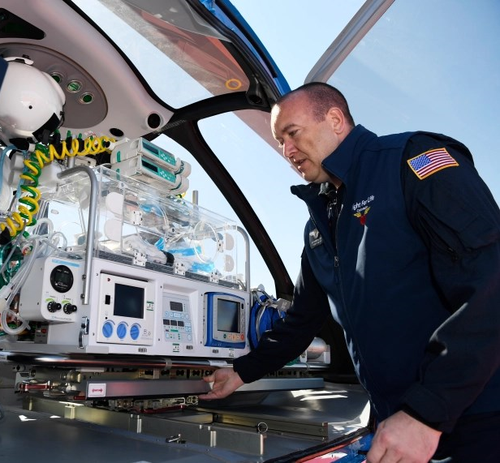
PATIENT TRANSPORT
Immediate: Transported from the scene by ambulance or helicopter to a trauma center, if available
Delayed: By ambulance to other emergency facility
Minimal: Limited to on-site management, can be transferred to a more distant health care center, if necessary
Deceased: To the morgue (hospital)
Notes:
52

Slide 53
HOSPITAL ORGANIZATION
IMPACT ZONE
HOSPITAL DISASTER RESPONSE PLAN
COMMAND POST
Emergency Department
Search
Rescue
Triage
Traffic control
Regulation of evacuation
Triage
First aid; Stabilization
Evacuation
Triage
PRE-HOSPITAL ORGANIZATION
HOSPITAL ORGANIZATION
Multi-sector rescue chain

Slide 54
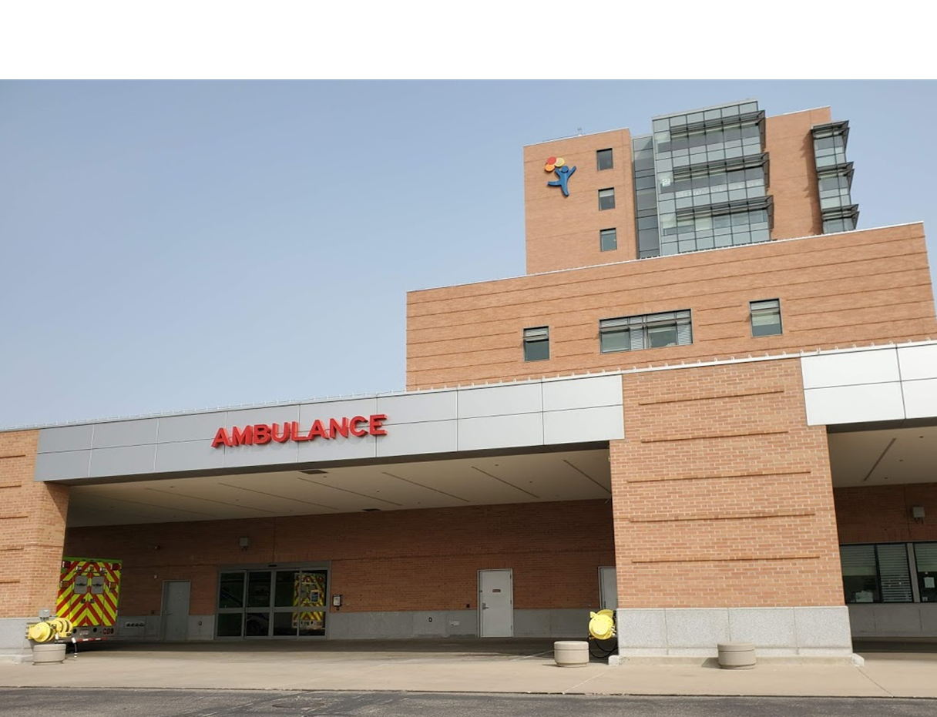
HOSPITAL: PATIENT RECEPTION
Prepare areas
  Reception and triage
  Decontamination
  Treatment
Determine capacity and surge capacity in:
  Emergency Department
  Trauma rooms
  Surgery
  Critical care unit
Assess available resources
Notes:
54
54

Slide 55
PREPARING FOR PATIENT INFLUX
Assume that health care will rely upon local resources
Activate the hospital emergency plan
  Notification and activation of chain command (HICS)
  Safety
  Prepare areas and increase availability
  Prepare decontamination and isolation procedures, if needed
  Assess available resources (personnel, blood, drugs, communications)
  Agreements for referral to other hospitals
  Information center for press, families
Frequent drills
Notes:
55

Slide 56
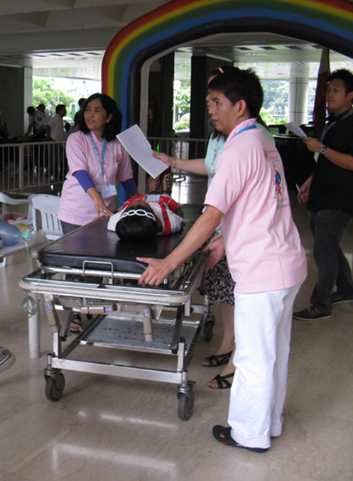
HOSPITAL TRIAGE IN AN MCI
Use a triage system that parallels normal routine
Practice regularly
Triage is a continuous process
Re-triage all victims transported by EMS
Set up triage area near the ED entrance
  Shielded and secure
  Readily accessible
Notes:
56

Slide 57
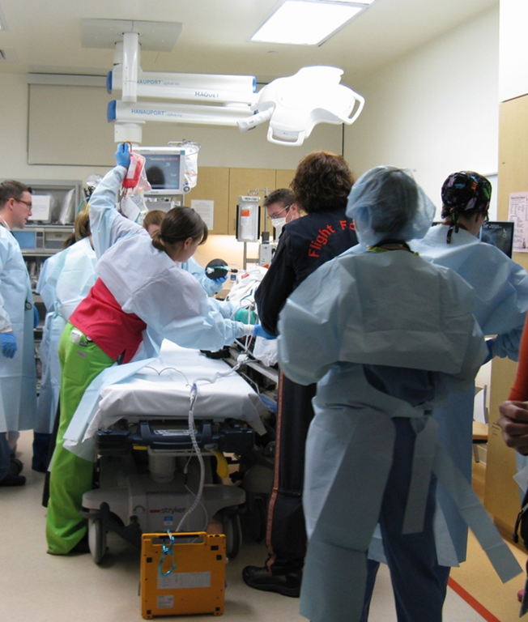
MEDICAL TRIAGE
Red: Require immediate stabilization, may need emergent operative intervention and ICU
Yellow: Care can be delayed, but close monitoring required, observation or admission
Green: Delayed care or no treatment or referral
Black: Deceased
Notes:
57
57

Slide 58
HAZMAT CONSIDERATIONS
1
4
Presence of
Contamination
Initiate
Secondary Decon
YES
2
5
Initiate START
Primary Decon
Secondary
Triage
Symptomatic Tx PRN
3
6
Strip/Bag
Evidence
Move to
Tx & Transport

Slide 59
SUMMARY
Disaster preparedness through planning at all levels
Accomplish the greatest good for the greatest number
Triage: simplified sorting of casualties & to prioritize treatment
Triage is a continuous process
Special considerations for children
Documentation!!

Slide 60
Thank you

