Slide 1


Preventative Medicine
in Humanitarian Emergencies
MODULE 2
Notes:
This course is designed to train participants in the management of the physical and emotional needs of children impacted by disasters. Each of the 10 modules have been carefully planned and some of the topics may not be appropriate for all participants, especially non clinicians such as public health students. Don’t worry about these clinical topics and their related sessions. Just being exposed to these concepts will be beneficial.

Slide 2
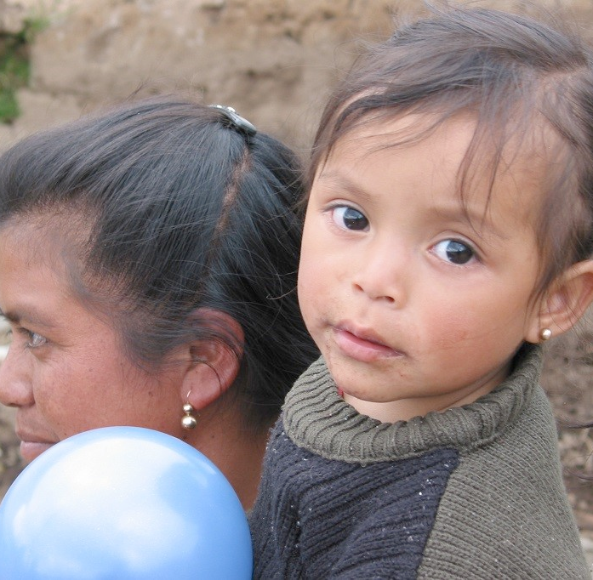
Vital signs = Disease rates
Used to compare the realities of different communities and to evaluate the success of interventions over time.
Rates = persons with disease/condition X even number of people at risk
Even number represents the size of the population: Usually either 1000, 10,000 or 100,000

Slide 3
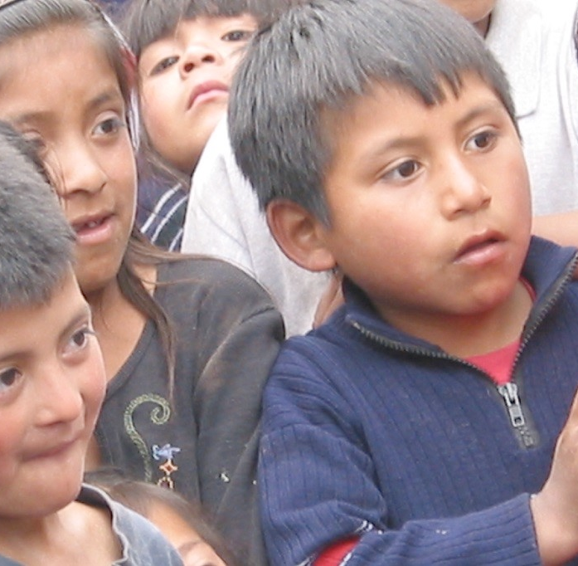
Rates
It is critical to define precisely both numerator and denominator
NUMERATOR: uniform criterion to define
a case, so as to ensure data can be compared
DENOMINATOR: define adequately the population at risk (usually age groups)

Slide 4
Incidence Rates:
Number of defined new cases in a given time (day, week, month, year) per n population (1000, 10,000, 100,000)
Prevalence Rates:
The proportion of defined cases present in a given population at a given time, and is expressed in percentages

Slide 5
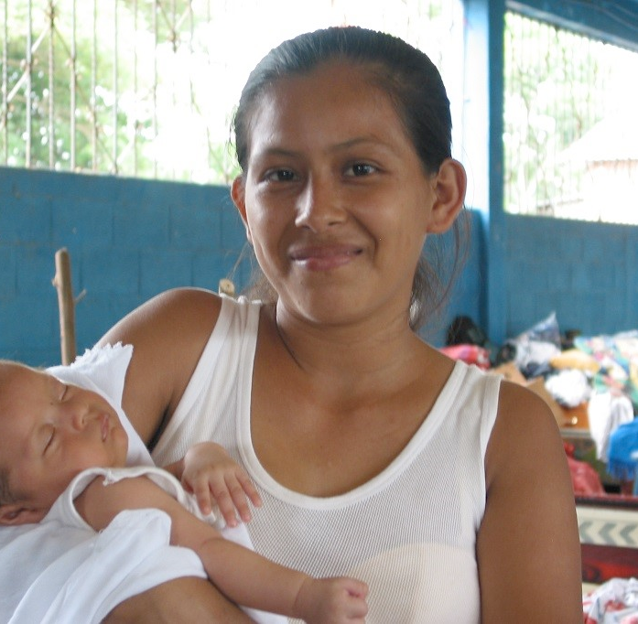
Children < 5 with diarrhea
Town A = 304 cases
Town B = 1054 cases
Which town has more diarrhea problems?

Slide 6
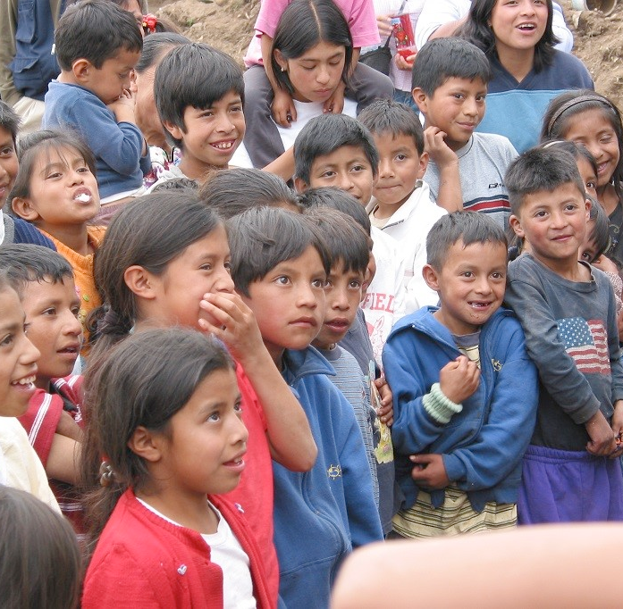
Rates of diarrhea per 10,000 children < 5
Town A: 1597 children < 5
Rate= 304/1597 x 10,000=1904
Town B: 12,818 children < 5
Rate= 1054/12,818 x 10,000= 822

Slide 7
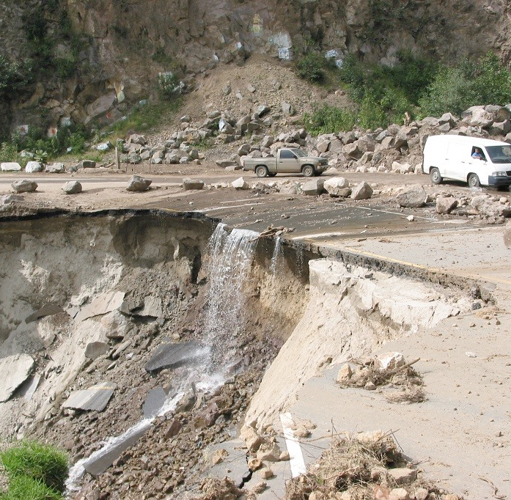
Hurricane in Guatemala
Destroyed roads, no electricity, inoperable land line and cell phone communications, difficult terrain, mud slides, harsh weather make it difficult to know what is happening in the urban and rural areas
You serve as a consultant helping to organize and coordinate the emergency response
What is your first recommendation?

Slide 8
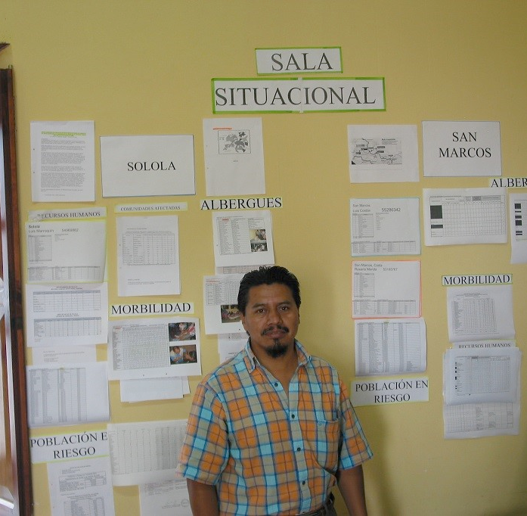
Population Evaluation
Demographics
Pre-disaster health conditions
Health care system evaluation
Mortality and morbidity surveillance
Emergency needs assessments

Slide 9
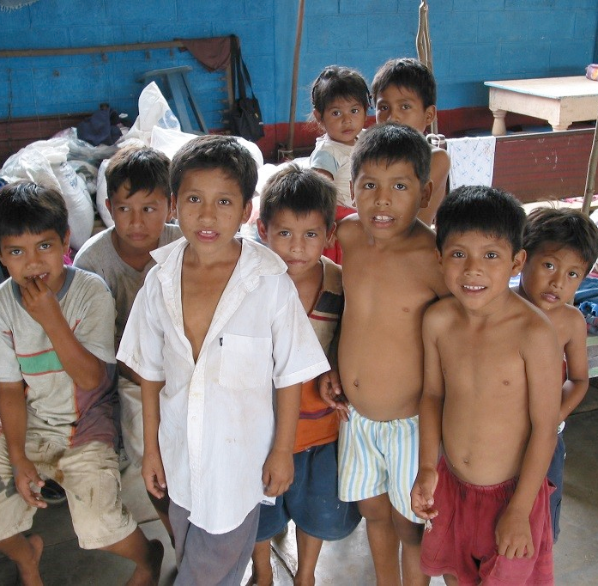
Demographic assessment
Counting methods
Over flights
Ground visual estimates
Sampling
Census
Population structure-male/female and age groups <5, 5-15 years and >15
At risk groups: small children, pregnant and breast-feeding women, injured and elderly

Slide 10
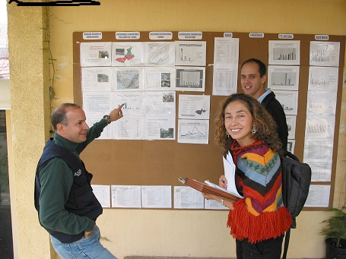
Pre- Disaster Health Conditions
Know your community before a disaster strikes
What is the baseline malnutrition rate?
What were the Immunization rates?
Where are the most vulnerable children living?
Are there vector-borne illnesses?
What are the most prevalent diseases?

Slide 11
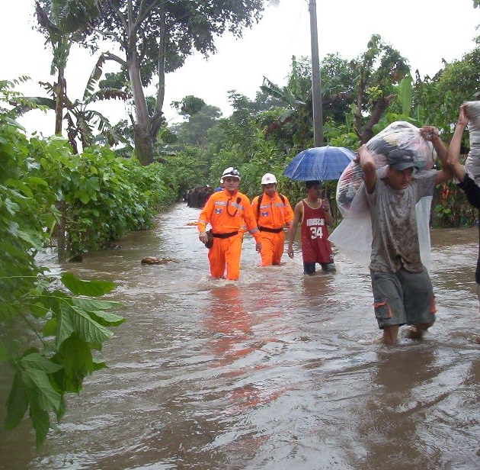
Rapid Assessment Team
Within 24 hours rapid assessment teams are flown into the affected areas by military helicopter
Members:
Doctors, nurses, surgeons,
Psychologists
Social workers
Logisticians
Water and sanitation experts
Flight-transport specialists

Slide 12
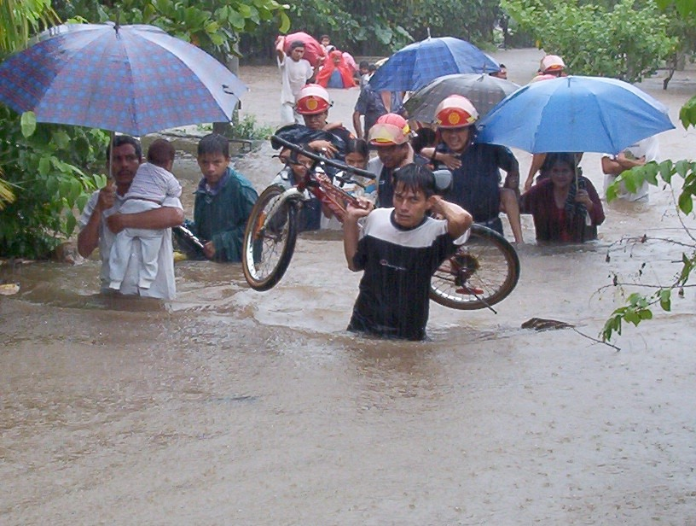
Critical needs in the evaluation of emergency needs
Safe water
Nutritional status
Shelter
Basic sanitation
Local environmental conditions
Public Health needs

Slide 13
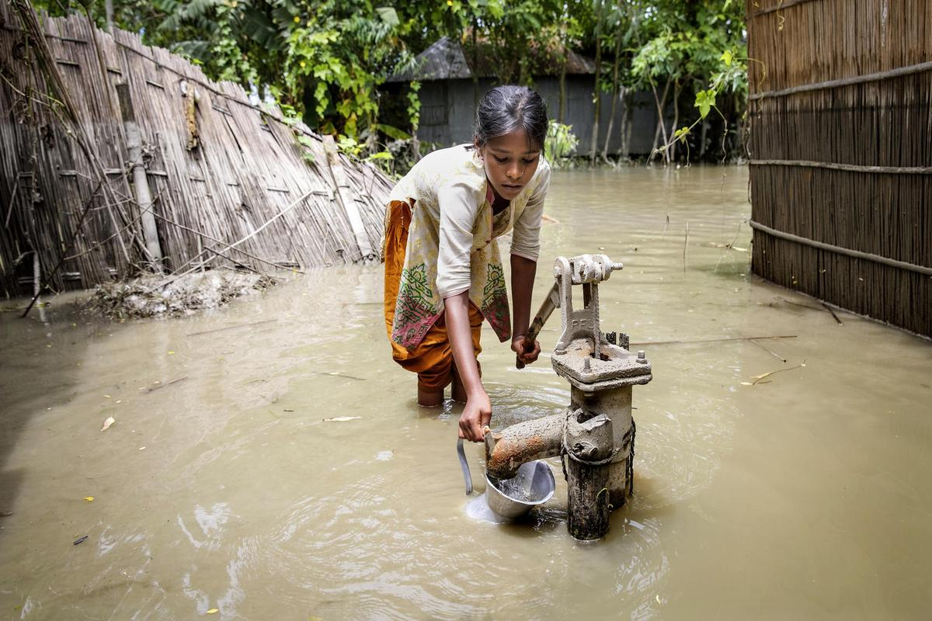
Water:
Number one priority
3-4 liters/person/day to maintain life*
15-20 liters/person/day: a better estimate- takes into account cooking and cleaning
While at first quantity is more important than quality, improving quality will do more to prevent disease than any other measure in most disaster scenarios

Slide 14
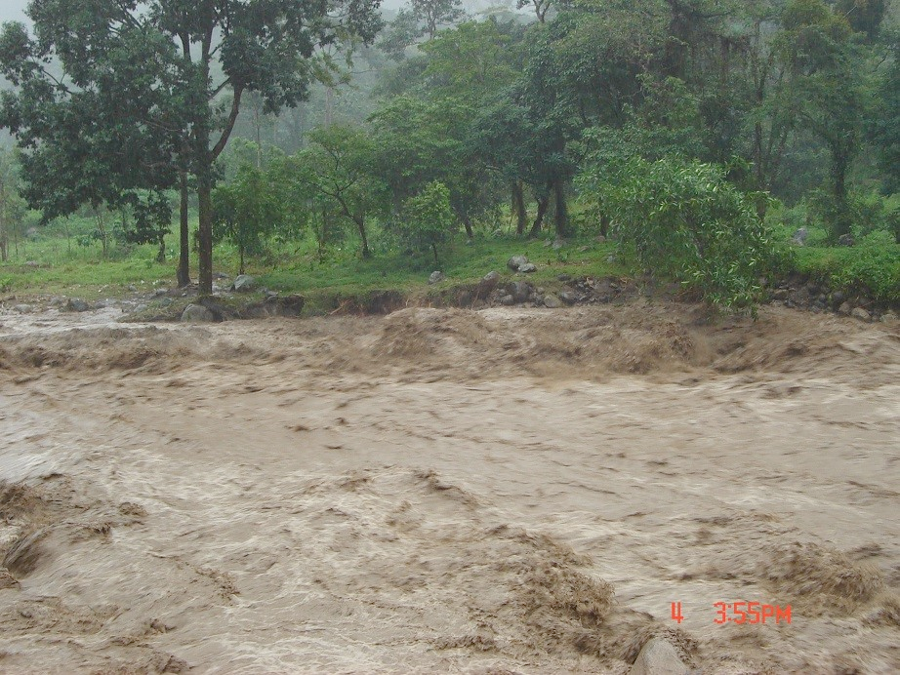
Water Purification
Cover and allow to stand
Sand filtration
Bulk chlorination
Reverse osmosis: good water in large quantities, but arrives late, is expensive, not sustainable
If other procedures not available, boiling or chlorination by individual user (least efficient method)
The most basic distribution system will need clean containers for transportation

Slide 15
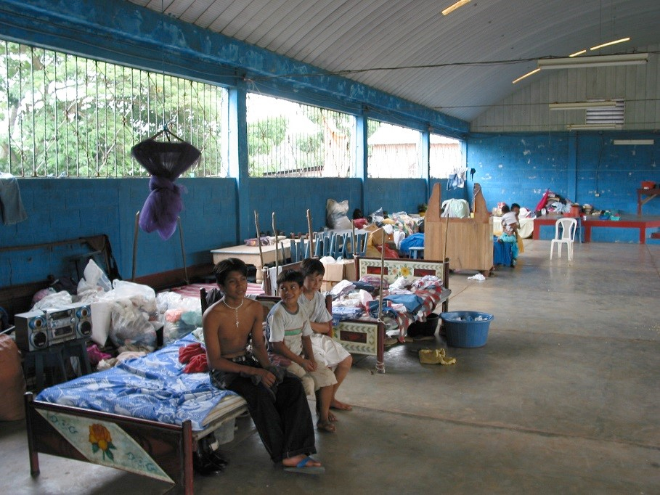
Shelter
WHO recommends 3.5 m² per person as minimum floor space for displaced population*
Increases to 4.5 m² per person in cold climates due to increased time indoors
For all needs: cooking, cleaning, sanitation, recreation, a camp should have 30 m² per person
Must be acceptable to local community or may not be used

Slide 16
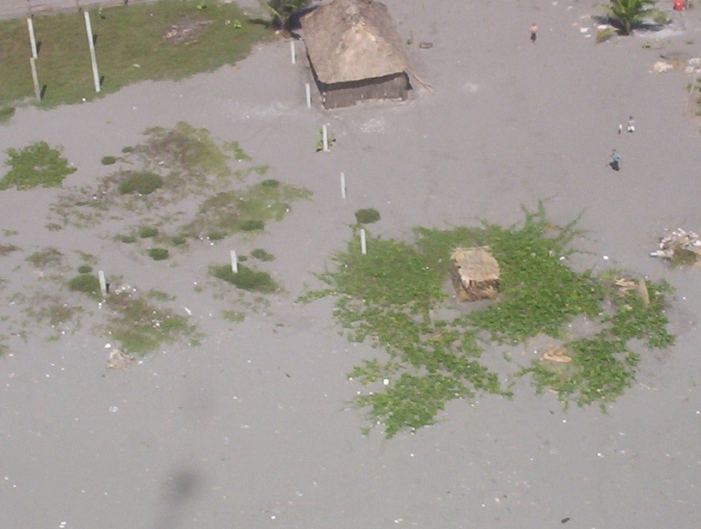
Basic Sanitation
Latrines- portable or hand-dug
One per 20 people
Must be acceptable to community
Between 6-50 meters from dwellings
Health education/specific assignments for maintenance
Consider children’s needs, otherwise may not be used

Slide 17
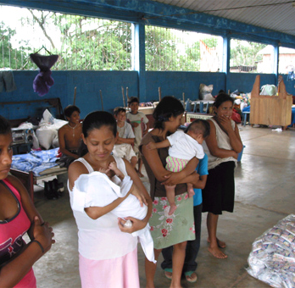
Basic Sanitation
Feces are a concentrated source of human pathogens
Potential for explosive water-borne epidemics following disruption of basic sanitation services
Keeping fecal matter away from water and food supply is critical

Slide 18
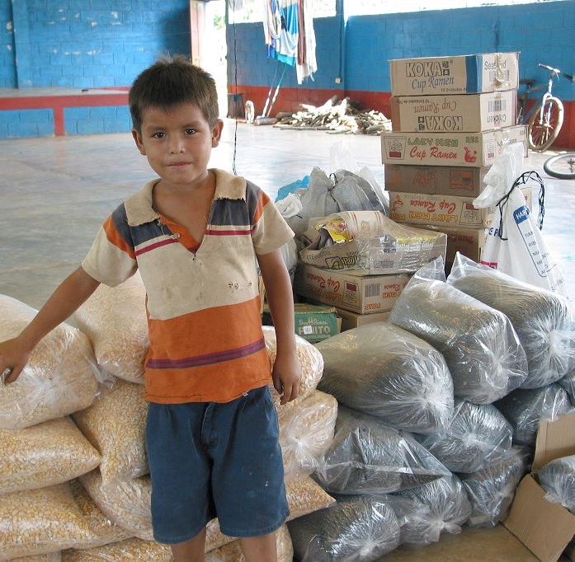
Nutrition
Minimum Needs: 2,100 KCals/person/day*
Food must be acceptable to community
Identify community resources

Slide 19
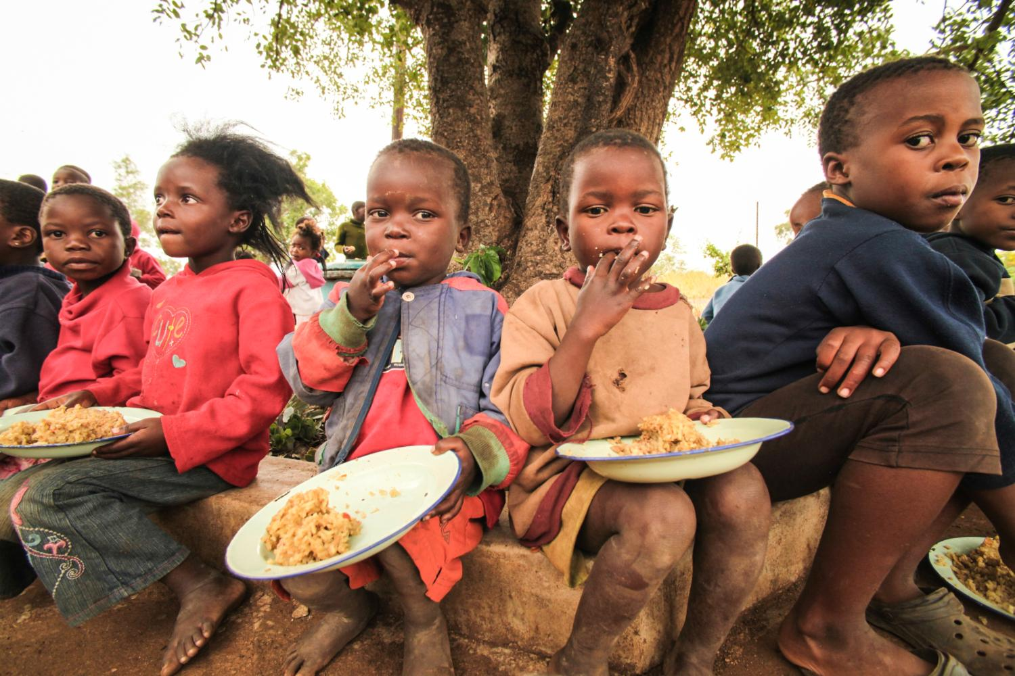
Nutrition
Know the previous acute malnutrition rate
Malnutrition rate of children < 5 years old: gold standard for assessing group status
Nutritional surveys: use standard sampling techniques, such as random, simple or systematic cluster or, if possible, a complete census

Slide 20
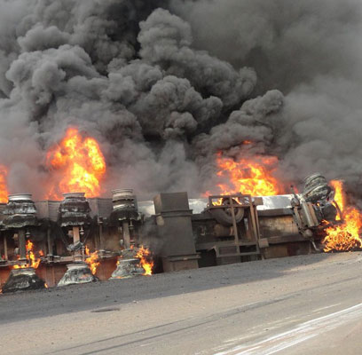
Local Environmental conditions
Contamination of air, water, land
Chemical spills
Flash floods
Unsafe buildings
Smoke
Slope
Presence of vectors (insects)*

Slide 21
COMMUNITY NEEDS
Security: prevent crime and violence
Transportation: different kinds of vehicles
Communications: radio, TV, internet for mass communication;
Radio/telephone/internet for coordination of relief efforts
Know your community pre-disaster capabilities/challenges!

Slide 22
Surveillance
HEALTH DATA MANAGEMENT SYSTEM
Data collection
    Ongoing
    Systematic
Data analysis
TAKE ACTION BASED ON ANALYSIS

Slide 23
Important Data
Deaths
Significant morbidity or frequent illness in community
Early warnings; e.g., a single case of cholera
Malnutrition
Malaria
Serious trauma

Slide 24
Crude Mortality Rate *
When assessing the outcome of a disaster, public health officers describe its severity by the number of human lives lost using the Crude Mortality Rate (CMR) or Crude Death Rate (CDR)
CMR is defined as number of deaths per 10,000 inhabitants per unit of time
CMR= Deaths x 10,000 per unit of time
Population
  A humanitarian emergency used to be indicated by:
  CMR of > 1 death per 10,000 people / day
  CMR in age <5y: >2 per 10,000 people / day (under 5-mortality)

Slide 25
Leading Causes of Deaths
Trauma
Diarrheal diseases and dehydration
Communicable diseases: Measles, Malaria, Pneumonia
Malnutrition

Slide 26
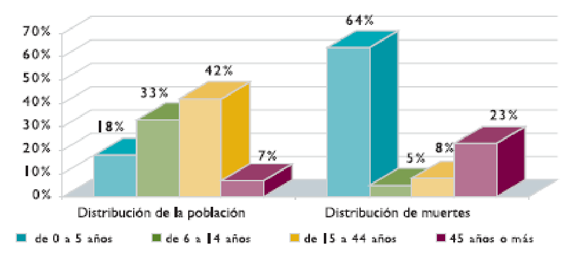
AGE- SPECIFIC MORTALITY
64%
70%
60%
50%
40%
30%
20%
10%
0%
42%
33%
23%
18%
7%
5% 8%
Population distribution Deaths distribution
0 to 5 years
6 to 14 years
15 to 44 years
45 years or more
Adapted from Toole, MJ, "Mass Population Displacement- A Global Public Health Challenge," Infectious Disease Clinics of North America, vol. 9; June 1995.
Notes:
This figure showing the age distribution of deaths in disasters demonstrates the vulnerability of the different age groups. For example, this figure shows the age distribution of mortality in a population of Kurdish refugees in Northern Iraq in 1991. Although children aged 0 to 5 years represented only 18% of the total refugee population, they accounted for 64% of the overall refugee mortality rate.

Slide 27
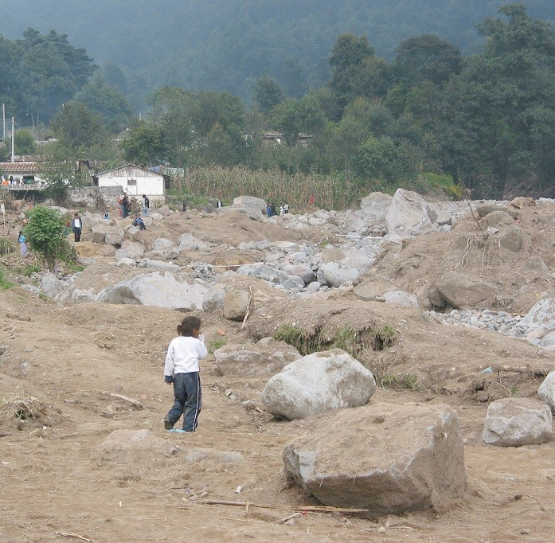
Assessment Recommendations
Set up field hospitals and medical tents to relieve partially functioning hospitals
Arrange transport of critical patients from affected areas to out of area hospitals
Provide mental health services and counseling (psychologists)
Establish security
Mobilize military and resources to clear roads, reestablish electrical grid, distribute gas and diesel and provide security

Slide 28
Thank you

