Slide 1


Disasters and their Impacts on
Public Health
MODULE I
Notes:
This course is designed to train participants in the management of the physical and emotional needs of children impacted by disasters. Each of the 10 modules have been carefully planned and some of the topics may not be appropriate for all participants, especially non clinicians such as public health students. Don’t worry about these clinical topics and their related sessions. Just being exposed to these concepts will be beneficial.

Slide 2
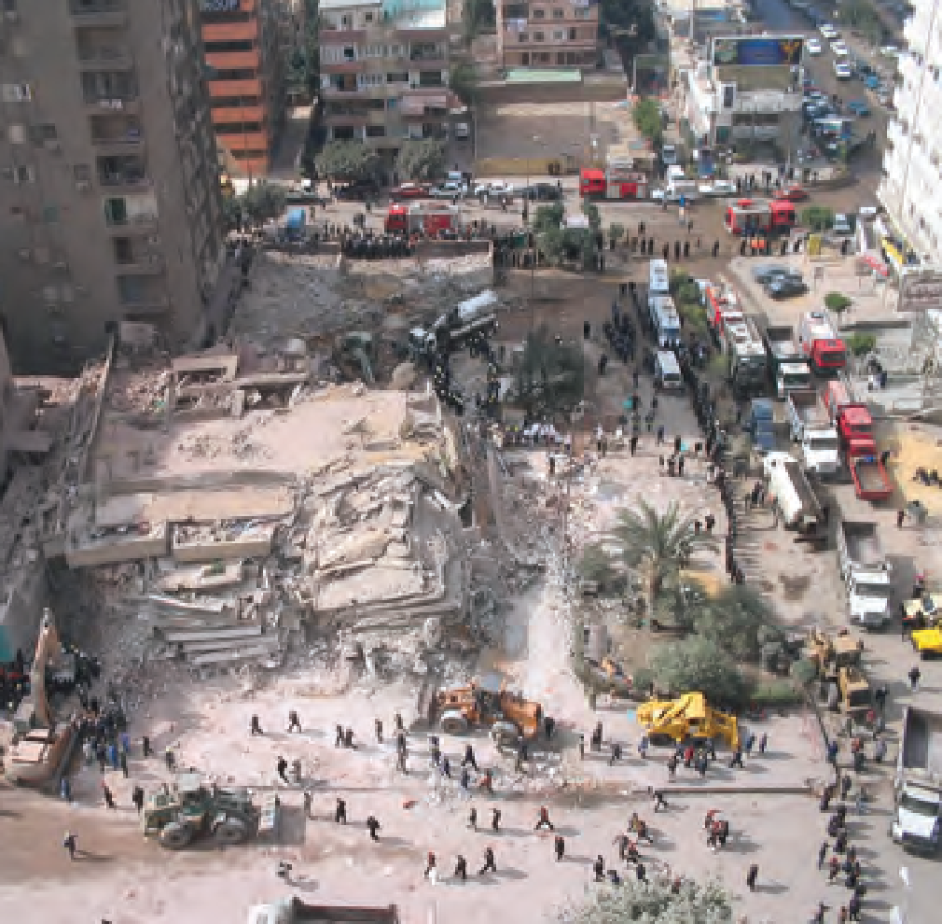
Disaster
An event often occurring suddenly and unexpectedly,
Causing trauma to people and/or severe damage to the environment,
Exceeds or overwhelms the response capacity of the affected community.

Slide 3
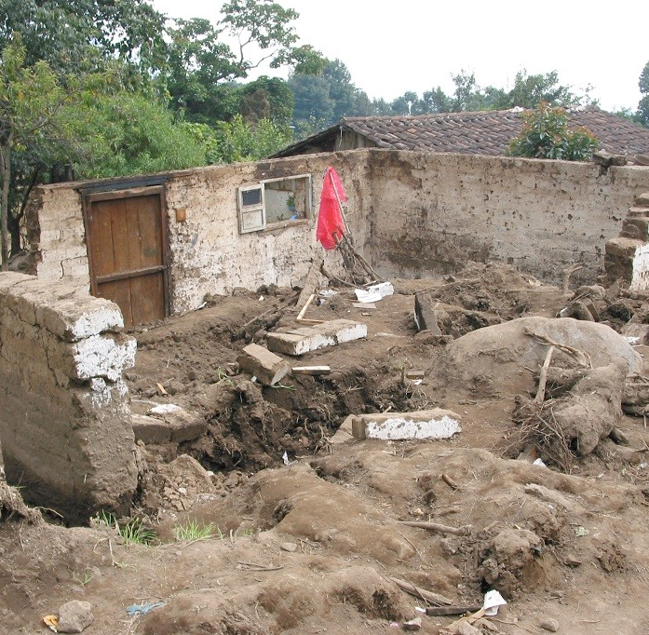
KEY DEFINITIONS
Hazard: any potential threat to public health and safety
Emergency: any actual threat to public health and safety
Risk: the consequences of exposure to a hazard
Vulnerability: determinants of risk
Capacity: way the community copes and responds
Risk = Hazard x Vulnerability/Capacity

Slide 4
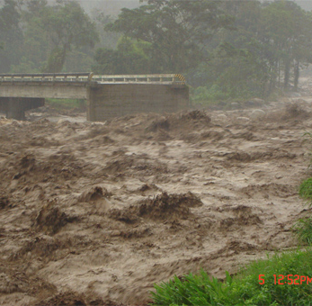
HAZARDS
Slow Onset:
Flood
Drought
Famine
Chemical Spill
Epidemic
Sudden Onset:
Earthquake
Cyclone
Flash Flood
Road Traffic Accident

Slide 5
Impact
Increased numbers of deaths and injuries
Population displacements
New cases of disease and disability
Exacerbation and increased numbers of cases of psychological and social behaviour disorders
Possible food shortages and nutritional deficiencies
Disease from environmental health hazards
Damage to health facilities and other infrastructure
Diversion of development resources to emergency relief

Slide 6
TRIGGERING EVENTS
NATURAL FORCES
Climatic / Geological
HUMAN ORIGIN
TECHNOLOGICAL
MASSIVE REPRESSION OR TERRORISM
COMPLEX
EMERGENCY
Industrial accidents
Massive destruction weapons
Chemical or biological weapons
Attacks on civilian population
Conflict / Civil war
Displaced population
Severe infrastructure losses
Significant security problems
Notes:
Events triggering an emergency can be caused by natural phenomena or by man. Natural disasters are associated with climatic factors (such as hurricanes) or geological factors (like earthquakes or tsunamis). Emergencies caused by man include technological disasters or industrial accidents; massive repression events, attacks on civilian populations and terrorist acts; and complex emergencies caused by conflicts or civil wars, that result in high numbers of victims, displaced people, social infrastructure losses and significant security problems.

Slide 7
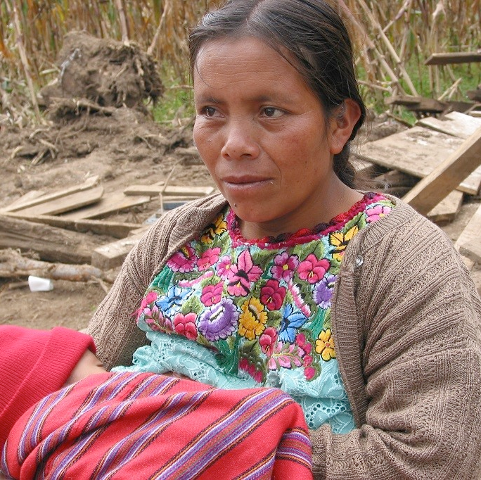
Vulnerable Populations
Children and Youth
Women
  Pregnant
  Lactating
  Without spouse
Elderly
Disabled

Slide 8
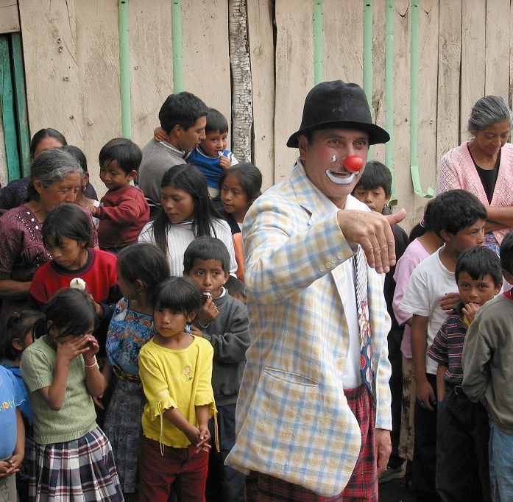
Children’s psychological and emotional needs
Often neglected following disasters, particularly when parents and other adults in their lives are having trouble coping with the event themselves.

Slide 9
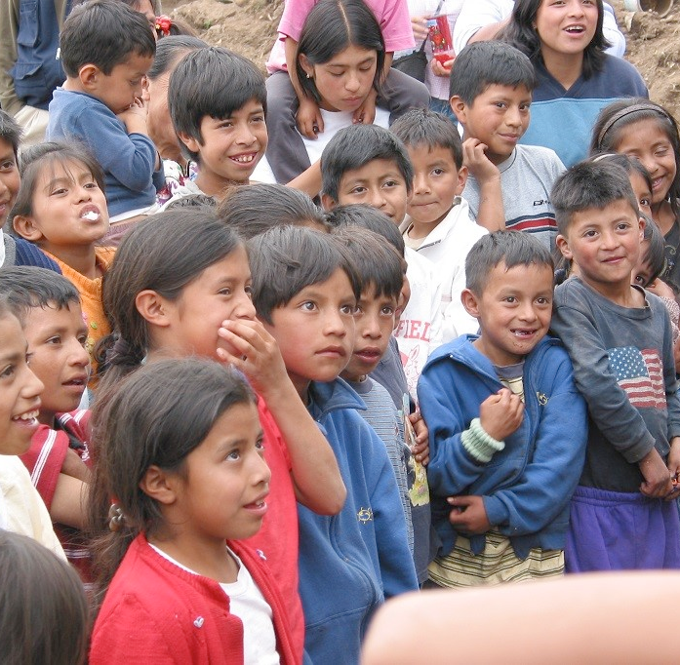
Risks for Children
Physical victimization
Rape
Torture
Robbery
Exploitation
Child labor
Child trafficking / sexual trafficking
Child soldiering

Slide 10
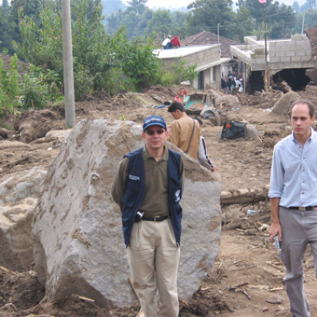
PHASES OF DISASTER MANAGEMENT
Preparedness
Emergency response
Recovery
Prevention/ Mitigation

Slide 11
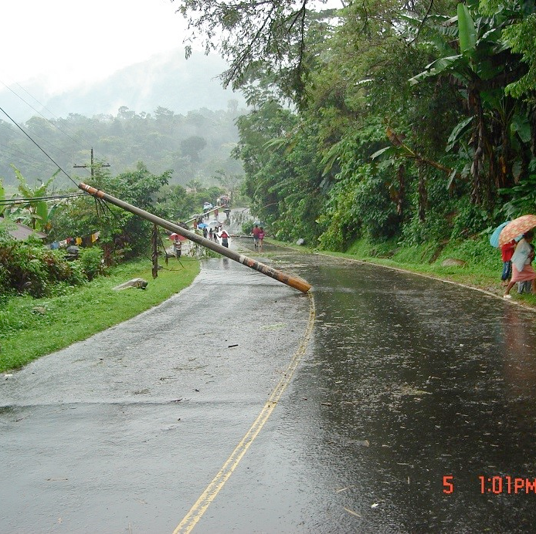
PREPAREDNESS
Risk assessment and vulnerability analysis
Information management
Policy and planning
Resource mobilization
Coordination and partnership
Community involvement
Training and simulation

Slide 12
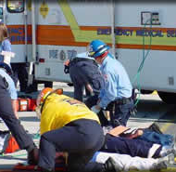
Emergency Response
Notification
Information management and communication
Coordination
Search and rescue
Damage and need assessments
Evacuation and sheltering
Resource mobilization
Notes:
This phase includes all actions and interventions performed during or immediately after the disaster

Slide 13
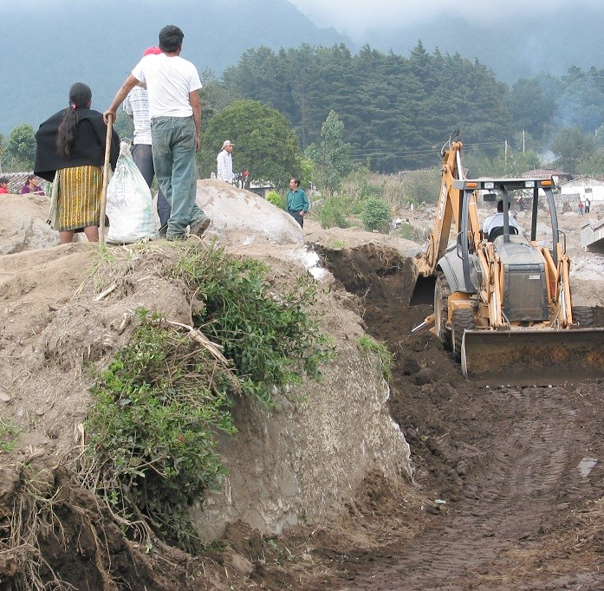
RECOVERY
Reestablish self-sufficiency
Community planning
Infrastructure rebuilding
Health recovery
Community sense of togetherness
Hope for a better future
Resilence
Notes:
The recovery phase is the period during which the affected community focuses on recovering its self-sufficiency. This includes setting guidelines and new planning based on ongoing assessments.
In this phase the reconstruction of damaged public service infrastructure (water supply, sewers) and governmental facilities begins.
Another aim in this phase is the restoration of pre-disaster health status.
During this phase, as the community recovers its self-sufficiency, external support is gradually withdrawn.

Slide 14
Prevention/ Mitigation
Lessons learned
Reassess preparedness
Risk reduction and preparedness are sets of strategies and actions for local communities to prevent hazards developing into emergencies and emergencies into disasters

